Slide 1
S-2S Meeting
2014.8.20
S. Kanatsuki

Slide 2
Contents
Design of Tracking Detectors by Geant4 simulation
Acceptance
Information on the Aerogel Counter for Proton Veto

Slide 3
Design of Tracking Detectors
What’s existing?
Downstream
SDC3, SDC4X, SDC4Y – Old SKS Drift Chamber
Upstream
E13: SDC2, “HASEGAWA Chamber”
E10: SSD, SFT
E19/27: SDC1, SDC2

Slide 4
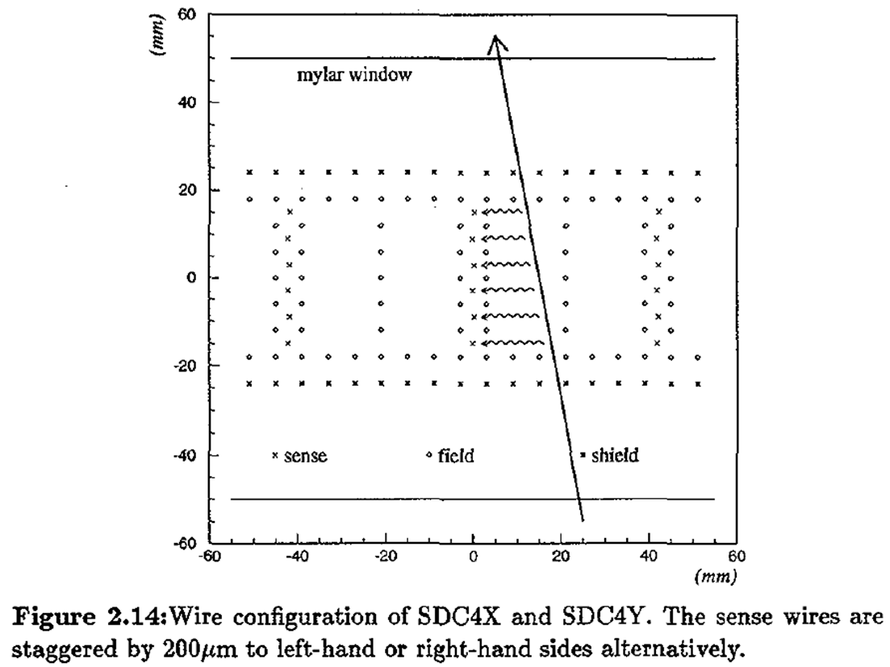
Design of Tracking Detectors
Downstream
SDC3, SDC4X,SDC4Y – Old SKS Drift Chamber
(Hotchi Doctor thesis)
Plane configuration and thickness of chamber in G4 programs is like left figure.
Materials are only gas(Ar+C2H6, 10cm) and windows(Mylar, 0.1mm*2layers)

Slide 5
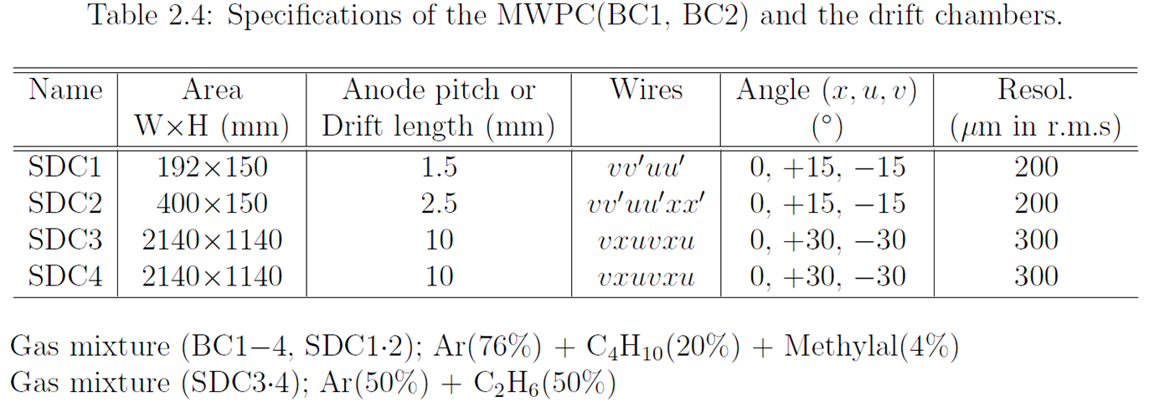
Design of Tracking Detectors
Upstream
SDC1, SDC2
(K. Shirotori: Doctor thesis)
Cathode plane = 20um graphite pasted on 12um aramid film.
Structures of SDC1,2 on G4 = SDC3,4 = Mylar+Gas+Mylar
Mylar 0.1mm*2、Gas=8cm
Notes:
SDC1 所在確認する
IQBRC4FでチェンバーSDC3,4とか修理したら良いのでは？

Slide 6
Design of Tracking Detectors
Upstream
SFT
(T. Soyama: Master thesis)
x-plane Φ=1mm
u/v-plane Φ=0.5mm

Slide 7
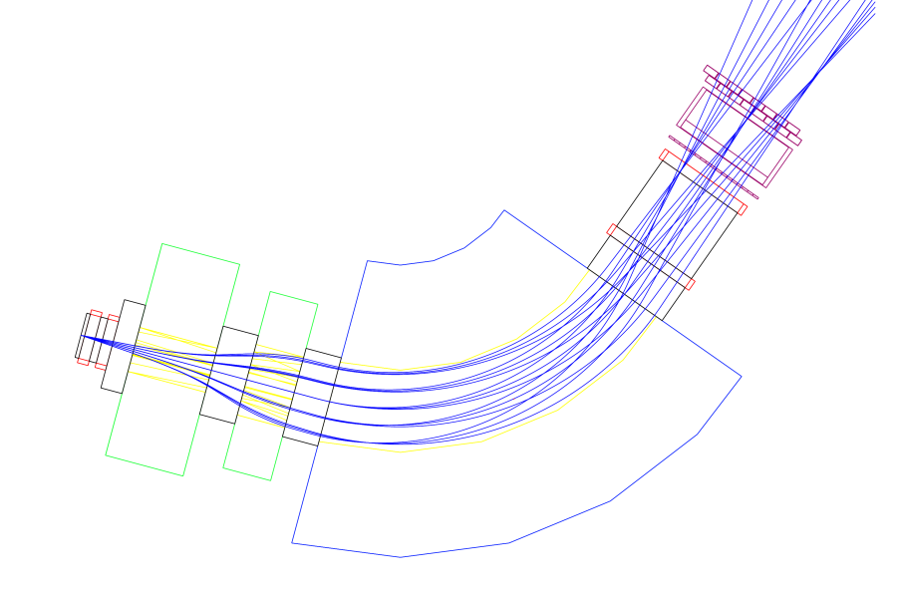
Simulations
Setup
Particles are generated at 60cm upstream from Q1
HeBags between QQD and Tracking Detectors
FieldMap
Opera-3d/TOSCA calculation
Analysis
RungeKutta method similar to SKS analysis code.

Slide 8
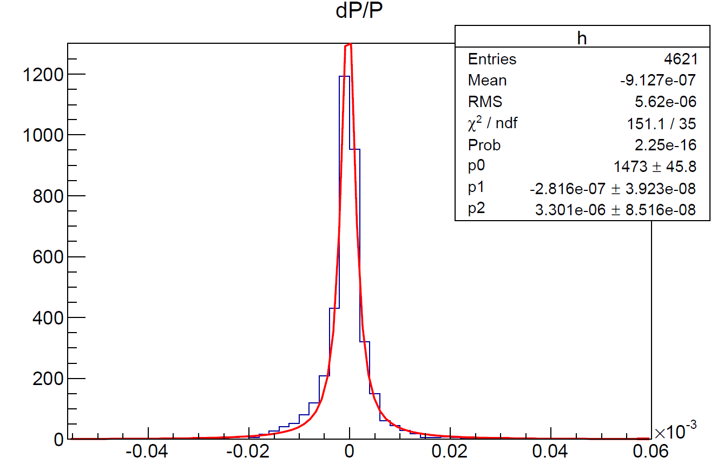
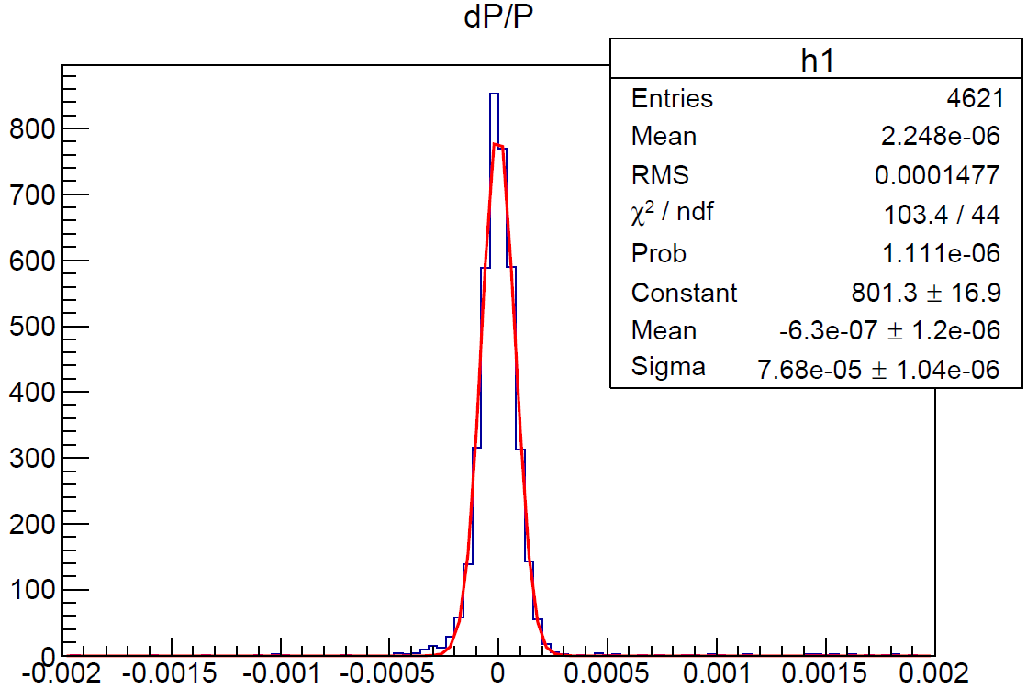
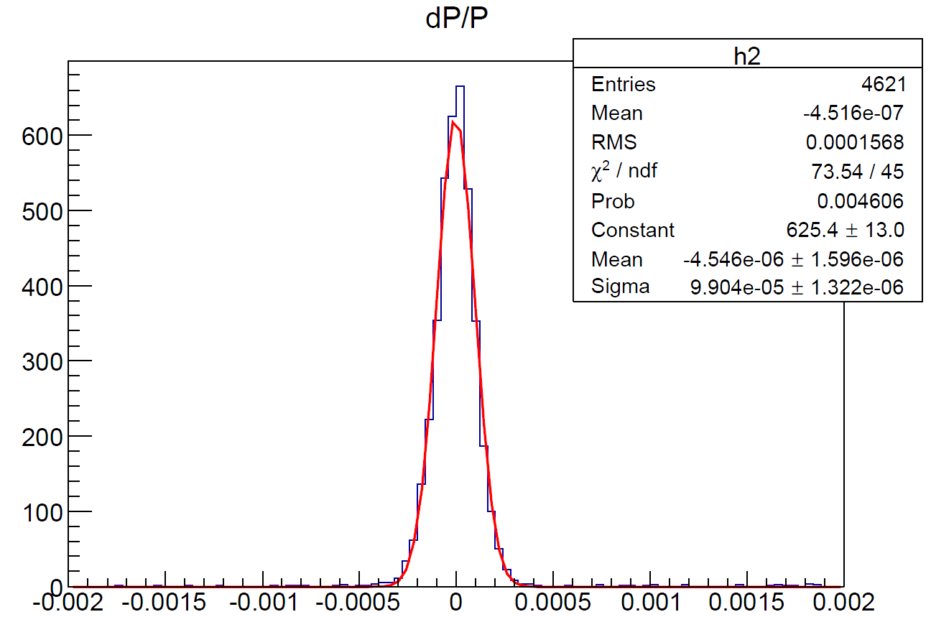
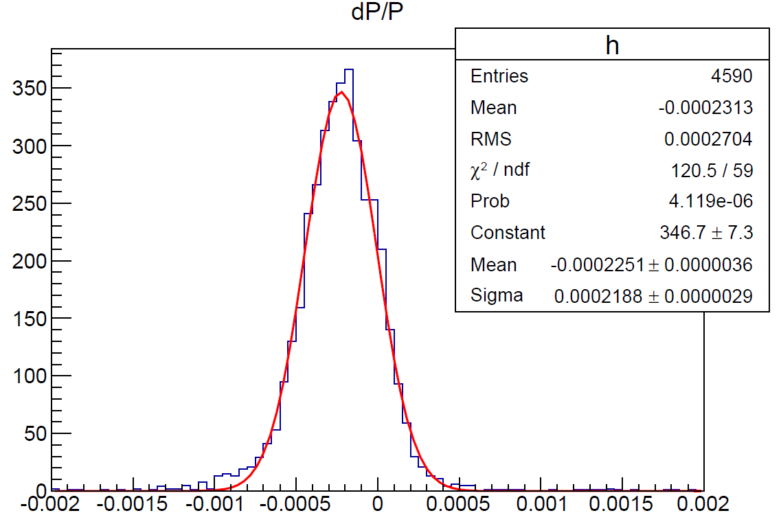
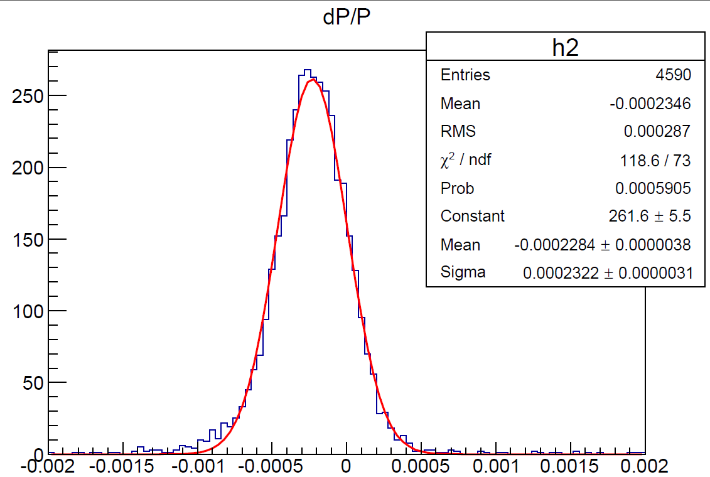
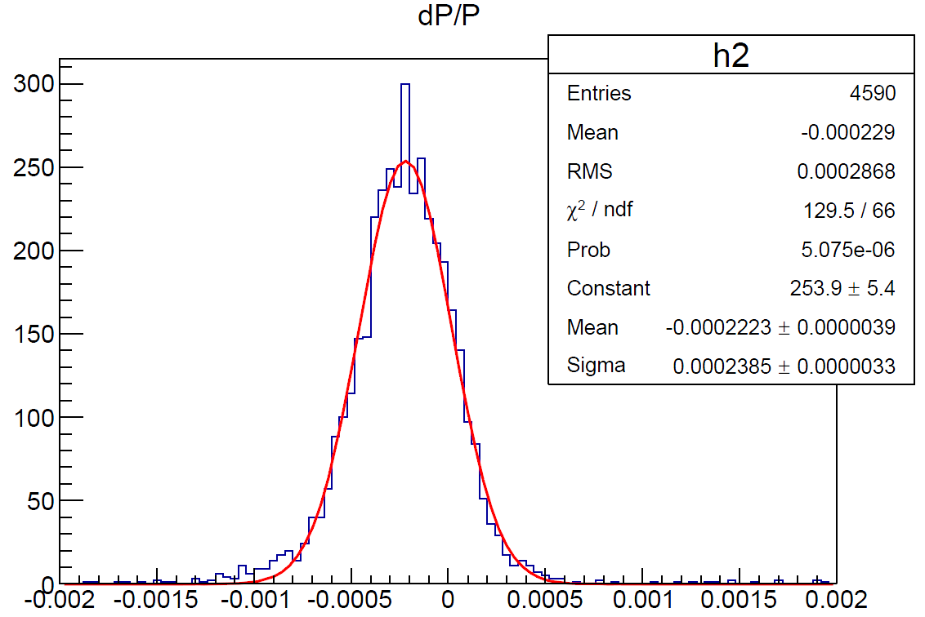
Results@1.375GeV/c (SDC1,2)
Position resolution of SDC1,2/3,4=0um/0um
200um/250um
300um, 350um
Material = vacuum
σ(dp/p)～3.3×10^{－6}
σ(dp/p)～1.8×10^{－4}
σ(dp/p)～2.3×10^{－4}
Material = Realistic gas and films
σ(dp/p)～5.1×10^{－4}
σ(dp/p)～5.5×10^{－4}
σ(dp/p)～5.6×10^{－4}

Slide 9
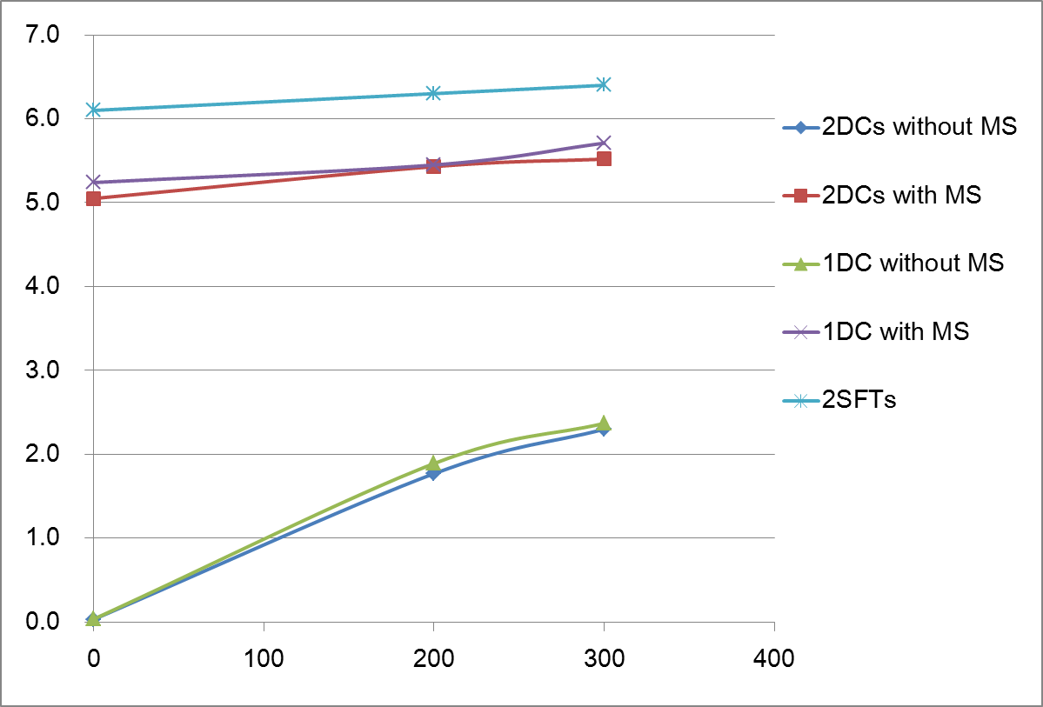
Results@1.375GeV/c (SDC1,2)
dp/p @ 1.375GeV/c in FWHM [10⁻⁴]
Main factor is the effect of multiple scattering mainly inside D1Gap
1DC = SDC2 only
MS = Multiple Scattering

Slide 10
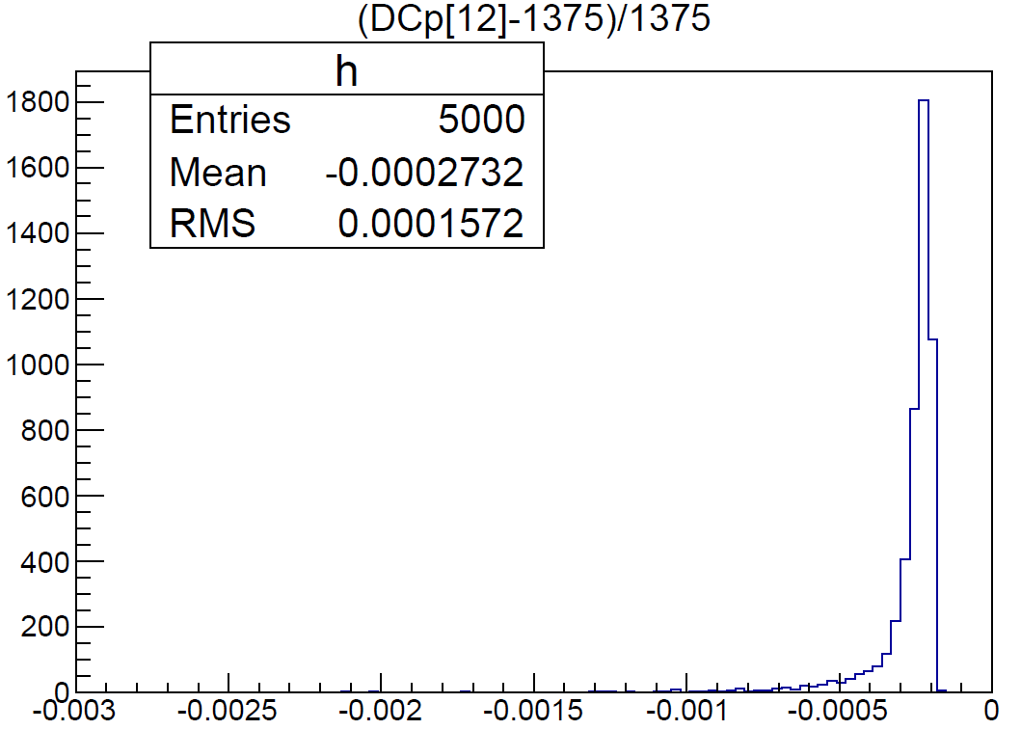
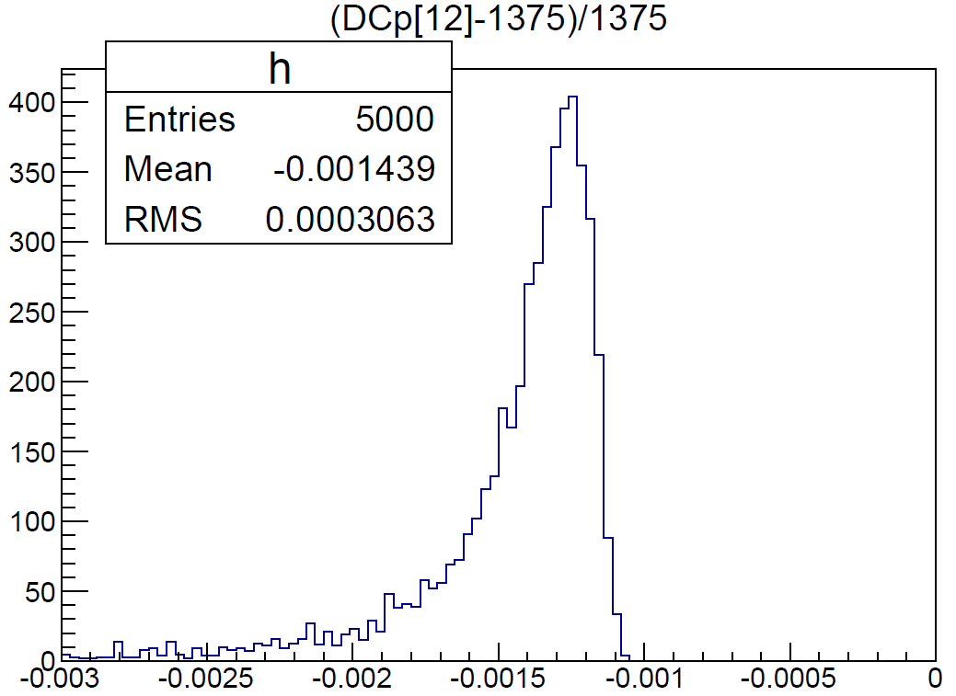
Energy Loss
Materials and Momentum decrease
DCs: 0.3 MeV/c
He: 0.17mg/cm³, 7m→0.1g/cm²
SFTs: 2.0 MeV/c
SiFi: 1.03g/cm², 1mm*4+0.5mm*8 = 8mm→8.24g/cm²
σ(dp/p)～0.4×10^{－4} (FWHM)
σ(dp/p)～2.4×10^{－4} (FWHM)

Slide 11
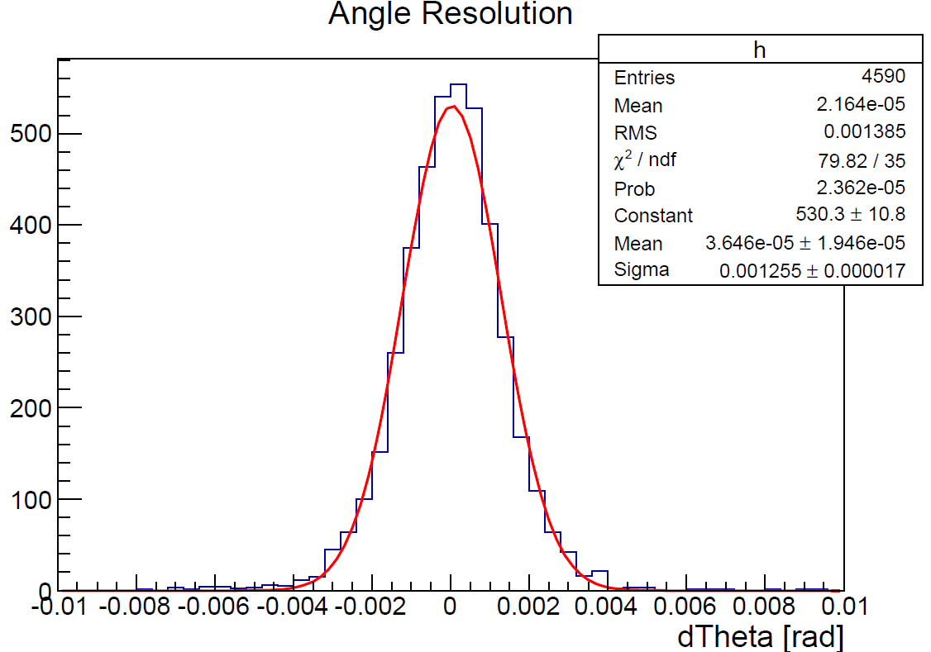
Scattering angle resolution
σθ～2mrad (FWHM)

Slide 12
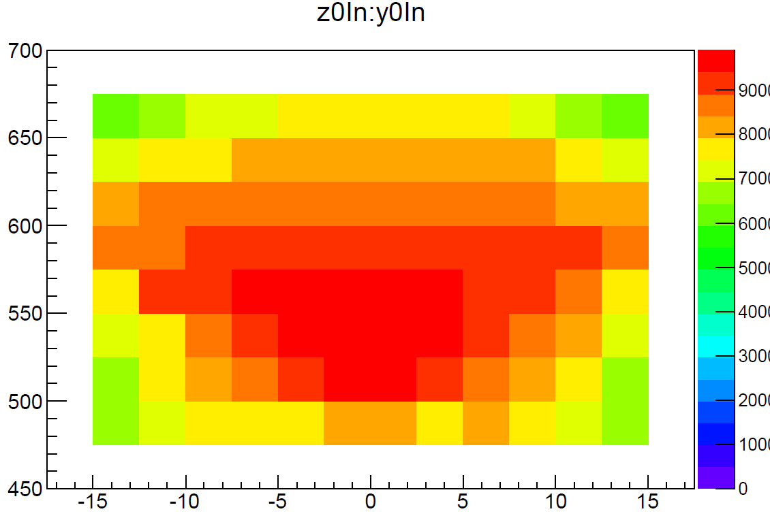
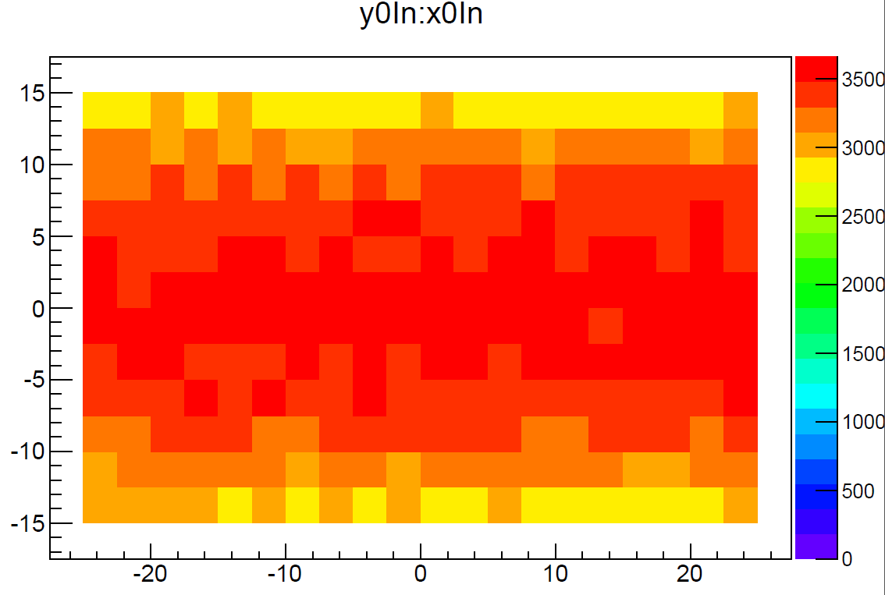
Acceptance
2D-Histograms shows events particles hit DC3
P=1.375 GeV/c
Generate point X(horizontal), Y(vertical), Z(beam) are uniformly distributed.

Slide 13
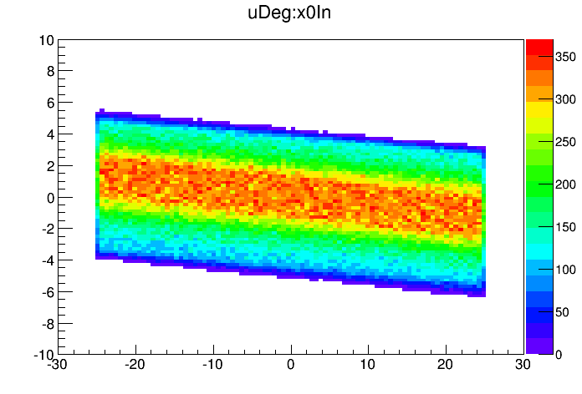
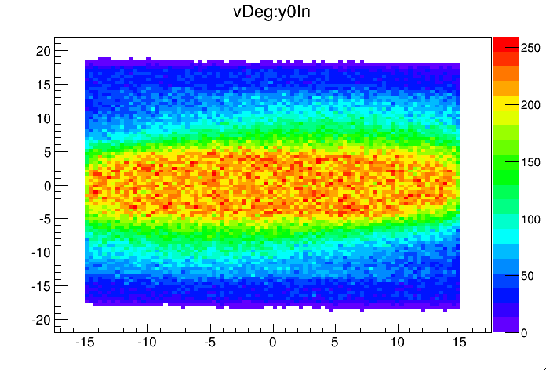
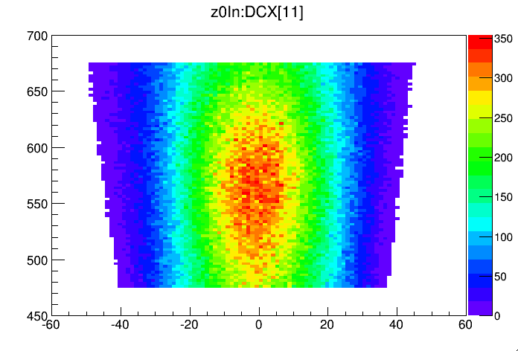
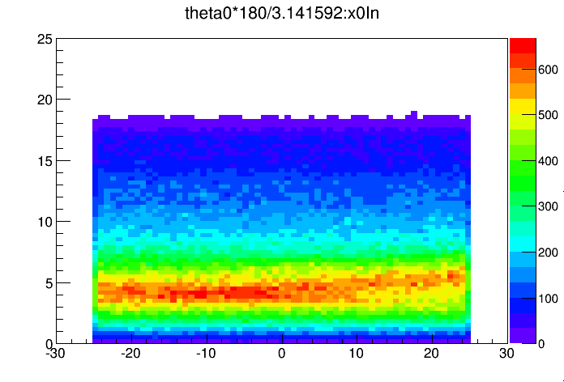
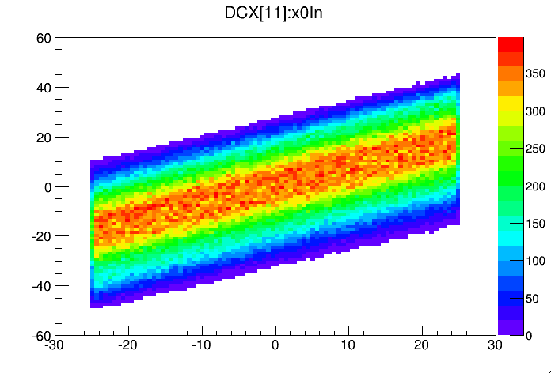
Acceptance

Slide 14
Acceptance

Slide 15
Information on the PVAC
Proton veto counter is needed for E05 with SKS
PVAC for E07
Radiator
Refractive index: 1.16~1.17 (3 pieces)
Size: 12×12 cm2, thickness: 2 cm, 1 cm, ? cm
Box
Paper Box
Teflon sheet
Can’t suppress
“elastic protons”.

Slide 16
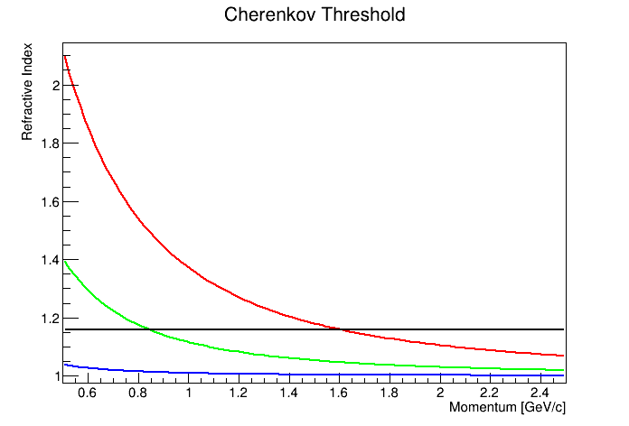
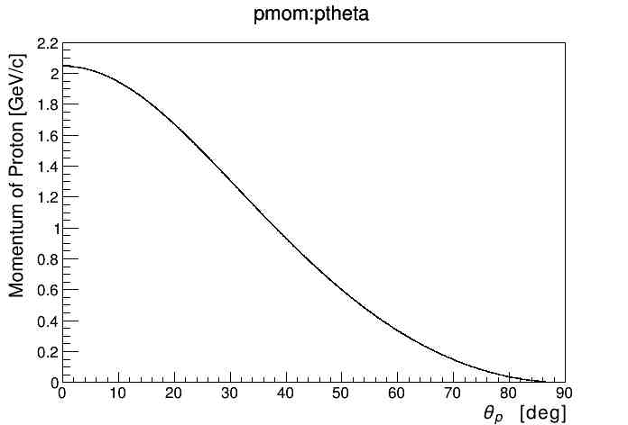
Information on the PVAC
SKSminus
S-2S

