Slide 1
JAM simulation for E05
2014.5.16
S. Kanatsuki

Slide 2
Background estimation by JAM
JAM（Jet AA Microscopic transport model）
http://www.aiu.ac.jp/~ynara/jam/
ver. 1.200
How many particles can pass through S-2S?
K― beam on ¹²C and p(for performance check) target.
Information of all particles in the final state can be output from JAM
Check cross sections and make .root file
The outputs are set to Geant4 PrimaryGeneratorAction.
Check count rates and momentum distribtions at downstream of S-2S.

Slide 3
JAM simulation
Conditions
projectile = ‘k-’
target = ‘p’, ’12C’ （1 nucleus is put in JAM）
momentum = ‘1.8gevc’
bmin=0; bmax= −5.0 fm（enough large for ¹²C）
The number of K― ：10⁷
Decay of Σ and Ξ* is stopped
Output
The number and the kind of the particles involved in the simulation.
Momenta of particles which collide with others at least once

Slide 4
CrossSections
Calculation of cross sections
We need to estimate the absolute value of count rate
Cross sections in JAM are checked by the number of events of each process
Example
“K⁻p→Λπ⁰” is defined as “nP=5, nN=6, nL=1, nPz=1、nmeson=1”
→ GetEntries(“KmP_LPz”) → 57000 events
dσ = (5.7×10⁴)/10⁷ ×π(5fm)² = 4.5×10⁻³¹ m² = 4.5 mb
In case of 2 particle collision, bmax is forced to be set acconding to CS of elementary process. (ex. K―p→something, b=1.009 fm)
Comparizon with Experimental data
“Compilation of Cross-Sections : K± induced reactions”, CERN-Library(1983)
Compare JAM with CERNlib for proton target

Slide 5
Results on dσ
Why small?
π(1.009fm)² = 32 mb
[mb]
more than 6 times!
Too large?
p ×4.5 → ¹²C
JAM 2~4 times smaller than Data
JAM is larger than Data

Slide 6
Results on Geant4 simulation
Conditions
“event” stops when particle hits on magnets.
Field map is obtained from TOSCA simulation
Count rate
Convert JAM results(nevent) to the number in the case of realistic target thickness（3 g/cm²） and beam intensity（10⁶ K―）.
Rate = nevent * (mass thickness) * beam size * beam rate
= nevent * 3*N_{A}/12 [/cm²] * π(5 fm)² * 10⁶/10⁷
= nevent * 0.0118
and should we take into account cross-section error? (2~4times?)

Slide 7
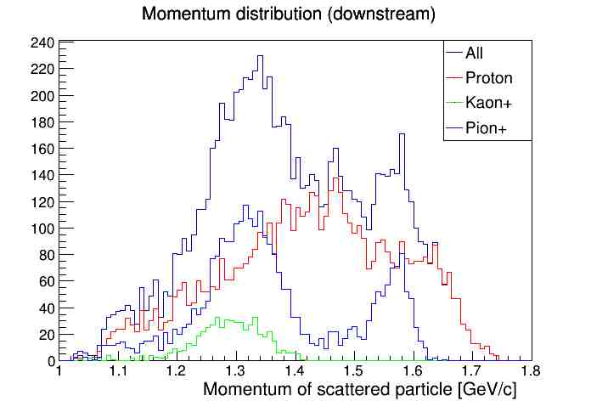
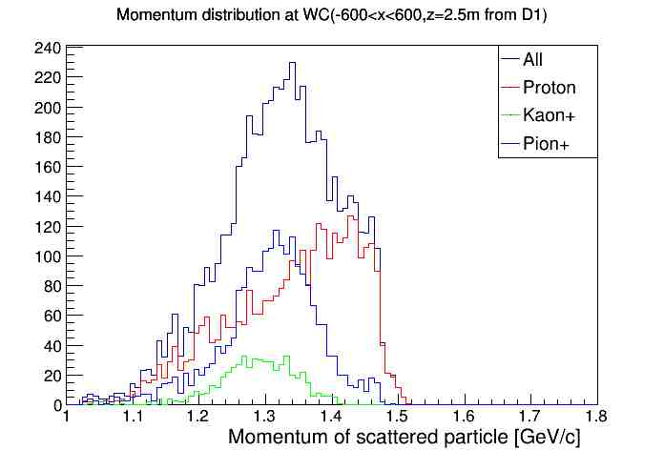
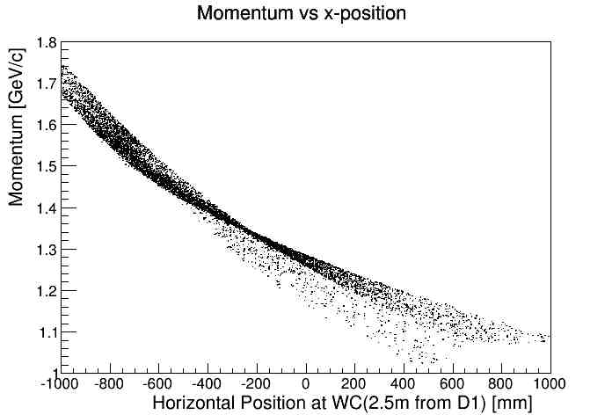
Results on Geant4 simulation
JAM & Geant4 S-2S
Mometum distribution at the position of WC (2.5m from D1exit)
Decay is OFF in these simulations
No interaction with magnets
Hits WC
BG rates（left figure） for 10⁶K―/spill
Proton : 5587×0.0118 = 66
Pion+ : 2892×0.0118 = 34
Kaon+ : 542×0.0118 = 6
BGs from target are a few hundred at most…?
a few times underesitimate?
overesitimate?

