Slide 1
Magnetic Field measurement of the S-2S D1 magnet
@SNP School 2016
Kyoto University, RCNP^{A}，KEK^{B}，Yamagata University^{C}
T. Nanamura, T. Gogami^{A}, T. Nagae, S. Kanatsuki,
M. Naruki, H. Takahashi^{B}, E. Hirose^{B}, S. Kato^{C},
S. Ashikaga, S. Ichikawa, K. Inaba, A. Koshikawa, Y. Takahashi, T. Takeda, S. Matsumoto, K. Watanabe

Slide 2
Contents
Introduction
Study of operation characteristics S-2S D1 magnet
Field map measurement of S-2S D1 magnet

Slide 3
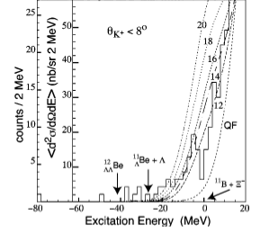
Study of Xi-hypernuclei
What can we know from Ξ-hypernuclei ?
baryon-baryon interaction(Ξ-N, Λ-Λ)
role of multi-strangeness system in NS core
Spectroscopic study via the ¹²C(K⁻,K⁺) reaction
BNL-E885 experiment
Suggested existence of ¹²_{Ξ}Be
Estimated V_{Ξ} and dσ/dΩ
V_{Ξ}～-14 MeV
dσ/dΩ =89±14nb/Sr (θ<8°)
J-PARC E05 pilot run (2015)
SKS was used as the spectrometer for K+
Better missing mass resolution achieved
Observe significant excess in bound region
→Latest result will be presented in NSMAT 2016 ! (by S.Kanatsuki)
Bound region
P. Khaustov et al., PRC 61 (2000) 054603

Slide 4
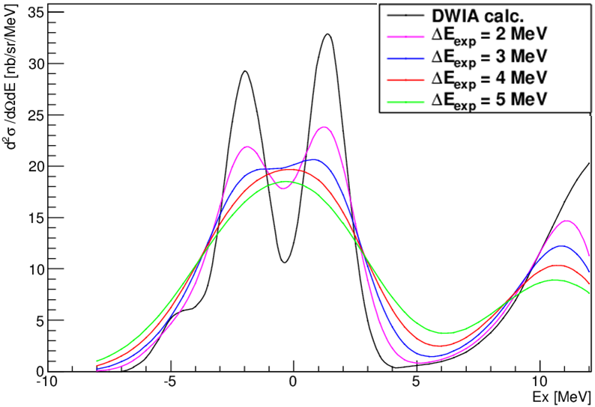
Why do we aim for better resolution ?
To observe Ξ-hypernuclear state definitely as peak(s) in missing mass spectra
To resolve excited states of Ξ-hypernuclei
Key to verify shell model and baryon-baryon interaction model
ΔE<2 MeV is essential
1-₃
1-₂
2+
1-₁
¹²_{Ξ}Be production cross section calculated with DWIA (for ESC08a interaction)
T. Motoba and S. Sugimoto, NPA 835 (2010) 223

Slide 5
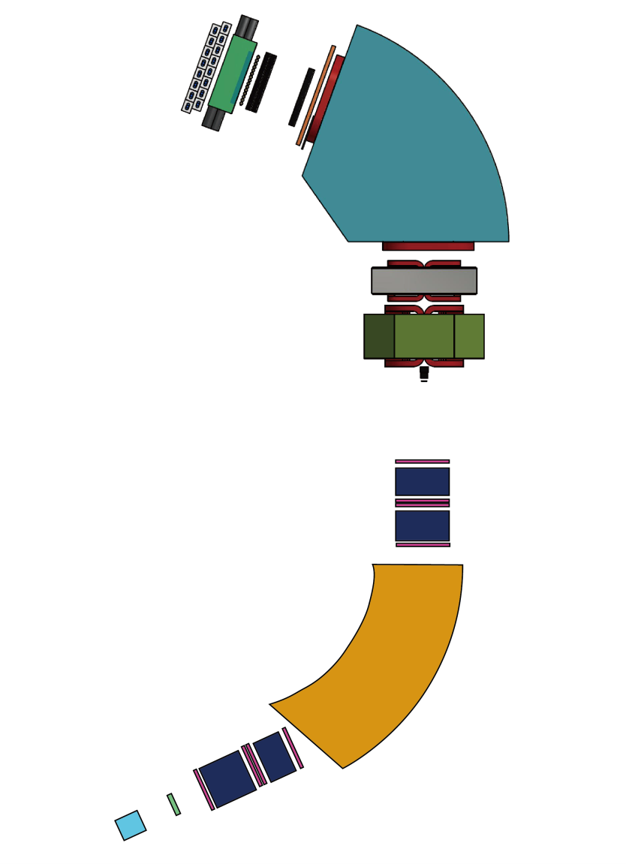
J-PARC E05 with S-2S
K+ ～1.4 GeV/c
New spectrometer S-2S
(Strangeness -2 Spectrometer)
Consists of two Q magnets and D magnet
Acceptance ～60 msr
Momentum resolution Δp/p =5×10⁻⁴ (FWHM)
→better missing mass resolution and statistics
will be installed K1.8 beamline ～2018 fiscal year
D1
Q2
Q1
 | Acceptance [mSr] | Peak counts | ΔM[MeV]
BNL E885 | 50 | 42(θ<8°) | 14
E05 (pilot) | 110 | 39 | 7
E05 With S-2S | 60 | 100 | 2
1.8 GeV/c K-
Δp/p=1.0×10⁻³

Slide 6
Significance of Magnetic Field Measurement
We will use calculated magnetic field for analysis
The difference between calculated magnetic field and real one may make momentum resolution worse.
Optimizing B-H curve and 3D-model, we make calculated magnetic field accurate.
As for the field map of the Q magnets, the consistency has been confirmed within +/-0.1%.
For S-2S D1 magnet, we study operation characteristics and measure magnetic field map.

Slide 7
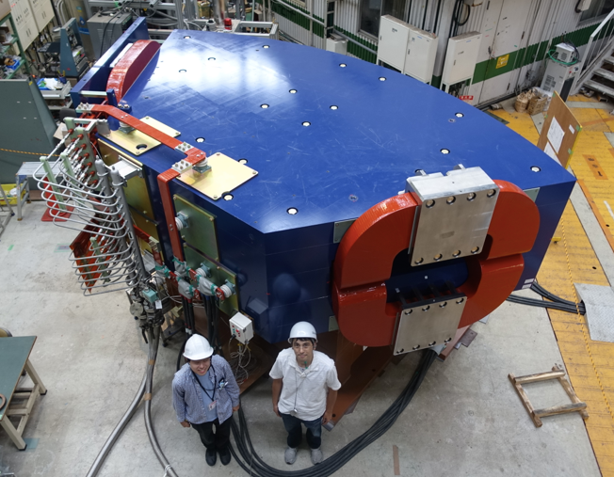
S-2S D1 magnet
Gap volume:800×320×3650 [mm³]
Maximum central magnetic Field : 1.475 [T]
Maximum current: 2500 [A]

Slide 8
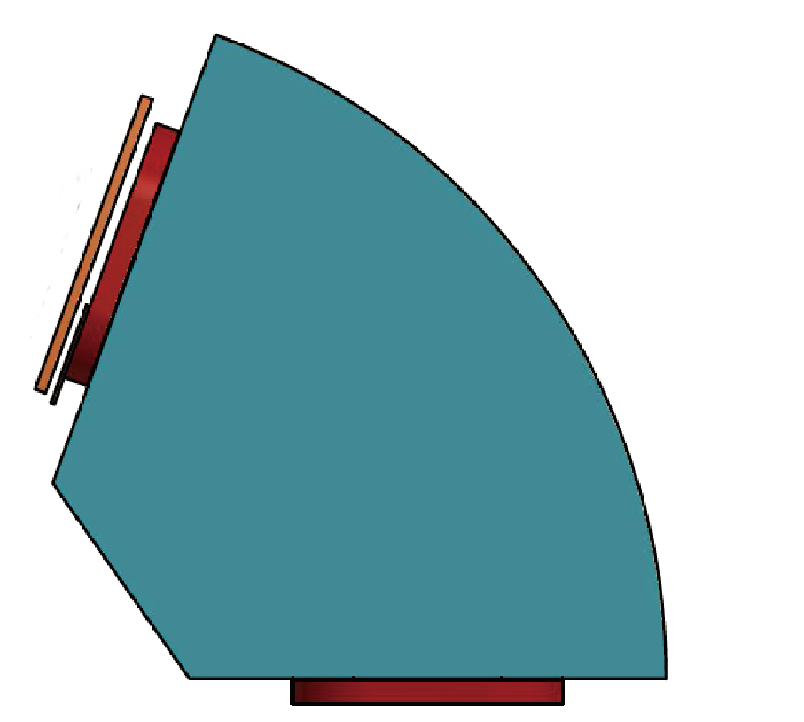
study of operation characteristics S-2S D1 magnet
We put NMR probe in D1 magnet
NMR is also used to correct calculated field map and measured one with Hall-probe
We take data for
Long-term stability
Excitation curve
Hysteresis
1m
NMR probe

Slide 9
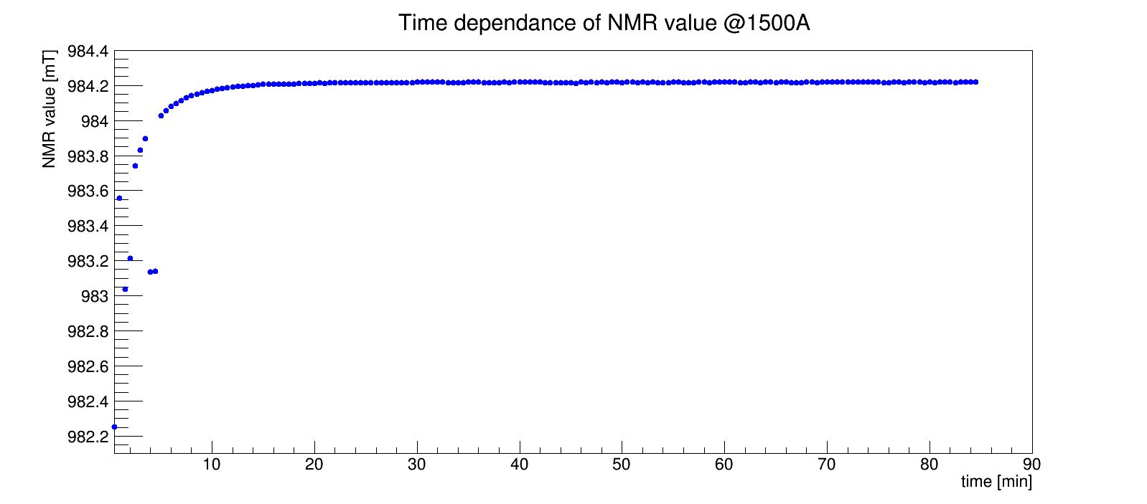
Long–term stability
From excitation @1500A, we had taken NMR data for about 90minutes. (every 30seconds)
10 minutes after excitation, NMR value becomes very stable. (σ= 1.6μT)

Slide 10
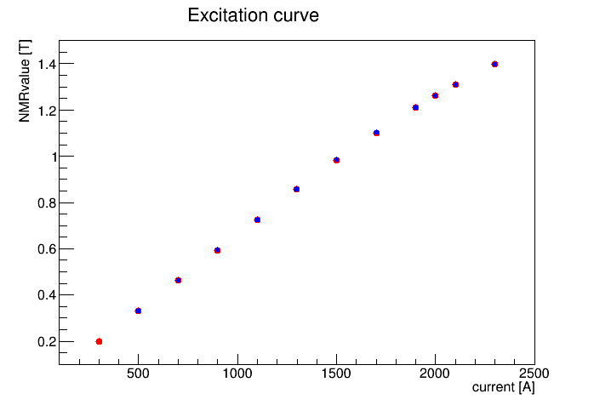
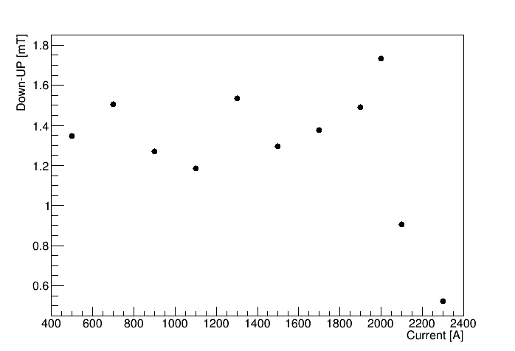
Excitation and hysteresis curve
Changing current and taking value of NMR
0A→300A→500A→･･･→2500A (UP)
2500A→2300A→･･･→500A→0A (DOWN)
0A→1100A→1500A→2000A (UP2)
NMR value of “UP2” correspond with “UP” within 0.05 %.
→hysteresis effect is enough small.
DOWN-UP

Slide 11
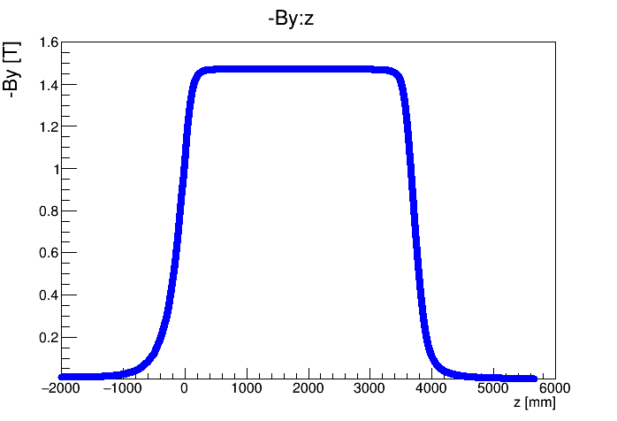
Consideration of field mapping volume
800mm×320mm×1700mm for each side
(up stream, down stream)
Step:50 mm× 20 mm × 50 mm
Correspond with central
magnetic field in 0.1 %
Down stream
1670 mm
1430
mm
Y
Z axis
X
Z=3650
Z=0
Up stream
B_{y} is less than 1 % of central magnetic field

Slide 12
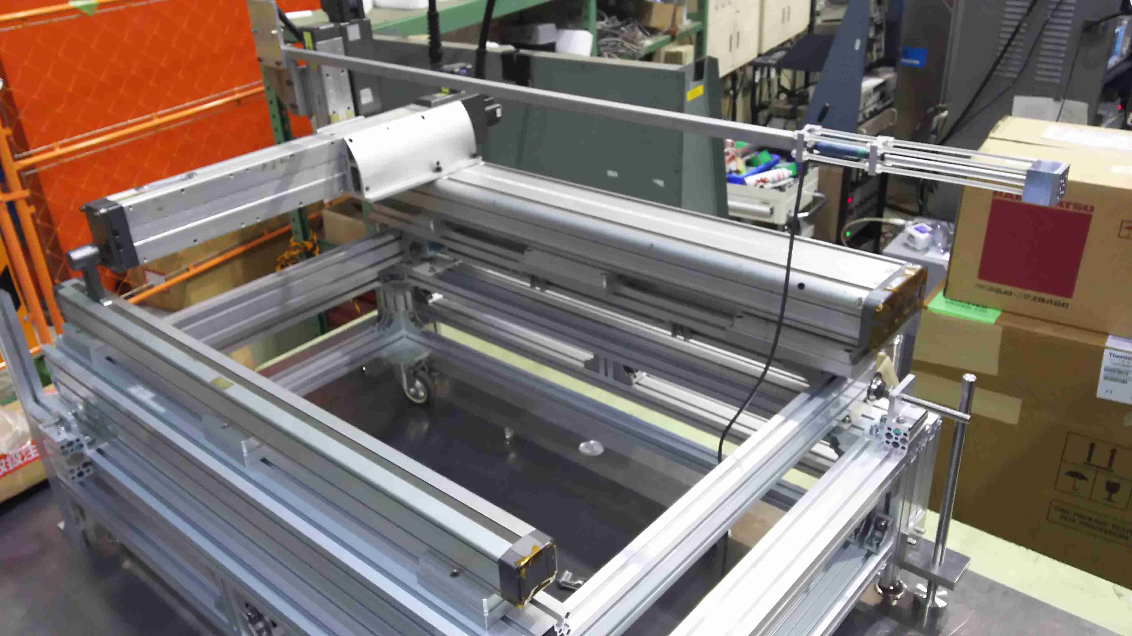
Field mapping system
To cover whole mapping area, we change position of this system 12 ways for each side of magnet.
Mover
It can move 450×130×1000 [mm]
with 10μm step.
Three-axis hall probe
(Lake shore MMZ-2508-UH)

Slide 13
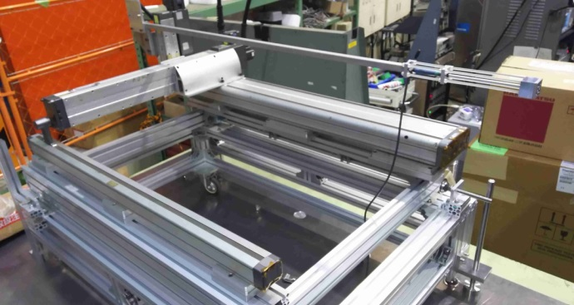
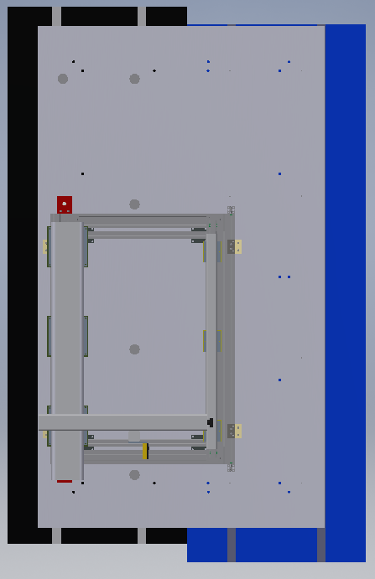
Transformation between coordinates
Defined three coordinates
“probe coordinates”
Measured (B_{x},B_{y},B_{z})
“mover coordinates”
Position of probe (x,y,z)
“S-2S coordinates”
(x,y,z), (B_{x},B_{y},B_{z}) of calculated magnetic field
To compare two magnetic field maps,
transform measured value to S-2S coordinates.
(x_{meas},y_{meas},z_{meas}) (Bx_{meas},By_{meas},Bz_{meas})
X
Y
x
Z
Z
Y
Rotation
according to survey
(check ing symmetry of magnetic field)
Z
X
Parallel shift and
Change axis labeling
according to survey
Y
Z
Y
(x_{S-2S},y_{S-2S},z_{S-2S})
(Bx_{S-2S},By_{S-2S},Bz_{S-2S})
X

Slide 14
Error evaluation
considering these errors in the field map, the total momentum resolution is estimated to be 6×10⁻⁴ (FWHM) by simulation.
Event generation: Geant4, with calculated map
Analyzer :using Runge-Kutta method (when it reads calculated map, these parameters were fluctuated)
parameters | Precision | accuracy
position | 25μm | 125 μm
Angle |  | 0.01 degree
By (NMR) | 2.0×10⁻⁴ %
Bx,By,Bz(Hall probe) | 50μT | 0.1 %

Slide 15
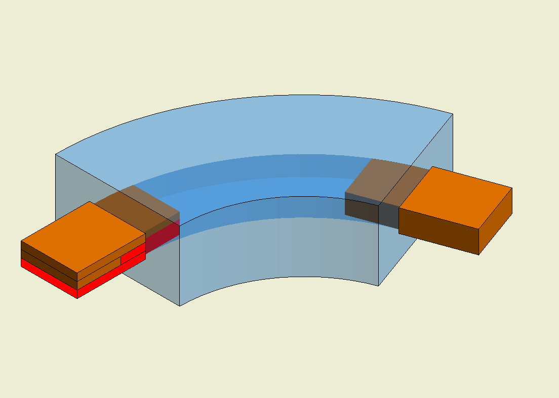
Present status
Progress of measurement
About 50 %of down stream side was completed.
Data analysis just started…
Red･･･completed
Orange･･･To be measured

Slide 16
Summary
New generation spectroscopy of Ξ-hypernuclei via the (K⁻,K⁺)reaction with the S-2S will provide us keys to understand baryon-baryon interactions by achieving unprecedented missing-mass resolution.
The basic operation performance was studied for the D1 magnet.
The magnetic field measurement of the D1 magnet is ongoing to check the consistency between the measured and calculated field maps.

Slide 17
Back up

Slide 18
How long should we wait to take data from the mover moving ?
When the mover move, the position of hall probe may oscillate and therefore magnetic field will oscillate.
@1500A
Moving x±5 cm, y±5cm, z± 5cm(and conposition of these shift) and read hall probe value every 200ms, during 12minutes from moving.
When we wait two seconds,
magnetic field vary within 0.05%.
Magnetic field value normalized
by average of last 2 seconds

Slide 19
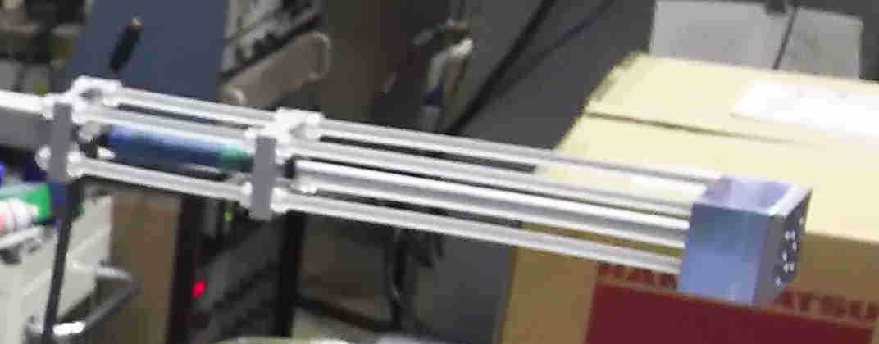
Standard and resolution of survey
We set two theodolite and level on standard line.
Move probe to see marking in center of theodolite and record
value of mover moved.
We could resolve 25μm
→angler resolution ～0.01 deg.
X standard
(336mm from pole tip,
20mm from End guard)
Z standard
(2m height)
Probe almost fixed this two point
Y standard
(S-2S center)
189.5 mm

Slide 20
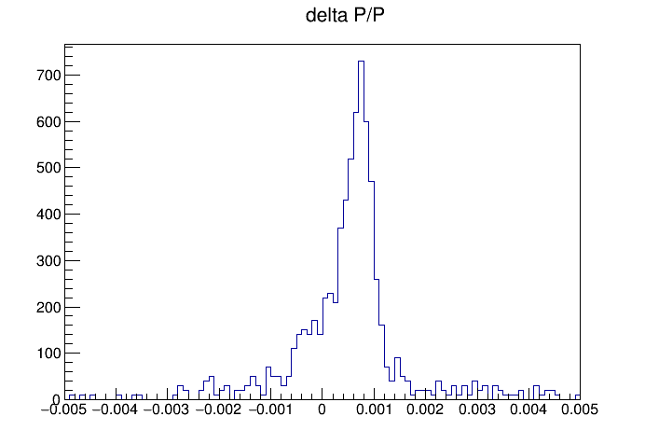
Simulation for error estimate
Generated K+
Momentum 1.3000±0.0975 [GeV/c]
Angle θ<10°
6.2×10⁻⁴ (FWHM)

