Slide 1
Spectroscopic study of S=-2 hypernuclei with a new spectrometer S-2S
S. Kanatsuki (Kyoto University), N. Amano, H. Ekawa, H. Fujioka, E. Hirose, Y. Ichikawa, S. Kato, M. Moritsu, T. Nagae, H. Takahashi, T. Takahashi, K.Takenaka, and the J-PARC E05 Collaboration
The 2nd International Symposium on Science at J-PARC
2014.7.14

Slide 2
Contents
Introduction
Baryon-baryon interaction
Previous experiments
J-PARC E05 experiment at K1.8 beam line
Missing mass spectroscopy ¹²C (K^{ー}, K＋) _{Ξ}¹²Be reaction
Future plans
New spectrometer S-2S
Design and performance
Preparation status

Slide 3
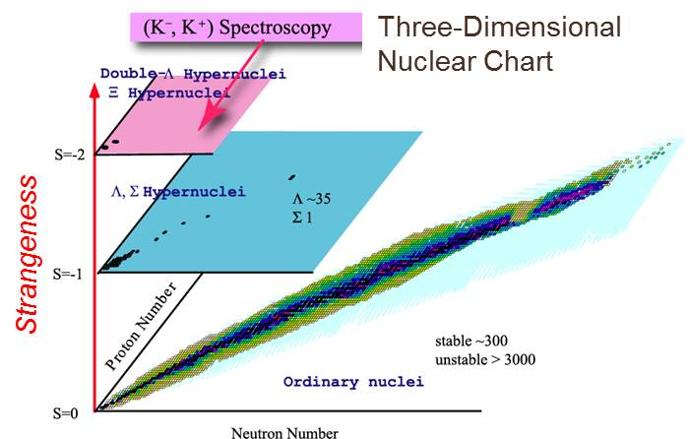
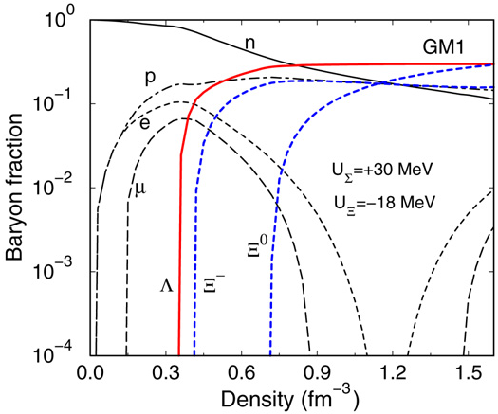
Introduction
Study of hypernuclei
Baryon-baryon interaction
A role of strangeness in dense nuclear matter in neutron stars
S=-1
Detail information of ΛN interaction was obtained from various experiment.
(K⁻,π⁻),(π⁺, K⁺),(e,e’K⁺) …
γ-ray spectroscopy
ΣN is strongly repulsive.
S=-2
Doorway to the multi-strangeness systems
Experimental information is very limited.
J. Schaffner-Bielich, NPA 804, 309 (2008)
Baryon fraction in neutron star matter for RMF calculation

Slide 4
Previous experiments
“NAGARA” event
H. Takahashi et al., PRL 87 (2001) 212502
Emulsion experiment KEK-E373
Discovery of _{ΛΛ}⁶He
ΔB_{ΛΛ} = 0.67 MeV ： weakly attractive
Candidate of Ξ-hypernuclear state?
BNL-E885
¹²C(K－,K＋) reaction
Small cross section：60 nb/sr
V_{Ξ} ～－14 MeV
BNL-E885：¹²C(K－,K＋)
High resolution is strongly required
Bound region
Poor energy resolution
of ΔE ～14 MeV (FWHM)
No clear peak
P. Khaustov et al., PRC 61 (2000) 054603

Slide 5
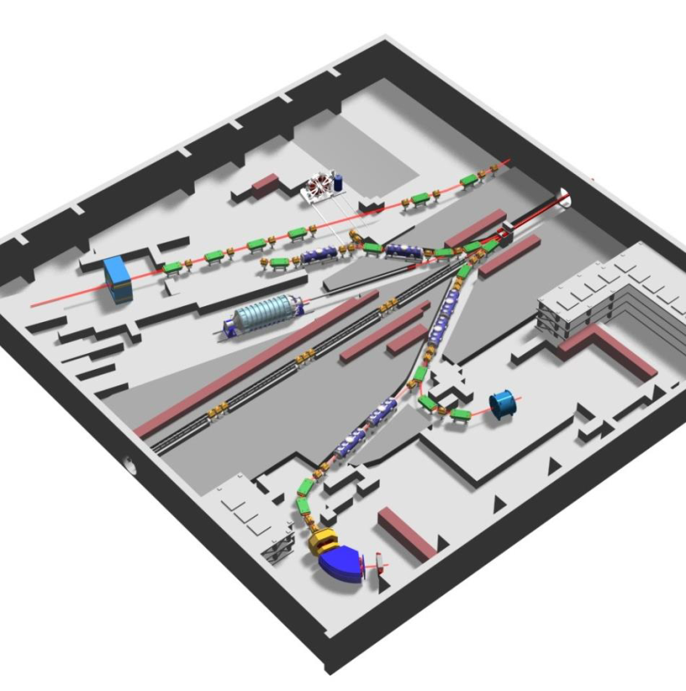
J-PARC E05 experiment
Spectroscopy of Ξ-hypernucleus using ¹²C (K－,K＋) reaction
K1.8 beam line at Hadron Facility
Intense and pure K－ beam at 1.8 GeV/c
1.5×10⁶ K/spill @100kW
First observation of _{Ξ}¹²Be
With much improved energy resolution of a few MeV
The depth and width of Ξ-nucleus potential
Future Plan
Various targets
⁷Li→_{Ξ}⁷H(αnnΞ), ⁸⁹Y→_{Ξ}⁸⁹Rb, etc.
Spin and mass dependence of ΞN potential
Double Λ-hypernuclei
Excited states
Sensitive to ΞN-ΛΛ coupling strength

Slide 6
Spectrometer
Missing mass spectroscopy
via the (K^{ー},K＋) reaction
Two good spectrometers
Beam and Scattered particles
Beam K－
K1.8 Beam Spectrometer: dp/p～1×10^{ー3}
Scattered K＋
Momentum of K＋ is 1.3 GeV/c～1.4 GeV/c
for high momentum resolution
New spectrometer S-2S
Strangeness -2 Spectrometer
dΩ = 60 msr, dp/p = 5×10^{ー4} → ΔE = 1.5 MeV
SKS: 110 msr, dp/p～3×10^{ー3} → ΔE～4 MeV
Will be ready for installation in JFY2015
×10 higher resolution

Slide 7
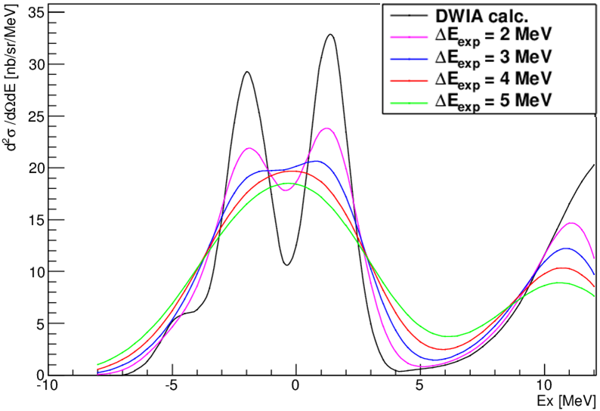
Expected spectrum
DWIA spectrum for ESC08 interaction
Nuclear core excitation is taken into account.
Colored line : calculation convoluted with experimental resolution
ΔE > 2 MeV → 1 peak
¹²C(K^{ー},K＋)_{Ξ}¹²Be
(T=1)
S-2S will be a powerful tool to explore the S=-2 world.
Black line: T. Motoba and S. Sugimoto, Nucl. Phys. A 835, 223 (2010)

Slide 8
Schematic view of S-2S
Momentum reconstruction
QQD-type magnets
→high resolution and large solid angle
dp/p < 5×10⁻⁴ for p<1.4 GeV/c
Tracking detectors (σ=0.2mm)
Scattered K＋
Tracking Detector 1,2
Q1: vertical focus
Trigger Counters
K＋ = TOF∧AC∧WC
TOF → offline analysis
AC: pion rejection
WC: proton rejection
Q2: horizontal focus
D1: 70 deg. bend
on-line trigger
Tracking Detector 3,4
TOF
Momentum Acceptance
1.2～1.4 GeV/c
Pathlength: 9 m
βγcτ: ～9.5 m
(K＋@1.3 GeV/c)
Aerogel Cherenkov
Water Cherenkov
1m

Slide 9
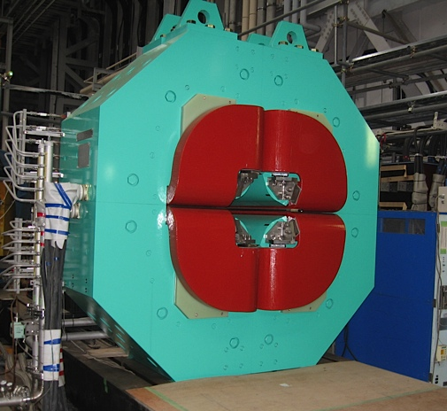
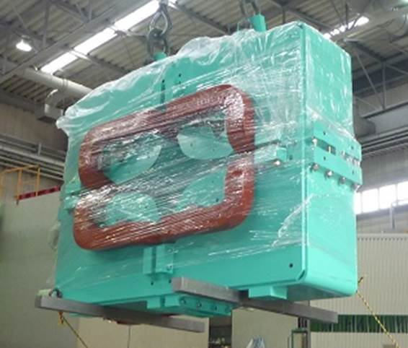
Magnet Status
Q1 (vertical focus)
8.72 T/m
aperture 31 cm
37 ton
2.4×2.4×0.88 m³
Completed
Q2 (horizontal focus)
5.0 T/m
aperture 36 cm
12 ton
2.1×1.54×0.5 m³
Pole was modified.
Completed
D1
1.5 T (70°bend@1.37GeV/c)
pole gap 30×80 cm²
86 ton
Central trajectory 3.7 m
Coil will be mounted.
Wait until next spring
1m

Slide 10
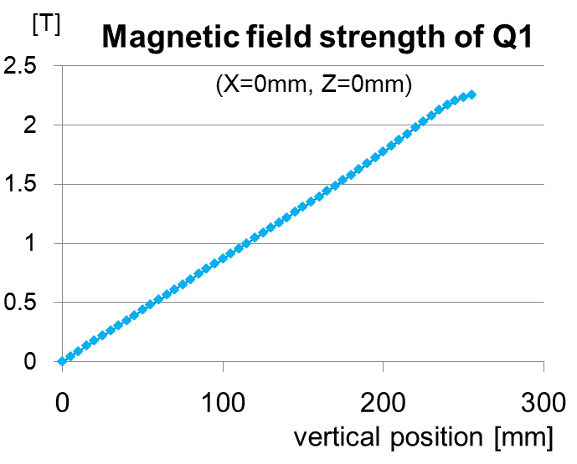
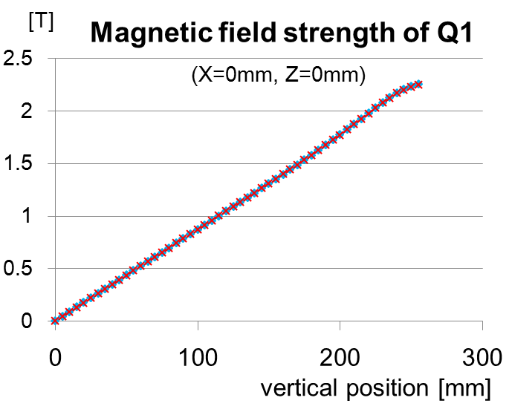
Q1, Q2 magnet
Measurement of Magnetic field
Using hole probe
B/r = 8.7 T/m (Q1), 5.0 T/m(Q2)
Enough to achieve large acceptance
Measurement
Calculation
Field Calculation (Q1 only)
3D electromagnetic field calculation software Opera-3d/TOSCA
Residual
[T]
Field distribution is well reconstructed
±0.1%

Slide 11
Status summary
Magnets
Q1,Q2 : Ready
D1 will be completed in JFY2014
Tracking Detector 1,2
Existing Detectors
Q1
Tracker 3,4
1 m×1 m Drift chambers
Need some repairments
TOF
Almost ready
Aerogel Cherenkov
Ready
Q2
D1
Tracking Detector 3,4
TOF
R&D
AC
Tracker 1,2
Under design
Water Cherenkov
Test experiments of prototype has been done.
WC
1m

Slide 12
Yield estimation
Assumption
1.5×10⁶ K－/spill @ 100 kW
3 g/cm² target, 60 nb/sr cross-section
dΩ 60 msr, K＋ decay 40%, analysis efficiency 70%
Yield (_{Ξ}¹²Be) = N_{beam}×N_{target}×dσ/dΩ×ΔΩ×f_{decay}×f_{analysis}
= 4.6 [/day]
= 90 [/month]
Enough statistics with ΔE ～1.5 MeV
The first step to S=-2 world

Slide 13
Summary
The spectroscopy of Ξ-hypernuclei will be performed at K1.8 beam line.
New spectrometer S-2S will play an indispensable role to observe peaks of hypernuclei with S=-2.
Construction of S-2S is in progress.
Q1 and Q2 construction is finished.
D1 will be completed in JFY2014.
Detectors are under development.
S-2S will be ready for installation in JFY2015

Slide 14
Back up

Slide 15
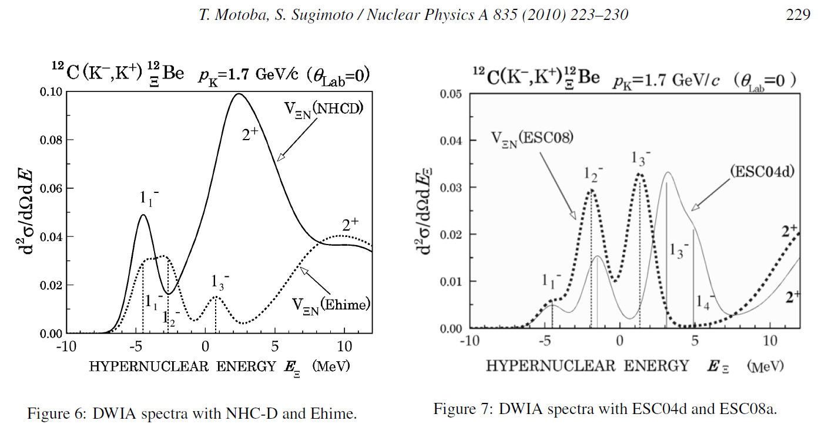
Expected spectra
The shapes of spectrum depends on the interaction models

Slide 16
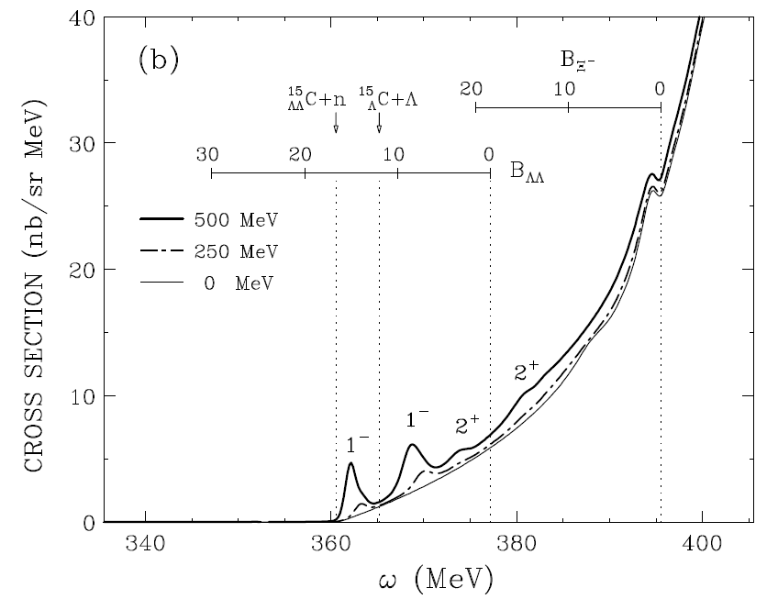
Double Λ hypernuclei
two-step process
Sensitive to ΞN-ΛΛ coupling strength
～0.1 nb/sr
one-step process
7～12 nb/sr
T. Harada et al., Phys. Lett. B 690, 363 (2010)

Slide 17
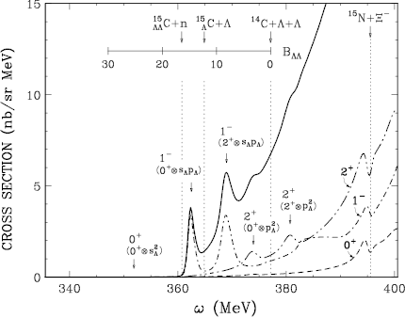
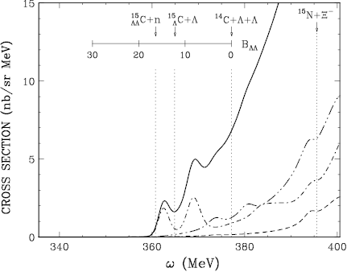
Double Λ hypernuclei
ΔE_{exp} = 1.5 MeV
¹⁶O (K－,K＋) _{ΛΛ}¹⁶C
[¹⁵N(1/2⁻,3/2⁻)×s_{Ξ}]₁-→[¹⁴C(0⁺,2⁺)]×s_{Λ}p_{Λ}]₁-
[¹⁵N(1/2⁻,3/2⁻)×p_{Ξ}]₂+ → [¹⁴C(0⁺,2⁺)×p_{Λ}²]₂+
ΔE_{exp} = 3 MeV
T. Harada et al., Phys. Lett. B 690, 363 (2010)

Slide 18
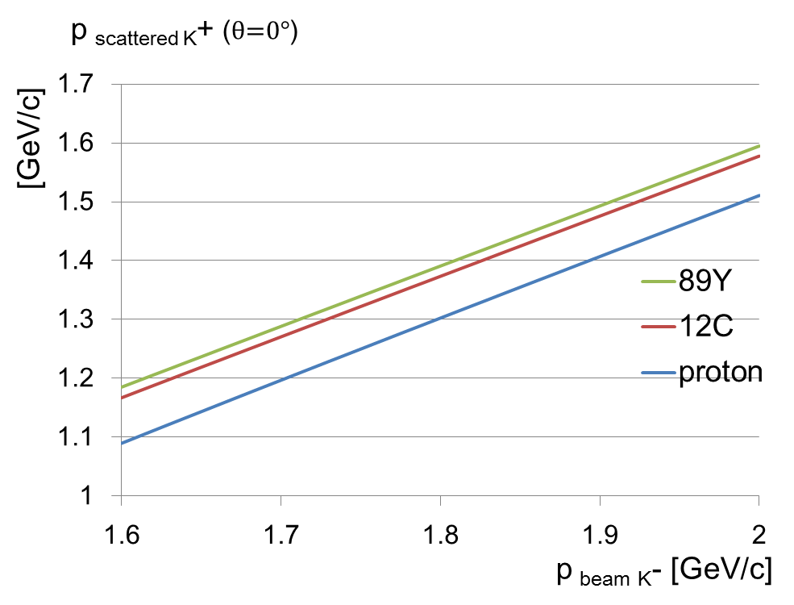
Momentum region
Production cross section of elementally process p(K－,K＋)Ξ－
Momentum of K＋[GeV/c]
Peak@1.8 GeV/c
Momentum K－ [GeV/c]
Momentum of K^{ー} [GeV/c]

Slide 19
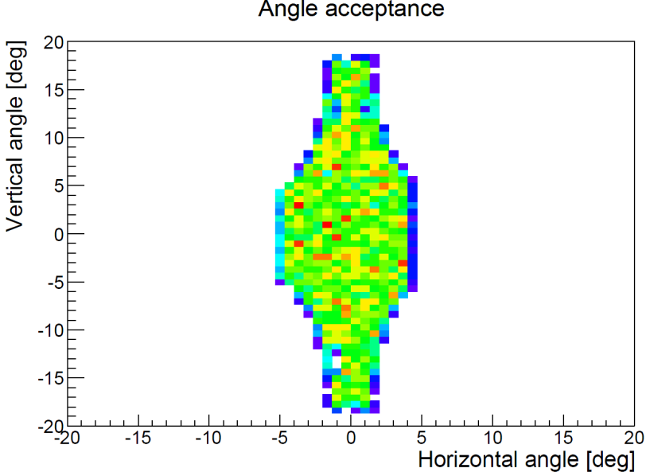
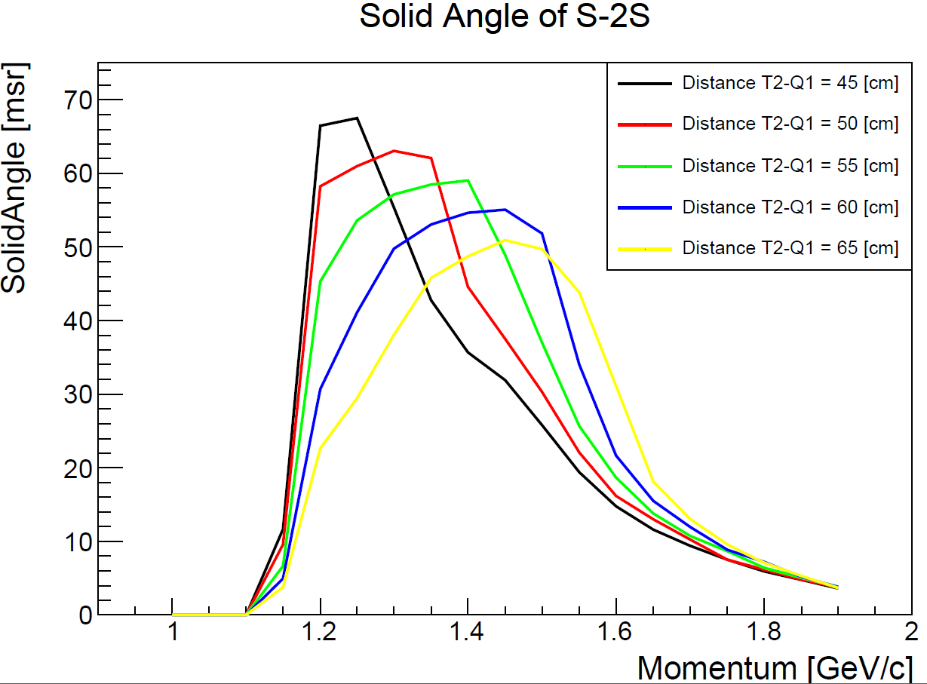
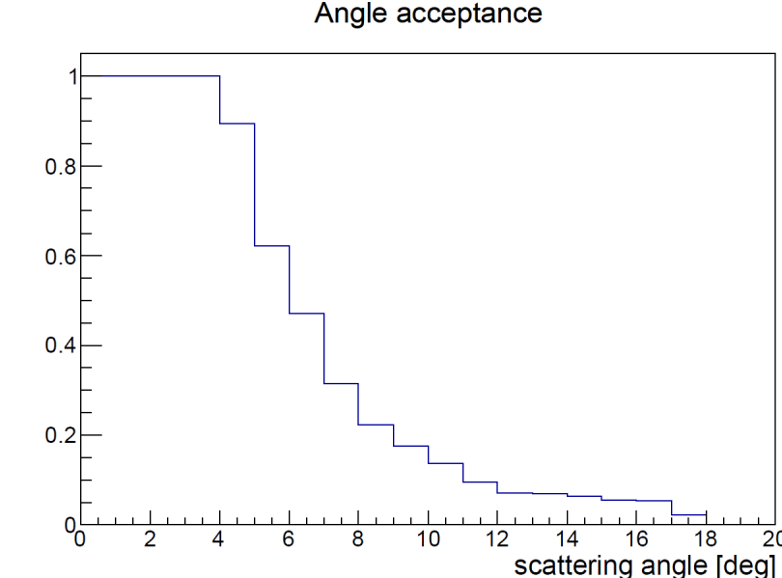
Acceptance of S-2S
Q1,Q2,D1=2500 A (maximum current)
p = 1.35 GeV/c
T2-Q1 = 50 cm

