Slide 1
23th J-PARC PAC
1 /
22
Beam time request for E07 2nd run
Double Strangeness (S = -2) system with a Hybrid-emulsion Method
Kazuma Nakazawa
Phys. Dept., Gifu Univ., JAPAN
12th Jan., 2017
Outline
1. Introduction.
2. Preliminary Results of Physics Run@2016.Jun (E07 ).
3. R&D status and Beam time request
4. Summary

Slide 2
Beam time request for 2017 Run
Start up
  timing check
  beam tuning
  interval to set collimator
  beam check
  calibration
    beam through
    CH2
Emulsion exposure (100 stacks)
  2016 Run (1 stack)
    cassette exchange : 0.5h
    pattern match : 0.5h
    exposure : 6h
    total : 7h
  reduce time : 7h → 6h
    beam intensity : 310k → 350k
    reduce SSD calibration time
  6h x 100 stacks = 600h (25days)
1 day
1~2 days
1 day
25 days
(29 days in the last PAC)
total : 27 days

Slide 3
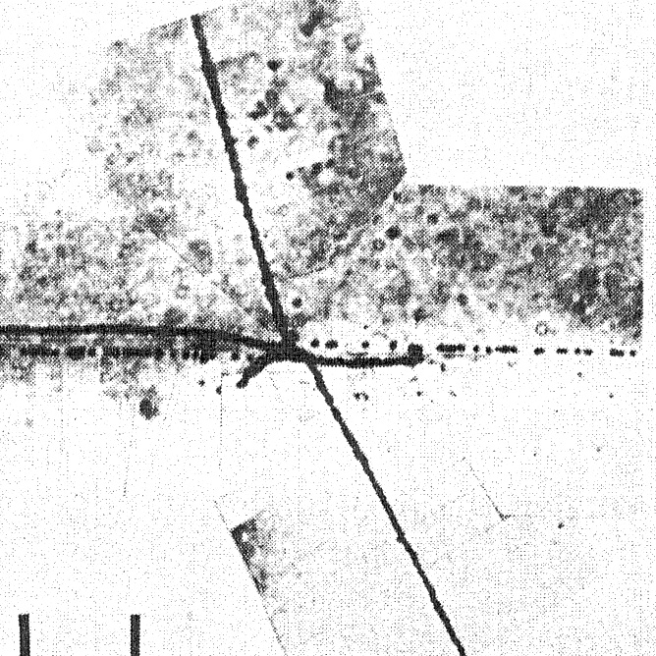
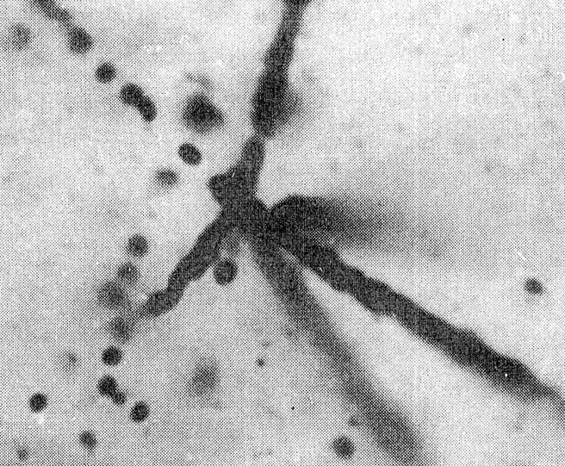
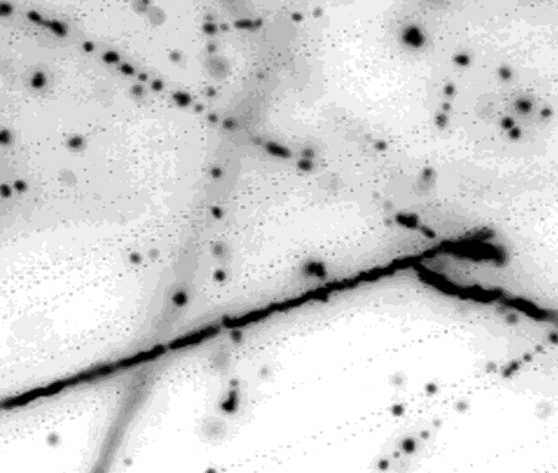
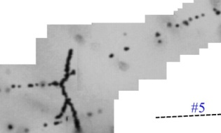
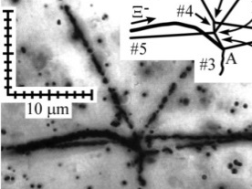
Double hypernuclei with a hybrid-emulsion method
Ξstops
KEK-E176
KEK-E373
~4
~80
several x 10²
ΛΛ S-wave int.
=》weakly attractive
(1991 )
NAGARA
⁶ He
“the most significant
result of the past 5 years
in hypernuclear physics.”
Final Report of the 2004 KEK PS
External Review Committee
(August 30, 2004), p5.
ΛΛ
M.Danysz et al.,
PRL.11(1963)29;
¹⁰Be
¹³ B
ΛΛ
ΛΛ
(2001 )
ΔBΛΛ = 0.6 +/- 0.8 MeV
ΔBΛΛ = 1.3 +/- 0.4 MeV
ΔBΛΛ - B Ξ⁻ = 0.67 +/- 0.17 MeV
DemachiYanagi
MIKAGE
¹¹ Be
HIDA
(2000 )
ΛΛ
¹⁰ Be*
ΛΛ
Ξ ⁻
1.15 +/- 0.15
⁶ He
3.64 +/- 1.71
2.38 +/- 1.34
Vertex Picker
(overall-scanning system / free from counter data)
ΛΛ
¹¹ Be
3.73 +/- 2.71
ΛΛ
J.K.Ahn et al., Phys. Rev. C88, 014003(2013)
Systematic Measurement of
mass number
dependence of ΔBΛΛ,
Ξ-N interaction under
the mixing Ξ-N ⬄ Λ-Λ (⬄ H)
(~10³ DHY)
Ξ⁻ + ¹⁴N ➔ ¹_{Λ}⁰Be (#1) + ⁵_{Λ}He (#2)
Fast image taking (×300)
CCD camera ➔ CMOS Camera
Mechanical ➔ Piezo stage
K. Nakazawa et al., PTEP. 2015, 033D02
KISO
B_{Ξ}⁻ ⁽¹_{Λ}⁰Be_{g.s.}⁾ = 3.87 +/- 0.21 MeV / 17.5 σ
B_{Ξ}⁻ ⁽¹_{Λ}⁰Be_{1st} _{ex.}⁾ = 1.03 +/- 0.18 MeV / 4.6 σ
(2) Fast image processing (New)
from atomic
3D = 0.17 MeV
ΞΝ int. =》attractive
¹_{Λ}⁰Be; Ref. Gogami et al.,
Phys. Rev. C 93, 034314 (2016)

Slide 4
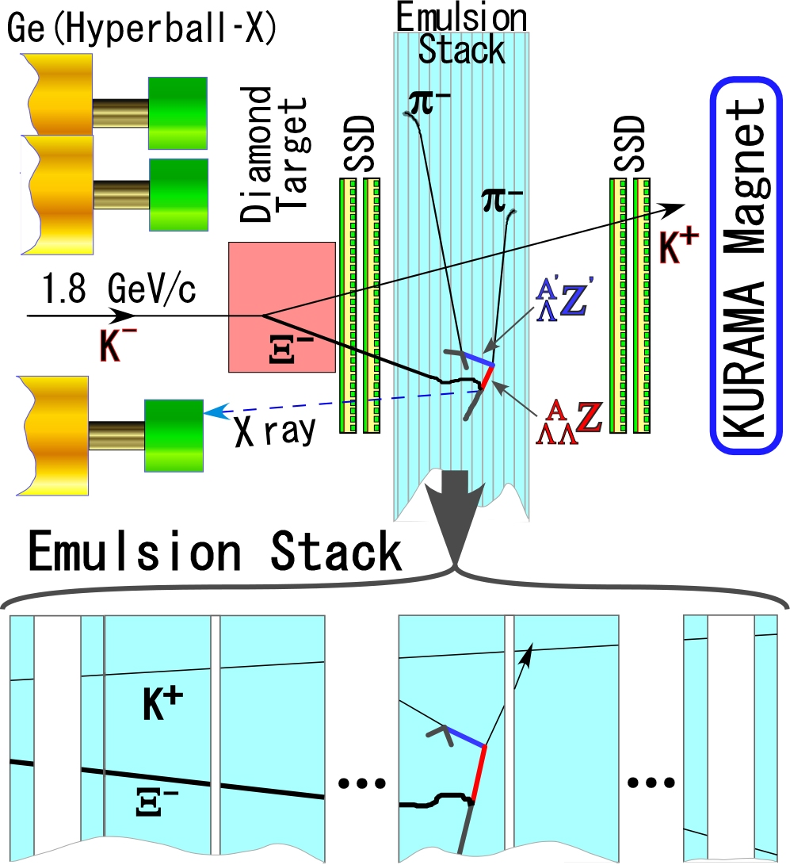
The E07 experiment with a hybrid emulsion method
3 /
22
K
+
Ξ
−
p
ΛΛ + 28 MeV
=>
K
−
Λ
Λ
o
r
H
Ξ
−
Λ
Λ
Λ
Ξ
−
A
Ξ
−
Λ
atom
A*(S = -2)
Λ
１．Pure K-beam
( ×3.5 than KEK-PS)
２．Enough emulsion volume
(×3 than KEK-E373)
➔ 10 times statistics
of E373
1 + 11 + 1 = 13 plates / 1 stack
Thin plate Thick pl. Thin pl.

Slide 5
Topics with 10 times statistics of E373
1) s-shell DBL. hypernuclei : _{Λ}⁴_{Λ}H, _{Λ}⁵_{Λ}He and _{Λ}⁵_{Λ}H
  ΛΛ-ΞN coupling interaction affects mass, since s-shell nucleons are not fully occupied. Thus, it can be determined.
2) A = 6~17 ΛΛ hypernuclei (spectroscopy)
  Confirmation of ΛΛ interaction strength and nuclear structure effects such as shrinkage due to Λ, independent information of NAGARA event, _{Λ}⁶_{Λ}He.
3) Ξ-hypernuclei : Ξ⁻¹⁶O, Ξ⁻¹⁴N(KISO event), Ξ⁻¹²C
  From multiple events of Ξ-hypernucleus, we can determine the (natural) width of Ξ-hypernucleus, which is related to ΛΛ-ΞN coupling interaction.
4) ΞN interaction with X-ray from Ξ-atoms
  Expected yields for X-rays from Br and Ag are so small. To observe the shifts, it is necessary for detecting peak shapes with 10 times statistics.
5) Λ-Λ P-wave interaction (?)
  If ΛΛ hypernuclei can be detected in excited states with one Λ-hyperon in p-orbit, it may present information on ΛΛ p-wave interaction, where that will be recognized via the spectroscopy of ΛΛ hypernuclei. The interaction might change max. mass of n-star about 10%.

Slide 6
1) s-shell DBL. hypernuclei : _{Λ}⁴_{Λ}H, _{Λ}⁵_{Λ}He and _{Λ}⁵_{Λ}H
➔ ΛΛ-ΞN coupling effect
_{Λ}⁶_{Λ}He
Forbidden
V _{ΛΛ－ΞN}
P_{3/2}
Λ
Λ
Ξ^{０}
S_{1/2}
n
n
p
p
n
The effect of ΛΛ-ΞN coupling is small in _{Λ}⁶_{Λ}He and the p-shell double Λ hypernuclei
・I.R. Afnan and B.F. Gibson, Phys. Rev. C67, 017001 (2003).
・Khin Swe Myint, S. Shinmura and Y. Akaishi, nucl-th/029090.
・T. Yamada and C. Nakamoto, Phys. Rev.C62, 034319 (2000).
s-shell nuclei, ex. _{Λ}⁴_{Λ}H
allowed
P_{3/2}
Λ
Λ
Ξ^{０}
S_{1/2}
n
p
n
(Ξ⁻ p)
There is NO Pauli blocking and the ΛΛ－ΞN effect can be large.
By E. Hiyama
If the strength of ΛΛ-ΞN coupling is large, _{Λ}⁴_{Λ}H can be bound. ➔ ΛΛ-ΞN effect
Notes:
First, let me explain He6LL. As shown in he shell-model picture, 2 proton, 2 neotron, and 2 Lambdas occupy in the lowest s-shell and this s-shell is closed. When these 2 lambdaS are conerted into ΞN by ΛΛ-ΞN coupling, this additional nueon is forbidden to occupy the s-shell due to Pauli blocking. Thereofre effect of ΛΛ-ΞＮ coupling is small in He6LL and the p-shell double Λ hypernuclei.
This Pauli suppresion effect in p-shell double Λ hypernuclei was already pointed out by these authors.

Slide 7
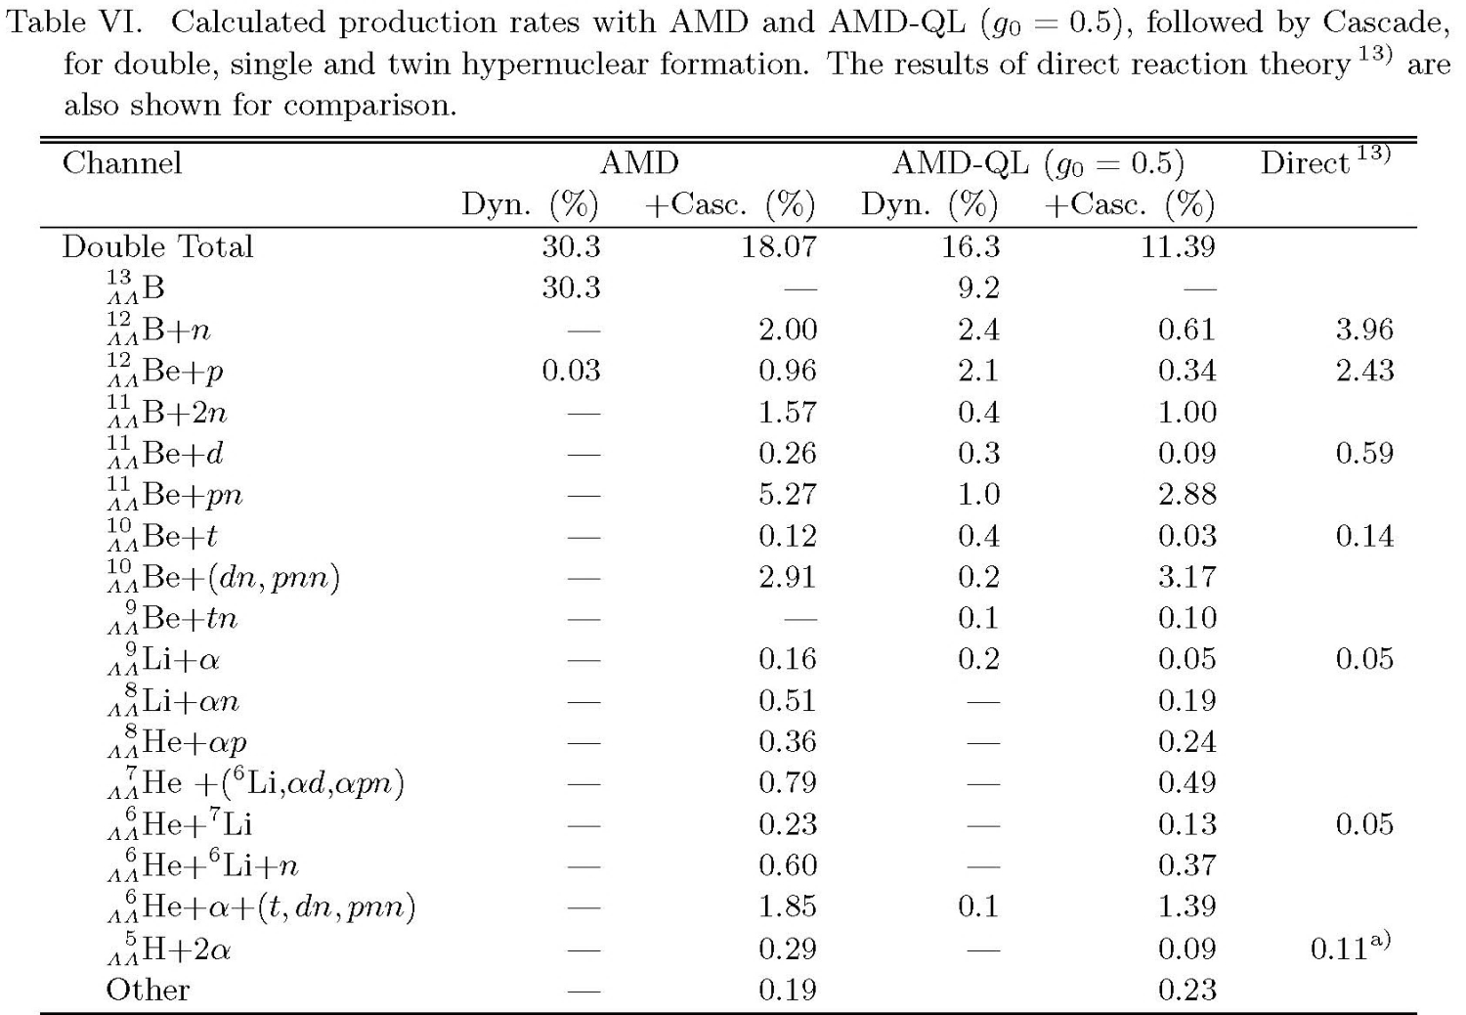
_{Λ}⁵_{Λ}H production from Ξ⁻ capture on ¹²C
Heaviest Hydrogen Isotope
E (MeV)
n+n+p+Λ+Λ
0.0
AMD/AMD-QL calc. by Y. Hirata et. al. PTP 102 (1999)89
－8.5
t+Λ+Λ
⁴_{Λ}H+Λ
－10.5
_{Λ}⁵_{Λ}H➔to be bound
NAGARA event
¹²C+Ξ⁻ → _{Λ}⁶_{Λ}He+α+t
_{Λ}⁶_{Λ}He → ⁵_{Λ}He+p+π⁻
⁵_{Λ}He → α+p+π⁻
1.85 (1.39) %
_{Λ}⁵_{Λ}H
¹²C+Ξ⁻ → _{Λ}⁵_{Λ}H+α+α
(_{Λ}⁵_{Λ}H → ⁵_{Λ}He+π⁻
⁵_{Λ}He → α+p+π⁻)
0.29 (0.09)%
∼1/10 of _{Λ}⁶_{Λ}He

Slide 8
Topics with 10 times statistics of E373
1) s-shell DBL. hypernuclei : _{Λ}⁴_{Λ}H, _{Λ}⁵_{Λ}He and _{Λ}⁵_{Λ}H
  ΛΛ-ΞN coupling interaction affects mass, since s-shell nucleons are not fully occupied. Thus, it can be determined.
2) A = 6~17 ΛΛ hypernuclei (spectroscopy)
  Confirmation of ΛΛ interaction strength and nuclear structure effects such as shrinkage due to Λ, independent information of NAGARA event, _{Λ}⁶_{Λ}He.
3) Ξ-hypernuclei : Ξ⁻¹⁶O, Ξ⁻¹⁴N(KISO event), Ξ⁻¹²C
  From multiple events of Ξ-hypernucleus, we can determine the (natural) width of Ξ-hypernucleus, which is related to ΛΛ-ΞN coupling interaction.
4) ΞN interaction with X-ray from Ξ-atoms
  Expected yields for X-rays from Br and Ag are so small. To observe the shifts, it is necessary for detecting peak shapes with 10 times statistics.
5) Λ-Λ P-wave interaction (?)
  If ΛΛ hypernuclei can be detected in excited states with one Λ-hyperon in p-orbit, it may present information on ΛΛ p-wave interaction, where that will be recognized via the spectroscopy of ΛΛ hypernuclei. The interaction might change max. mass of n-star about 10%.

Slide 9
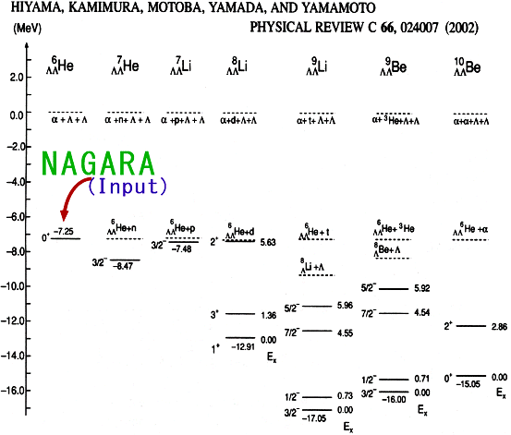
2) A = 6~17 ΛΛ hypernuclei (Spectroscopy)
Theoretical prediction & Experimental Data
- B ΛΛ
Demachi-
Yanagi
M. Danysz et al, PRL 11(1963)29;
R. H. Dalitz et al.,
Proc. R. S. Lond. A436(1989)1
MIKAGE
HIDA
E176
-18.0
¹_{Λ}¹_{Λ}Be
To confirm Λ-Λ interaction strength and nuclear structure effects such as shrinkage due to Λ, via independent information of NAGARA event, _{Λ}⁶_{Λ}He, it is necessary to study B_{ΛΛ} of p-shell DBL hypernuclei.
-20.0
¹_{Λ}²_{Λ}Be
¹_{Λ}³_{Λ}B
-22.0
-24.0
➔ spectroscopy of DBL hypernuclei

Slide 10
Topics with 10 times statistics of E373
1) s-shell DBL. hypernuclei : _{Λ}⁴_{Λ}H, _{Λ}⁵_{Λ}He and _{Λ}⁵_{Λ}H
  ΛΛ-ΞN coupling interaction affects mass, since s-shell nucleons are not fully occupied. Thus, it can be determined.
2) A = 6~17 ΛΛ hypernuclei (spectroscopy)
  Confirmation of ΛΛ interaction strength and nuclear structure effects such as shrinkage due to Λ, independent information of NAGARA event, _{Λ}⁶_{Λ}He.
3) Ξ-hypernuclei : Ξ⁻¹⁶O, Ξ⁻¹⁴N(KISO event), Ξ⁻¹²C
  From multiple events of Ξ-hypernucleus, we can determine the (natural) width of Ξ-hypernucleus, which is related to ΛΛ-ΞN coupling interaction.
4) ΞN interaction with X-ray from Ξ-atoms
  Expected yields for X-rays from Br and Ag are so small. To observe the shifts, it is necessary for detecting peak shapes with 10 times statistics.
5) Λ-Λ P-wave interaction (?)
  If ΛΛ hypernuclei can be detected in excited states with one Λ-hyperon in p-orbit, it may present information on ΛΛ p-wave interaction, where that will be recognized via the spectroscopy of ΛΛ hypernuclei. The interaction might change max. mass of n-star about 10%.

Slide 11
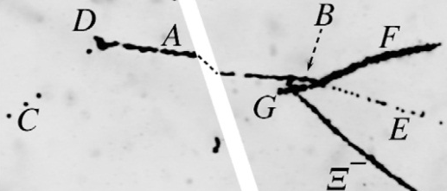

3) Ξ-hypernuclei : Ξ⁻¹⁶O, Ξ⁻¹⁴N(KISO event), Ξ⁻¹²C
Twin hypernuclear events give the information
on the natural width of Ξ hypernuclei.
Ξ⁻ + ¹²C (two events from E176)
Ξ⁻ + ¹⁴N (KISO event)
➔ ⁴_{Λ}H + ⁹_{Λ}Be B_{Ξ}- (MeV)
➔ ⁵_{Λ}He + ¹_{Λ}⁰Be B_{Ξ}- (MeV)
0.82 ±0.17
− 0.23 ±0.17 [ ⁴_{Λ}H* + ⁹_{Λ}Be]
KISO
3.87 ±0.21
1.03 ±0.18 [ ⁵_{Λ}He + ¹_{Λ}⁰Be*]
K. Nakazawa et al.,
PTEP 2015, 033D02
Ref.:Gogami et al., Phys.
Rev. C 93, 034314 (2016)
S. Aoki et al., PTP 89 (1993) 493
3.89 ±0.14
2.84 ±0.15 [ ⁴_{Λ}H* + ⁹_{Λ}Be]
0.82 ±0.14 [ ⁴_{Λ}H + ⁹_{Λ}Be*]
− 0.19 ±0.15 [ ⁴_{Λ}H* + ⁹_{Λ}Be*]
S. Aoki et al., PL B355 (1995) 45
Accumulation of multiple twin hypernuclear events is expected with 10 times Ξ stops.

Slide 12
Topics with 10 times statistics of E373
1) s-shell DBL. hypernuclei : _{Λ}⁴_{Λ}H, _{Λ}⁵_{Λ}He and _{Λ}⁵_{Λ}H
  ΛΛ-ΞN coupling interaction affects mass, since s-shell nucleons are not fully occupied. Thus, it can be determined.
2) A = 6~17 ΛΛ hypernuclei (spectroscopy)
  Confirmation of ΛΛ interaction strength and nuclear structure effects such as shrinkage due to Λ, independent information of NAGARA event, _{Λ}⁶_{Λ}He.
3) Ξ-hypernuclei : Ξ⁻¹⁶O, Ξ⁻¹⁴N(KISO event), Ξ⁻¹²C
  From multiple events of Ξ-hypernucleus, we can determine the (natural) width of Ξ-hypernucleus, which is related to ΛΛ-ΞN coupling interaction.
4) ΞN interaction with X-ray from Ξ-atoms
  Expected yields for X-rays from Br and Ag are so small. To observe the shifts, it is necessary for detecting peak shapes with 10 times statistics.
5) Λ-Λ P-wave interaction (?)
  If ΛΛ hypernuclei can be detected in excited states with one Λ-hyperon in p-orbit, it may present information on ΛΛ p-wave interaction, where that will be recognized via the spectroscopy of ΛΛ hypernuclei. The interaction might change max. mass of n-star about 10%.

Slide 13
4) ΞN interaction with X-ray from Ξ-atoms
Simulated for 10⁴ Ξ⁻-stopping events in the Emulsion
Energy resolution for Ge : 2keV FWHM
  Statistical accuracy of shift energies : Br(316 keV): 400 eV, Ag(370 keV): 200 eV
simulation
511 keV
Z(n,l) | E (keV) | Shift (keV) | Width (keV)
Ag(8,7)→(7,6)
Case 1 | 370.45 | 0.28 | 0.15
Case 2 |  | 3.3 | 0.79
Br(7,6)→(6,5)
Case 1 | 315.5 | 0.73 | 0.44
Case 2 |  | 5.5 | 1.74
Ag(370 keV)
33 counts
Br(316 keV)
18 counts
Case 1: assuming potential shape to be the same
as the nuclear density (tρ potential )
Case 2: Nijmegen D model correcting to produce
the potential depth of ~ 14 MeV.
To measure the shifts with peak shape, it is quite important to accumulate 10 times statistics, which is 10⁴ Ξ⁻-stopping events in the Emulsion.

Slide 14
Topics with 10 times statistics of E373
1) s-shell DBL. hypernuclei : _{Λ}⁴_{Λ}H, _{Λ}⁵_{Λ}He and _{Λ}⁵_{Λ}H
  ΛΛ-ΞN coupling interaction affects mass, since s-shell nucleons are not fully occupied. Thus, it can be determined.
2) A = 6~17 ΛΛ hypernuclei (spectroscopy)
  Confirmation of ΛΛ interaction strength and nuclear structure effects such as shrinkage due to Λ, independent information of NAGARA event, _{Λ}⁶_{Λ}He.
3) Ξ-hypernuclei : Ξ⁻¹⁶O, Ξ⁻¹⁴N(KISO event), Ξ⁻¹²C
  From multiple events of Ξ-hypernucleus, we can determine the (natural) width of Ξ-hypernucleus, which is related to ΛΛ-ΞN coupling interaction.
4) ΞN interaction with X-ray from Ξ-atoms
  Expected yields for X-rays from Br and Ag are so small. To observe the shifts, it is necessary for detecting peak shapes with 10 times statistics.
5) Λ-Λ P-wave interaction (?)
  If ΛΛ hypernuclei can be detected in excited states with one Λ-hyperon in p-orbit, it may present information on ΛΛ p-wave interaction, where that will be recognized via the spectroscopy of ΛΛ hypernuclei. The interaction might change max. mass of n-star about 10%.

Slide 15
5) Λ-Λ P-wave interaction (?)
By the Λ-Λ Nagara event, _{Λ}⁶_{Λ}He,
we found the ΛΛ S-wave (¹S₀) interaction to be attractive!
How about P-wave interaction?
If P-wave interaction is repulsive, maximum mass of n-stars can be kept by 10% larger than that of attractive cases.
ΛΛ hypernuclei in excited state with one Λ-hyperon in p-orbit ➔ P-wave interaction.
TYPE1,2: attractive
TYPE3,4: repulsive
H. Togashi, E. Hiyama, Y. Yamamoto, M. Takano,
PRC93,035808 (2016)

Slide 16
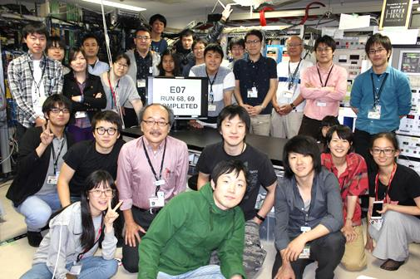
The 1st Physics run in Jun. 2016
KURAMA Commissioning : 5.0 days
  Detector study
  Beam tuning
  Trigger tuning
  Calibration
    Beam through
    CH₂ target
Physics : 4.9 days
  Emulsion exposure
  18 /118 stacks (~15% in all)
Run end photo @ K1.8 counting room
Jun. 30th, 2016
Total : 56 persons

Slide 17
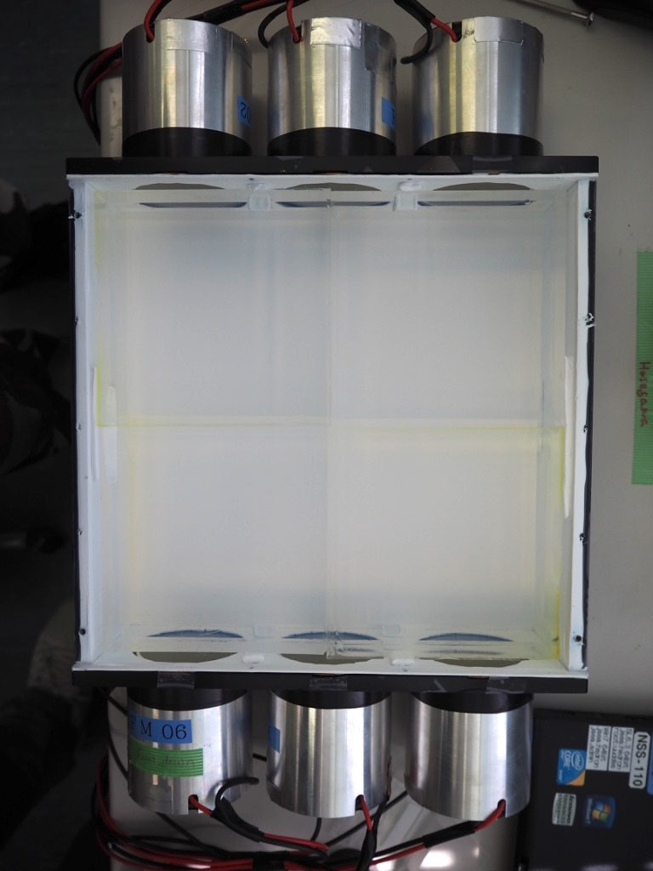
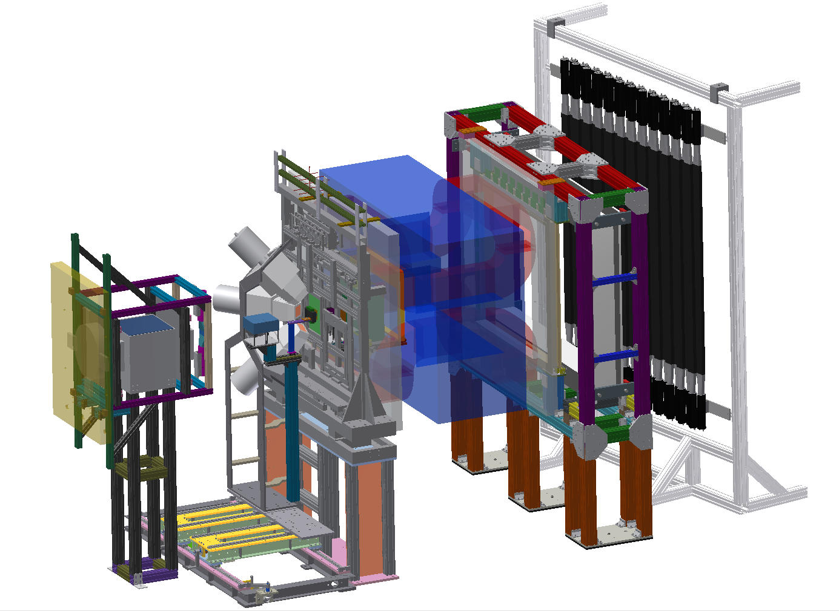
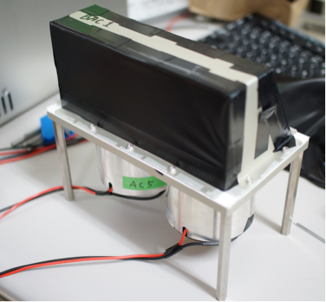
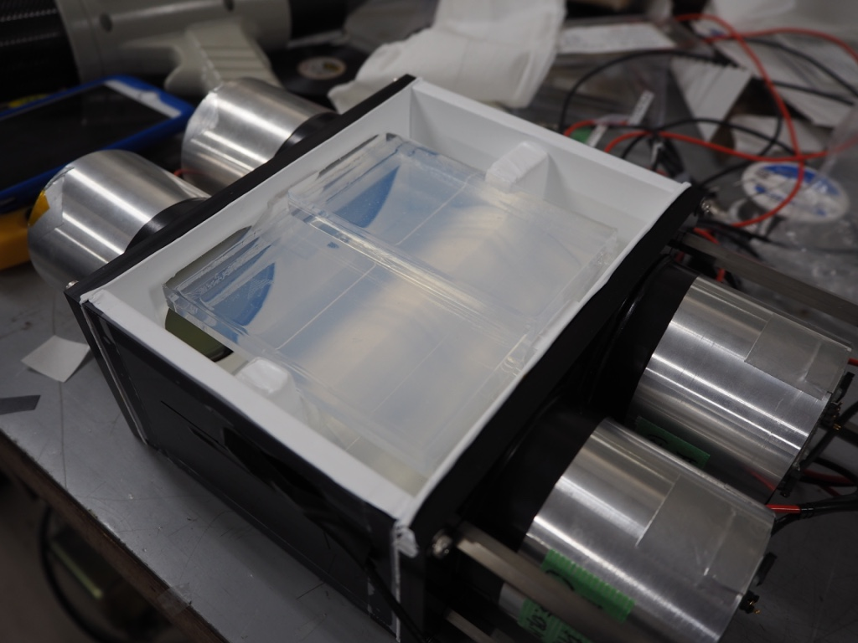
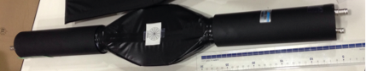
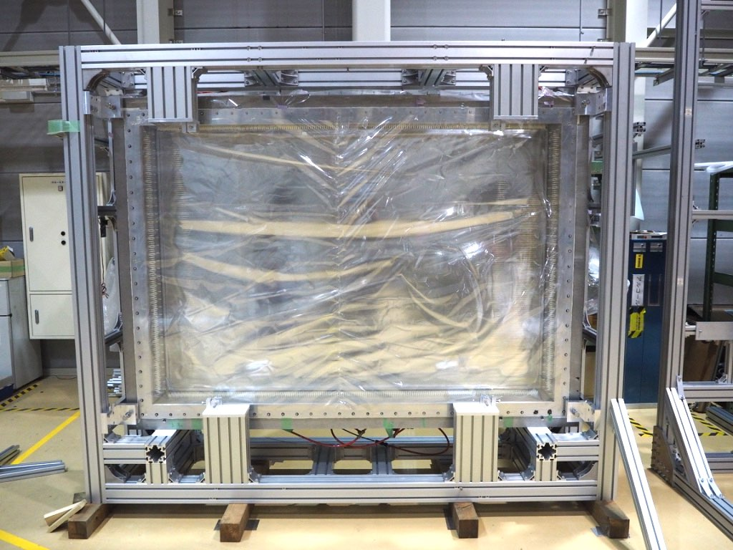
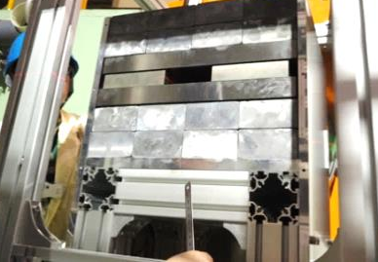


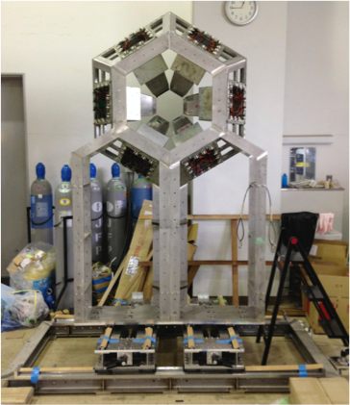
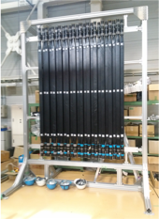
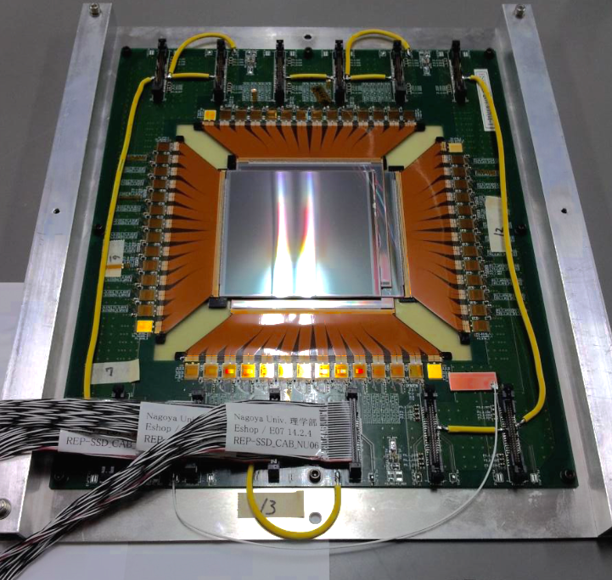
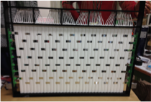
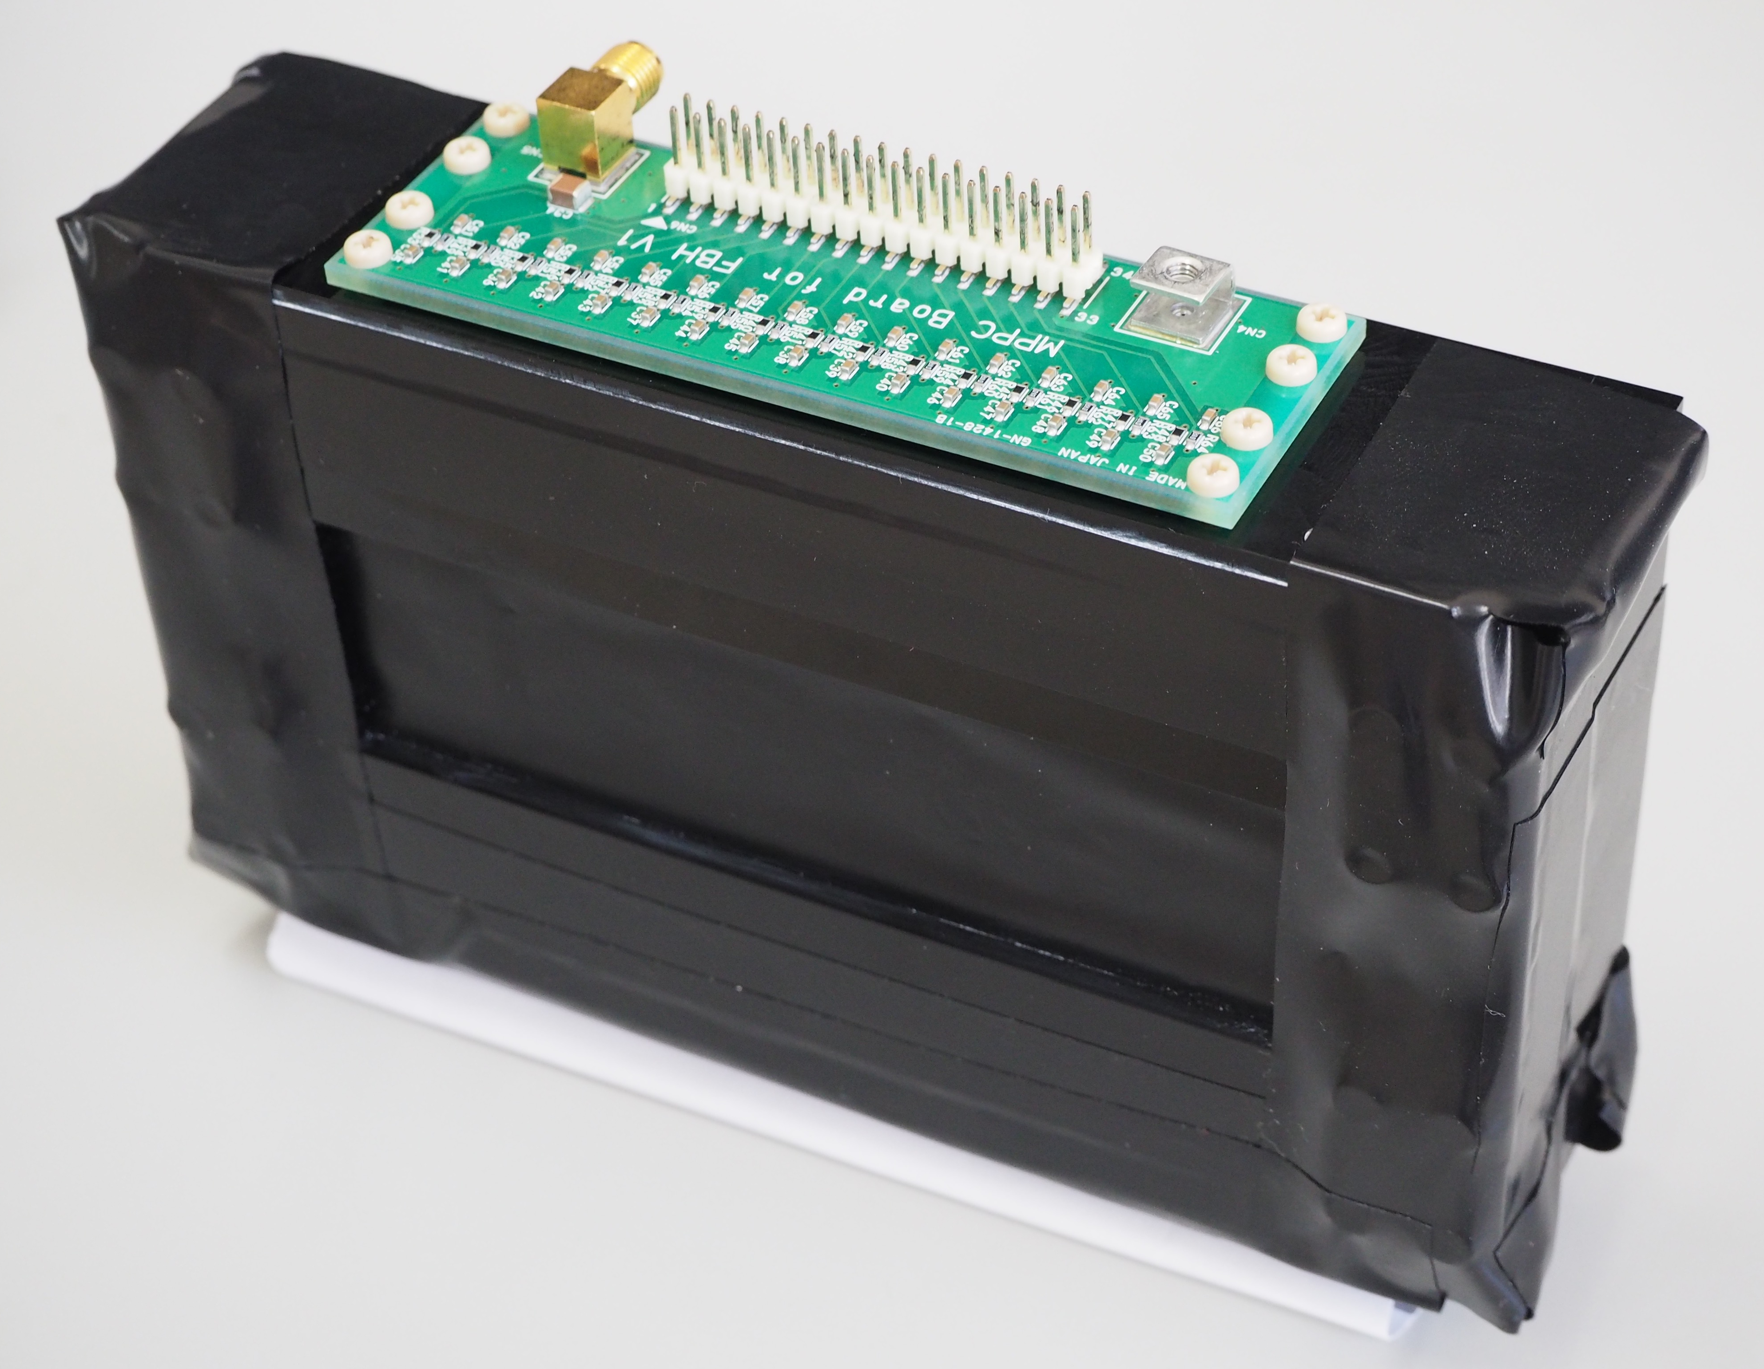
KURAMA spectrometer for E07
BH2
BAC
PVAC
FAC
Collimator
SDC3
SDC2
SDC1
Hyperball-X
SSD
FBH
CH
TOF

Slide 18
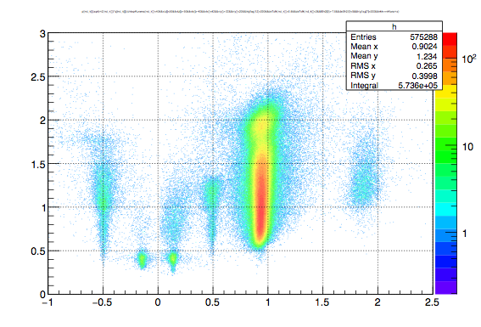
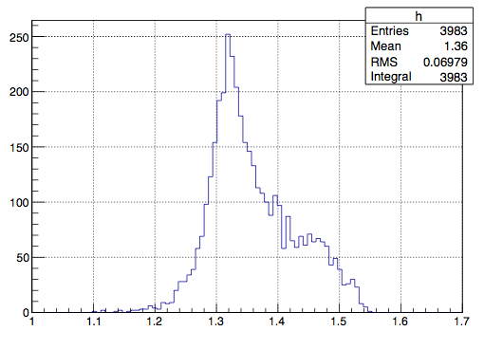
KURAMA analysis
Improvement
combine SSD to track reconstruction
    → momentum resolution : 2.5% → 1.5%
adopt redundant tracking algorism
  → K⁺ yield : 3000/stack → 5500/stack
mass and momentum of scattered particles
missing mass(CH2 target)
momentum [GeV/c]
K⁺
Ξ⁻
charge*mass [GeV/c²]
[Gev/c²]

Slide 19
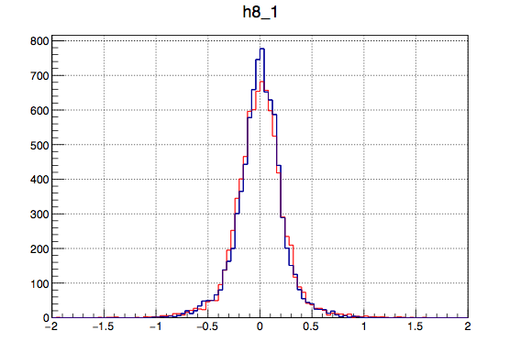
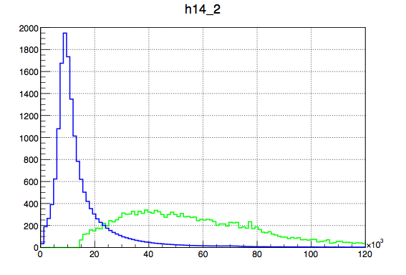
Ξ⁻ candidates in SSD
missing mom
Ξ⁻
K⁻
residual
SSD
Ξ⁻ tracks are identified by SSD
K⁺
dx/dz residual between
Ξ⁻ track and missing momentum
SSD dE
K⁺
data
simulation
Ξ⁻ candidates
dE (arb. unit)
dx/dz
Ξ⁻ track kinematics is consistent to simulation

Slide 20
Emulsion analysis1

Slide 21
Emulsion analysis2

Slide 22
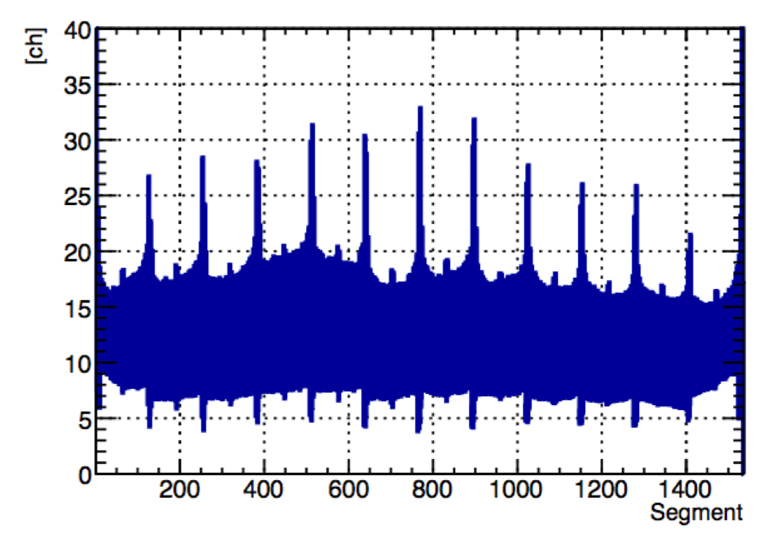
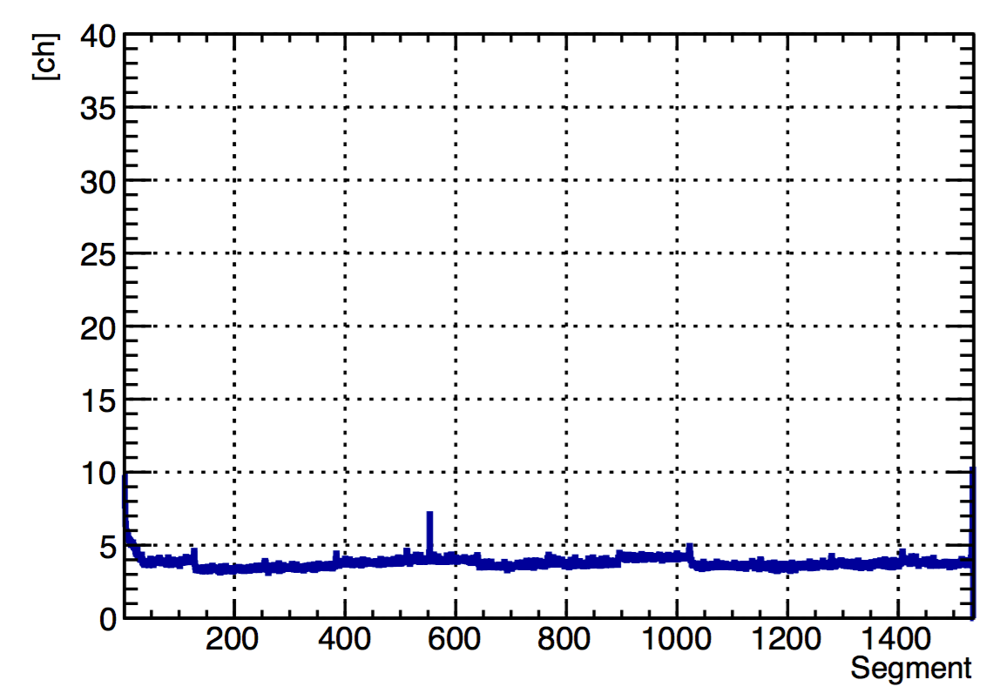
Statistics
Before
After
Run | Emulsion stack | Ξ⁻ candidates | Ξ⁻ stop (calculated from simulation)
2016 | 18 | 21500 | 1075
2017 | 100 | 147000 | 8025
RMS of Pedestal
RMS of Pedestal
total : 9100
Improvement for 2017 Run
- SSD optimization
    noise was reduced
    DAQ efficiency : 83% → 90%
- target position optimization
    Ξ⁻ stop rate : 20% increase
~10⁴ Ξ⁻ stop will be achieved

Slide 23
Beam time request for 2017 Run
Start up
  timing check
  beam tuning
  interval to set collimator
  beam check
  calibration
    beam through
    CH2
Emulsion exposure (100 stacks)
  2016 Run (1 stack)
    cassette exchange : 0.5h
    pattern match : 0.5h
    exposure : 6h
    total : 7h
  reduce time : 7h → 6h
    beam intensity : 310k → 350k
    reduce SSD calibration time
  6h x 100 stacks = 600h (25days)
1 day
1~2 days
1 day
25 days
(29 days in the last PAC)
total : 27 days

Slide 24
Summary

Slide 25
backup

Slide 26
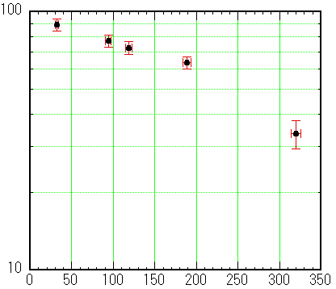
Emulsion damage
by Compton electrons
At the 21st PAC meeting [Jan., 2016]
Not work for Automated tracking
(for beam pattern match)
limit : ~250[/10⁶μm³]
Beam detection efficiency [%]
Forced fading of latent image
(named Refresh)
・erase tracks of Compton electron
70
50
30
?
2016
Jun.
2017
Mar.
By Mar. 2017
We will refresh
100 emulsion stacks (1300 sheets).
(1 stacks : thin plate : 2/thick plate : 11)
Not
working
(400 sheets done)
Compton electrons [/10⁶ μm³]

Slide 27
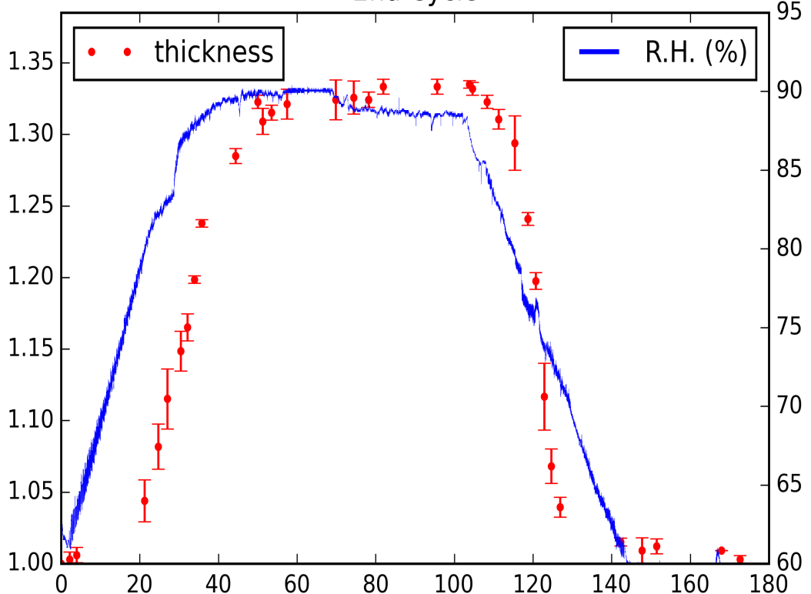
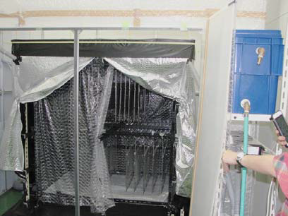
Emulsion damage
by Compton electrons
Relative
Thickness
R.H.(％)
25℃ / 90%(R.H.)
Time（h）
8days/1Cycle/100 plates
・Keeping 4days in humid air 90%(R.H.)
・drying gradually to 60%(R.H.) in 2days

Slide 28
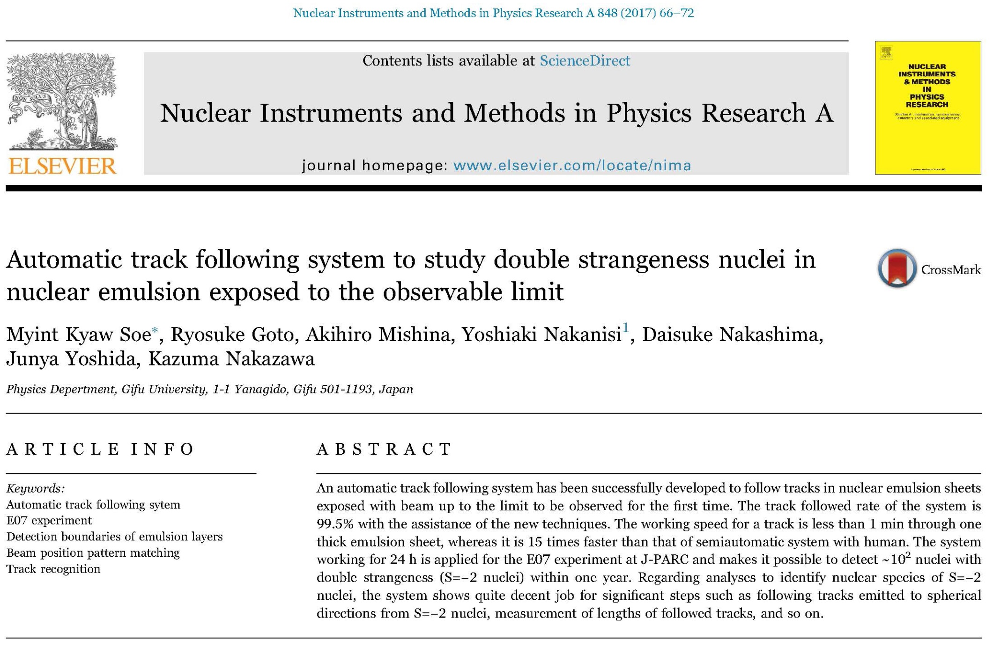
Result of R&D (using E373 Em.) of
“Fully automated tracking”

Slide 29
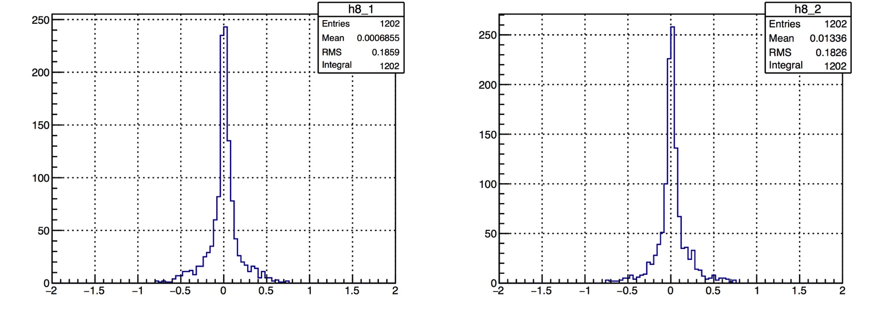
Ξ⁻ kinematics in CH₂ target run
dx/dz residual between
Ξ⁻ track and missing momentum
dy/dz residual between
Ξ⁻ track and missing momentum

Slide 30
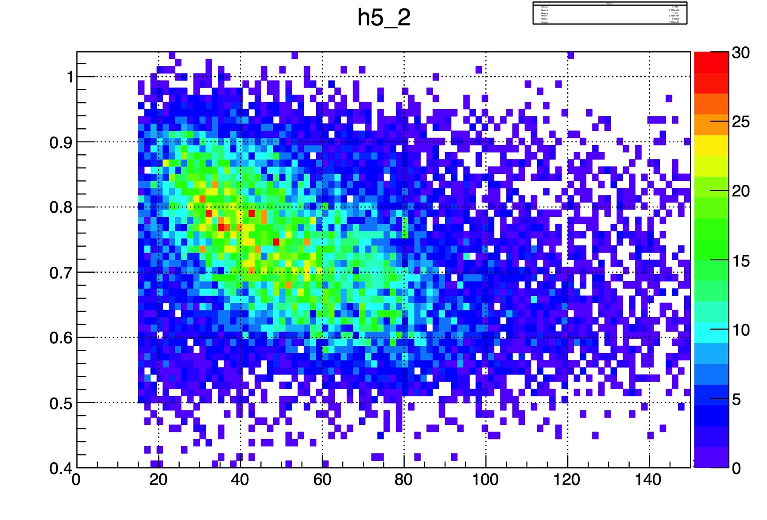
Ξ⁻ dE vs missing momentum
Missing momentum [GeV/c]
Ξ⁻ dE (SSD)
Correlation can be seen.

