Slide 1
Analysis Note JLab E12-17-003
Graduate School of Science, Kyoto University
Toshiyuki Gogami
Mar 24, 2021

Slide 2
Contents
A few comments
Missing mass resolution
Angle resolution
Simulation data + matrix tuner for real data
How good is the matrices after tuning with only Λ and Σ?
Fake peak study

Slide 3
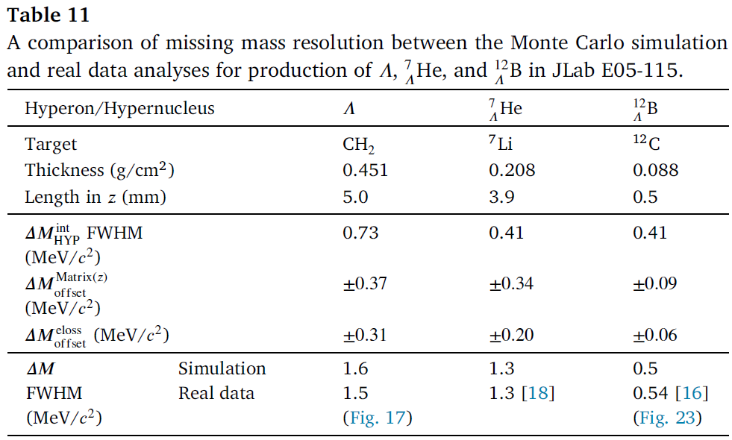
Comment (mass resolution in E05-115)
https://doi.org/10.1016/j.nima.2018.05.042
The simple estimation (intrinsic resolution) was not enough to reproduce mass resolutions in E05-115 as well as those in E01-011.
c.f.) Missing mass resolution report for E12-17-003 (Apr 21, 2020):
https://www-nh.scphys.kyoto-u.ac.jp/~gogami/e12-17-003/meeting/analysis/src/nnL_AnalysisNote_20200421_gogami.pdf

Slide 4
Geant4 simulation for the MM resolution estimation
Transfer matrix
$x,x^{′},y,y^{′}$ @FP
INPUT: Position/angle resolutions
Resolution estimation
(L and R)
Q
$\vec{p}$@Target
$$M_{HYP}$$
Result will be shown by K.N. Suzuki
D
Q
Q
Geant4 simulation
with materials (target, air etc.)

Slide 5
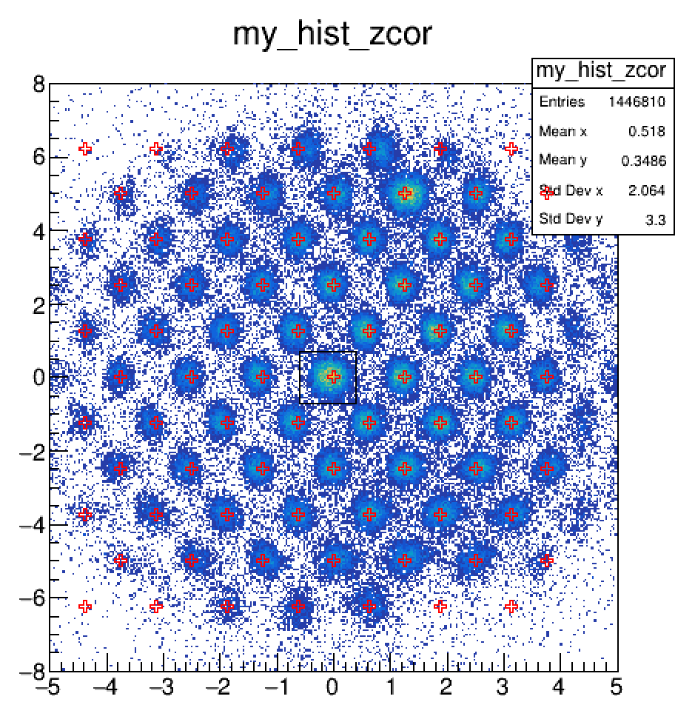
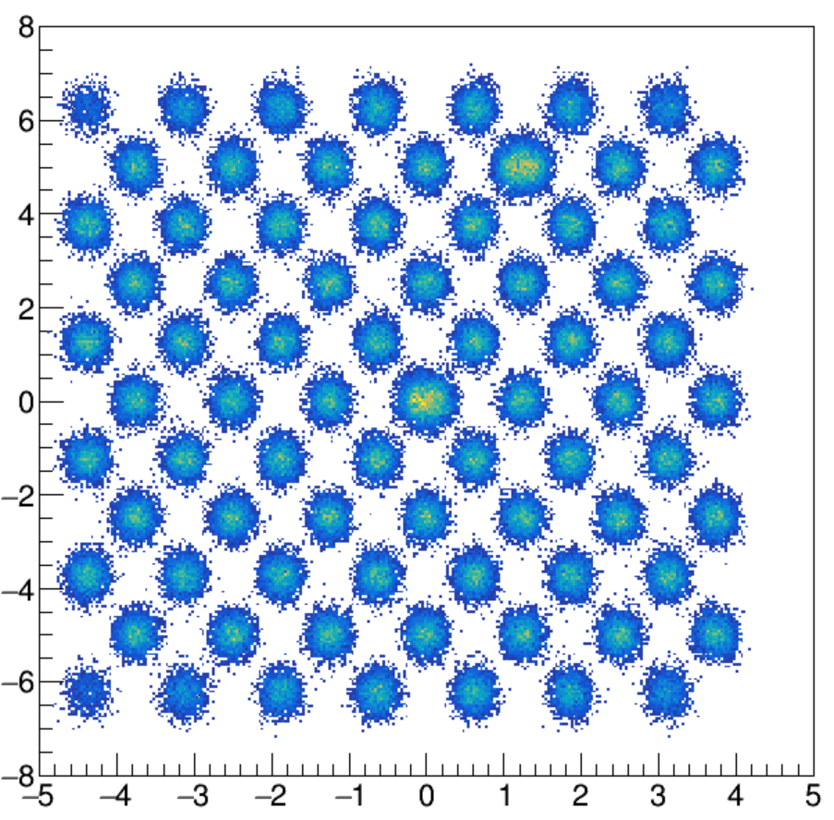
The angle resolution (SS + Multifoil)
Multifoil Target
https://www-nh.scphys.kyoto-u.ac.jp/~gogami/e12-17-003/meeting/analysis/src/nnL_AnalysisNote_20200501_gogami.pdf
$x$ (cm)
 | Resolution σ (/)
Target | Multi foil | T2 + Cigar cell
$$\frac{x}{X_{0}}$$ | $$2×{10}^{−3}$$ | $$20×{10}^{−3}$$
Estimation | Simple MC | Geant4 MC
$$Δx′$$ | $$2.2×{10}^{−3}$$ | $$2.5{×10}^{−3}$$
$$Δy′$$ | $$0.8{×10}^{−3}$$ | $$1.2{×10}^{−3}$$
$Δθ_{e^{′}}$ (rad) | $$1.6×{10}^{−3}$$ | $$1.7×{10}^{−3}$$
DATA
The least squares method
$y$ (cm)
SIMULATION
$$Δx^{′}=2.2×{10}^{−3}$$
$$Δy^{′}=8.0×{10}^{−4}$$
Note: $\tan^{2}{θ}={\left(x^{′}\right)}^{2} +{\left(y^{′}\right)}^{2}$
(sigma)
Details will be talked by K.N. Suzuki

Slide 6
Validity check of our matrix tuning
Physics god knows
Comparison
Real data
Matrix tuning
MM
Simulation data
MM
Physics we define
Comparison
Matrix Tuning with
Simulation Data (MTSD)

Slide 7
Conditions of the first trial (MTSD)
Matrices (momentum for LHRS and RHRS)
Prepared based on the Geant4 optics (with some distortion manipulation)
Up to 5th order for x, x’, y, y’ @FP
Up to 2nd order for zt @FP (others were set to zero)
252 → 232 parameters for each spectrometer
Angle and $z_{t}$ resolution
Randomly deteriorated based on realistic resolutions
Events used for the matrix tuning
Λ(H-kine): 3000
Σ(H-kine): 1500
Λ(T-kine): 1500
3/22—23 (two loops were done)
Tuning parameters
Not optimized at all (event selection, step size, weight etc.)

Slide 8
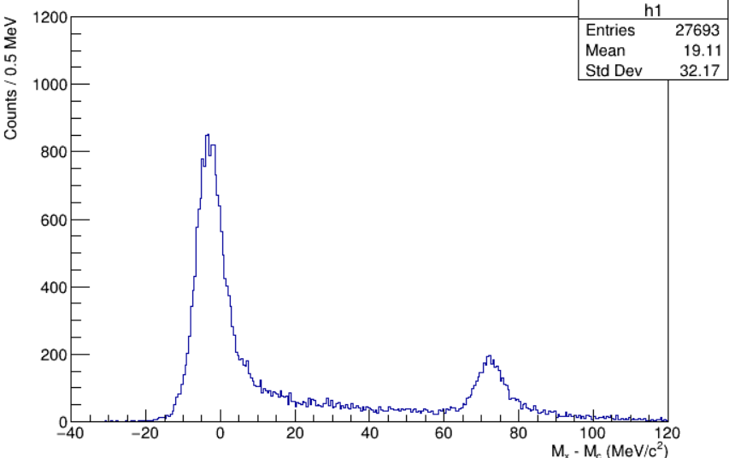
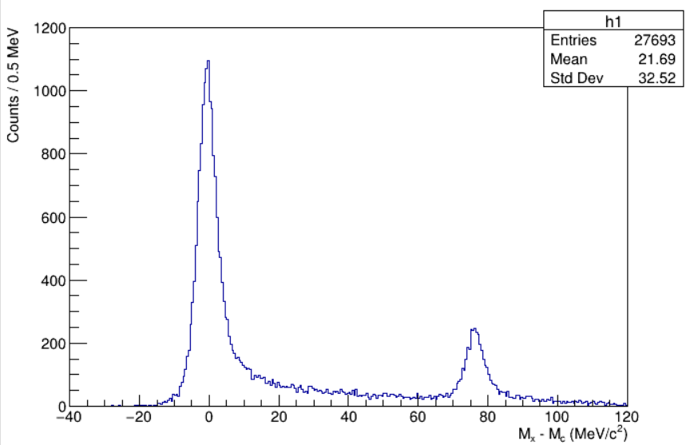
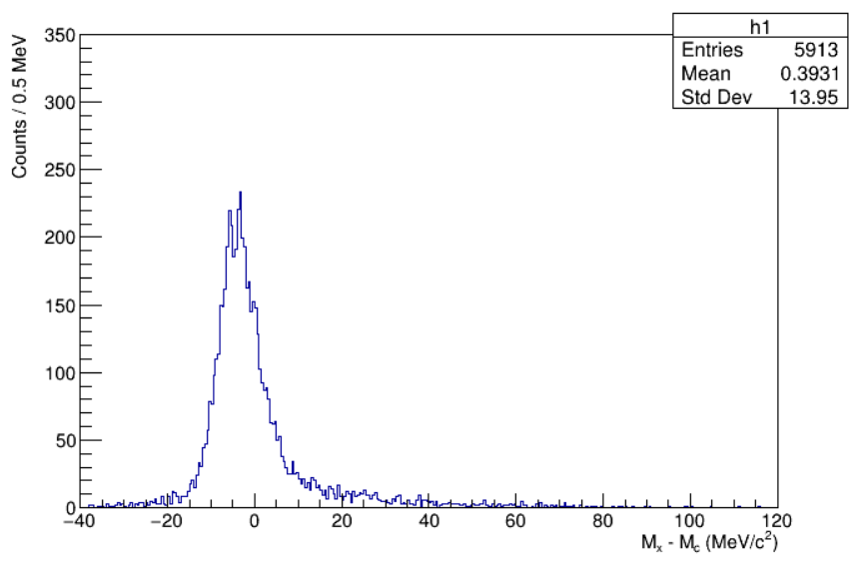
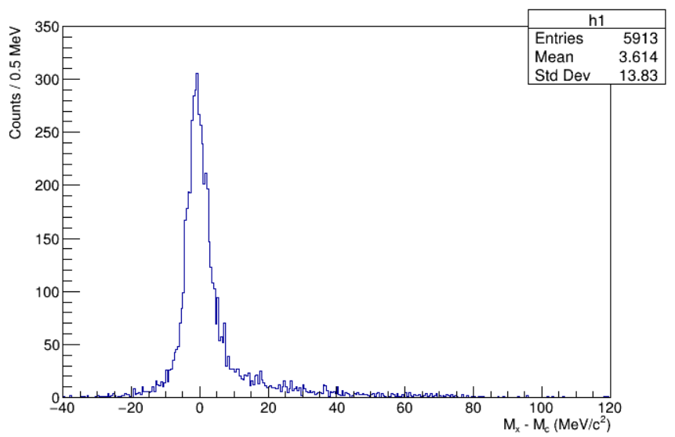
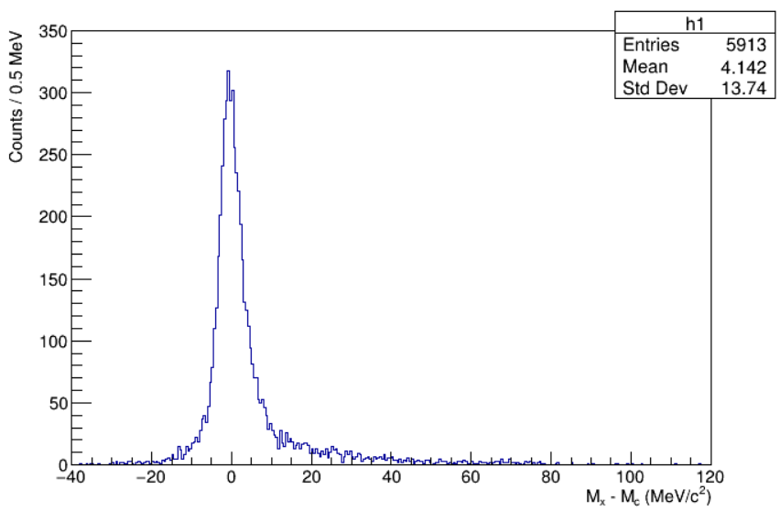
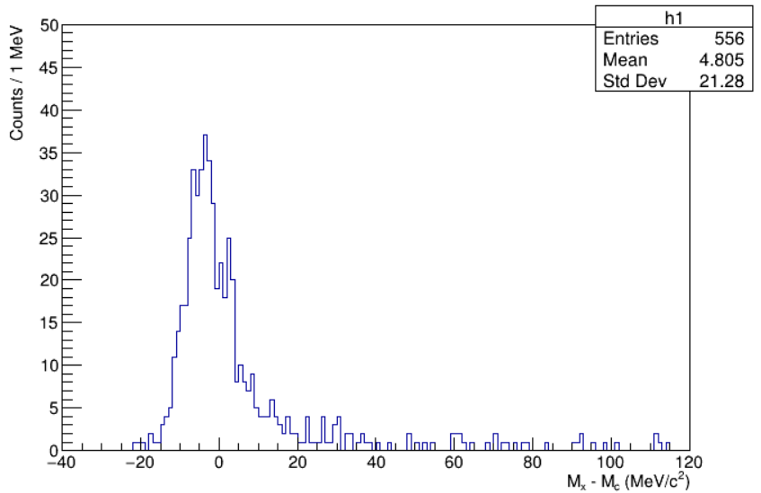
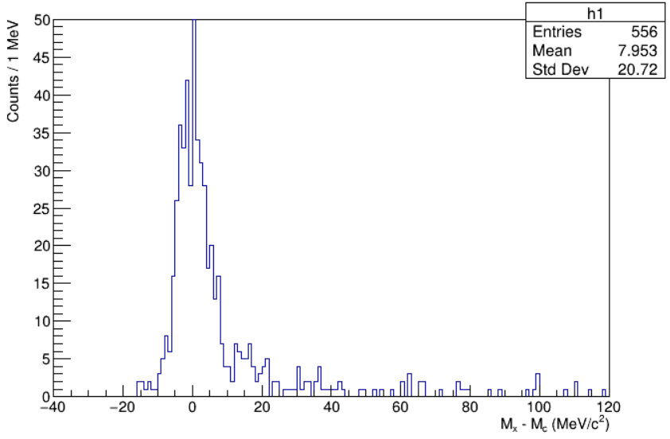
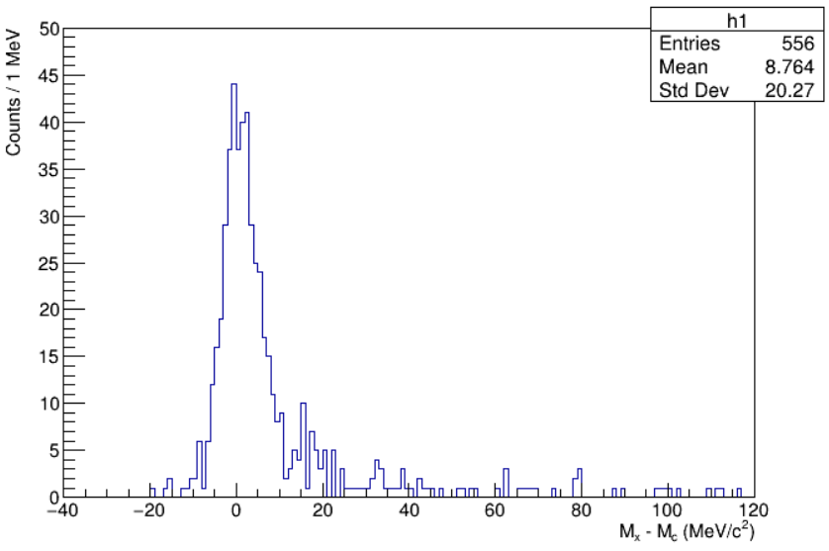
Matrix tuning by using only $Λ$ (H), $Σ^{0}$ (H), and $Λ$ (T)
$Λ, Σ^{0}$ (H)
$Λ, Σ^{0}$ (H)
$Λ, Σ^{0}$ (H)
$Λ$ (T)
$Λ$ (T)
$Λ$ (T)
$nnΛ$ (T)
$nnΛ$ (T)
$nnΛ$ (T)
Initial matrices
Tune Loop 1
Tune Loop 2

Slide 9
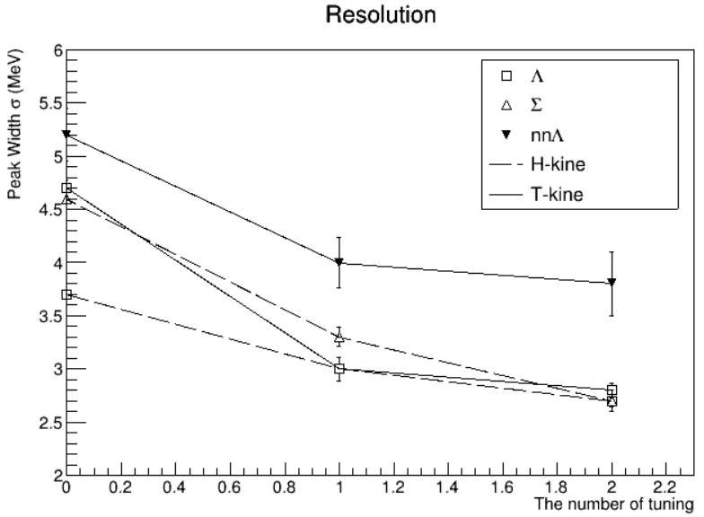
Result of the first trial (MTSD)
$ΔM$ (MeV)
Resolution (MeV)
The number of tuning loop
The number of tuning loop
Tuning with Λ (H-kine), Σ (H-kine), Λ (T-kine)
No issues for A = 3 were found so far
(not high precision yet though)
$nnΛ$ follows the $Λ$ and $Σ^{0}$

Slide 10
Backup

Slide 11
Documents in the past
Angle resolution (Summary of Suzuki’s study):
https://www-nh.scphys.kyoto-u.ac.jp/~gogami/e12-17-003/meeting/analysis/src/nnL_AnalysisNote_20200501_gogami.pdf
Missing mass resolution (Fake peak study by Itabashi is found in the last part):
https://www-nh.scphys.kyoto-u.ac.jp/~gogami/e12-17-003/meeting/analysis/src/nnL_AnalysisNote_20200421_gogami.pdf
Comments on the missing mass resolution：
https://www-nh.scphys.kyoto-u.ac.jp/~gogami/e12-17-003/meeting/analysis/src/JLabMeeting_20200424_gogami.pdf
How to treat angle resolution for the intrinsic resolution estimation (here, the worse resolution for angle is used compared to the recent values)：
https://www-nh.scphys.kyoto-u.ac.jp/~gogami/e12-17-003/meeting/analysis/src/JLabMeeting_20200416_gogami.pdf
The expected resolution, the number of events, items to be reexamined (p. 31, 32)
https://www-nh.scphys.kyoto-u.ac.jp/~gogami/e12-17-003/meeting/analysis/src/JLabMeeting_20200313_gogami.pdf

