Slide 1

Hypernuclear Experiment at Hall C
Kyoto University
Toshiyuki Gogami
June 22, 2021

Slide 2
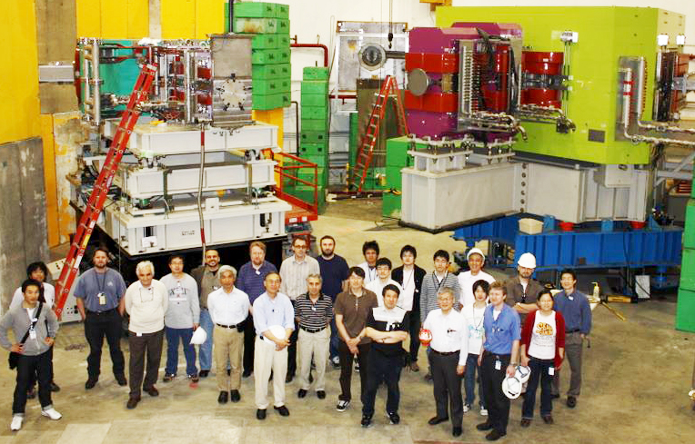
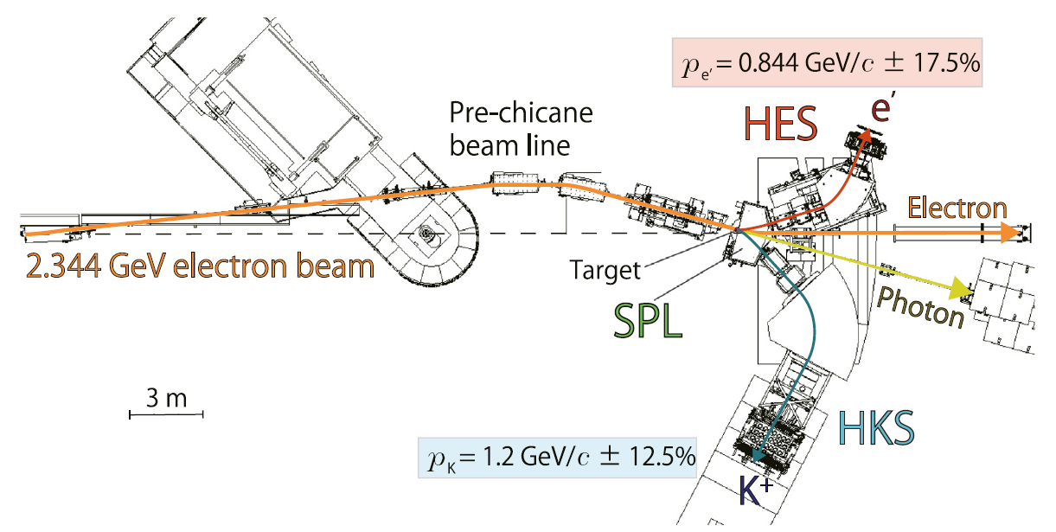
SPL+HES+HKS (E05-115) at Hall C
TG et al., PRC 103, L041301 (2021).
TG et al., NIMA 900, 69—83 (2018).
TG et al., PRC 94, 021302(R) (2016).
TG et al., PRC 93, 034314 (2016).
Y. Fujii et al., NIMA 795, 351—363 (2015).
L. Tang et al., PRC 90, 034320 (2014).
TG et al., NIMA 729, 816—824 (2013).

Slide 3
Issue to solve in HKS
Ref.) TG et al., NIMA 900, 69—83 (2018)
e⁺/e⁻ backgrounds generated at HKS-D exit
  High accidental coincidence rate
    Beam intensity was limited particularly for a large Z target
    S/N was bad in resulting spectra
Possible solutions:
Introduction of septum magnet
Changing to a lighter material for the lower momentum side of the HKS-D vacuum extension (or VE → He bag)
Changing to the vertical bending
  ← The need of massive modification (Base for HKS magnets, frames for detectors etc.)

Slide 4
To use gas targets
Reaction-position information would need to be measured by a vertical bending magnet at least because a point production cannot be assumed for a long z target.
  Previous configuration of HES-HKS is not suitable
  SHMS for e’ ?

Slide 5
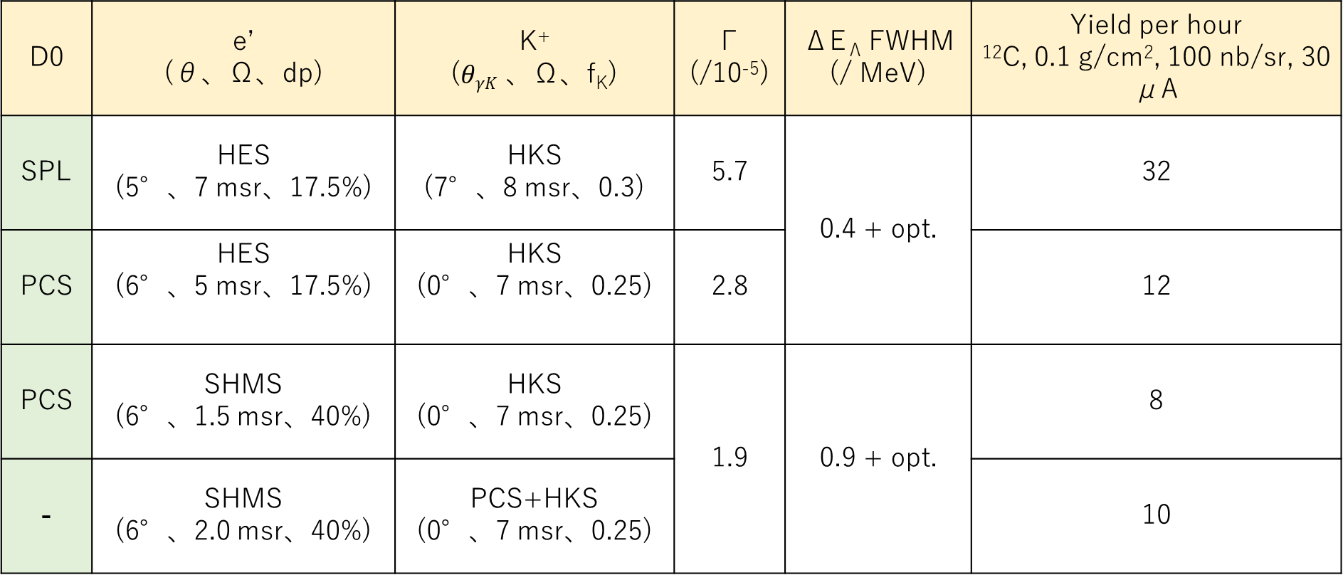
Summary table (yield and resolution)
D0 | e’ (θ、Ω、dp) | K⁺ ($θγK$ 、Ω、f_{K}) | Γ (/10⁻⁵) | ΔE_{Λ} FWHM (/ MeV) | Yield per hour ¹²C, 0.1 g/cm², 100 nb/sr, 30 μA
SPL | HES (5°、7 msr、17.5%) | HKS (7°、8 msr、0.3) | 5.7 | 0.4 + opt. | 32
PCS | HES (6°、5 msr、17.5%) | HKS (0°、7 msr、0.25) | 2.8 |  | 12
PCS | SHMS (6°、1.5 msr、40%) | HKS (0°、7 msr、0.25) | 1.9 | 0.9 + opt. | 8
- | SHMS (6°、2.0 msr、40%) | PCS+HKS (0°、7 msr、0.25) |  |  | 10
e: 2.344 GeV, e’: 0.844 GeV/c, K+: 1.2 GeV/c
Efficiency = 0.7
Scale for e’ solid angle = 0.75428571

Slide 6
Yield per day @ 20μA
 | ³He 5 nb/sr | ¹²C 100 nb/sr | ⁴⁰Ca 10 nb/sr | ²⁰⁸Pb 10 nb/sr
SPL+HES+HKS | 102 | 512 | 153 | 3
PCS+HES+HKS | 38 | 192 | 57 | 1.1
PCS+HRS+HKS | 25 | 128 | 38 | 0.8

Slide 7
Summary
HES+HKS
  The best option
  HKS needs to be modified (VE modification / VE → He bag)
  To the vertical bending for long z target
  w/ PCS → S/N (could be)↑、yield ↓
PCS+SHMS+HKS (VE modification)
  Might be similar quality of data to that of the Hall A experiment

Slide 8
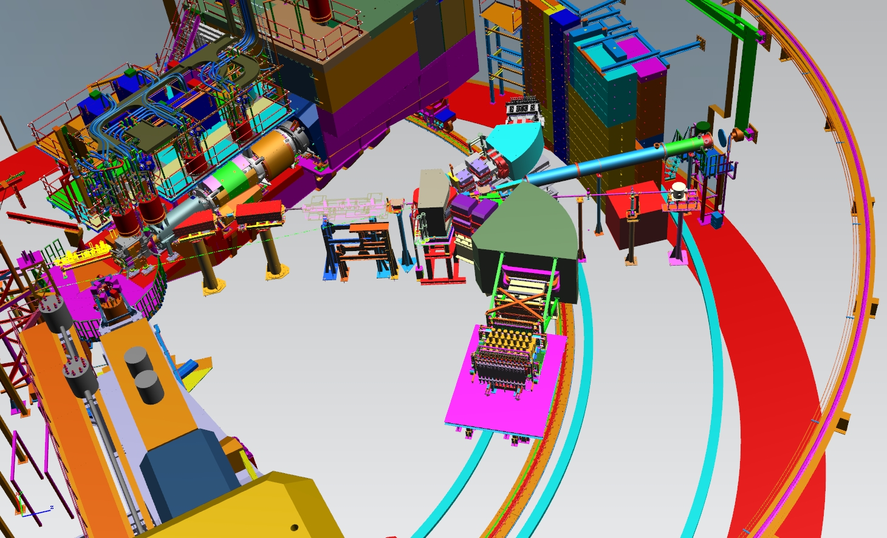

Slide 9
