Slide 1
Tohoku-Kyoto Meeting JLab hypernuclear experiment
Kyoto University
Toshiyuki Gogami
July 28, 2021

Slide 2
Done (7/1～)
Hall C futures task force meeting (Jul 1)
https://hallcweb.jlab.org/wiki/index.php/Hall_C_Futures
Japan-US meeting
7/9, 7/23(, 8/6)
Core member meetings
nnL analysis: 7/13, 7/27
Strategy: 7/27(, 8/5)
JLab Hall A/C Collaboration Meeting (Jul 8—9)
https://indico.jlab.org/event/451/
A = 3, 4 hypernuclei → 5:00 a.m. on July 10 JST
JLab PAC 49 (Jul 19—23)
https://www.jlab.org/physics/PAC
E12-19-002 → Approval with a rate of A

Slide 3
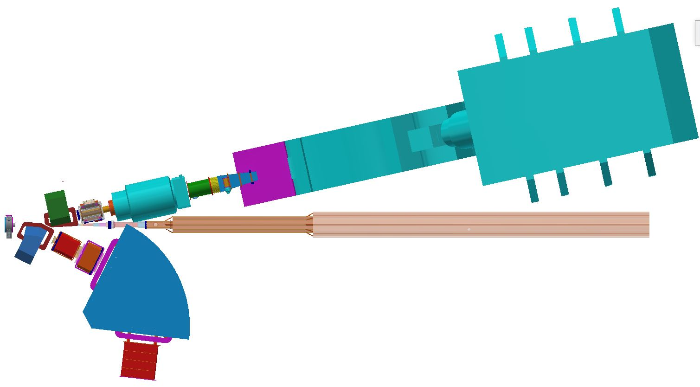
Experimental Setup
Experimental Setup at JLab Hall A
HRS (QQDQ)
2.7 GeV/c e’
New
Magnets
e⁻
(4.2 GeV)
$${}_{}^{3,4}{He}$$
$${}_{}^{40,48}{Ca}$$
$${}_{}^{208}{Pb}$$
HKS (QQD)
1.2 GeV/c K⁺
$$e$$
$$e^{′}$$
$$K^{+}$$
$$γ^{∗}$$
$${}_{}^{3}{He}$$
$${}_{Λ}^{3}H$$

Slide 4
Possibility in Hall C
$$e’$$
SHMS
K⁺
Evaluations are in progress
HKS
SHMS + HKS
Vertical HES + vertical HKS
…
$$e$$
Thank you for the drawings + discussions → Bert, Paul, Steve

Slide 5
HKS
HES
SPL/
PCS

Slide 6
Questions
Can HES (HKS) be vertical in terms of structural stability ?
Communication with JLab staff
Can we achieve the goal physics in Hall C?
Simulation study (SIMC, Geant4)
Resolution, yield, S/N

Slide 7
Yield per day (Hall C) @ 20μA
Areal density of target = 100 mg/cm²
Configuration | ΔE_{Λ} (# of events needed for $ΔB_{Λ}^{stat.}=20$ keV) | ${}_{}^{3}{He}$ → ${}_{Λ}^{3}H$ 5 nb/sr | ${}_{}^{12}C$ → ${}_{Λ}^{12}B$ 100 nb/sr | ${}_{}^{40}{Ca}$ → ${}_{Λ}^{40}K$ 10 nb/sr | ${}_{}^{208}{Pb}$ → ${}_{Λ}^{208}{Tl}$ 10 nb/sr
SPL+(HES+HKS) | 0.5 (113) | 109 (1 day) | 547 | 16 (7 days) | 3.2 (35 days)
PCS+(HES+HKS) |  | 40 (3 days) | 203 | 6.1 (19 days) | 1.2 (94 days)
SHMS+(PCS+HKS) | 1.0 (451) | 37 (12 days) | 186 | 5.6 (81 days) | 1.1 (410 days)
Not only yield and resolution, but also S/N needs to be studied
← S/N would be reasonable if the HKS-vacuum extension is modified
In case of $ΔB_{Λ}^{stat.}=50$ keV:
0.5 MeV FWHM → 18 counts
1.0 MeV FWHM → 72 counts

Slide 8
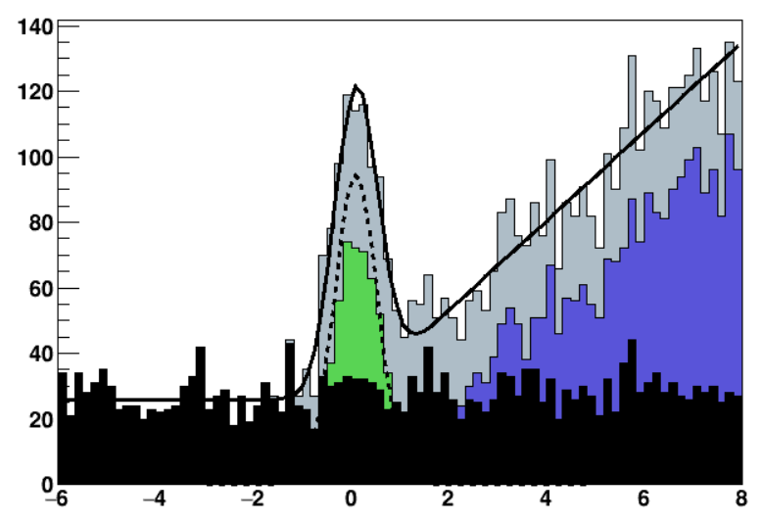
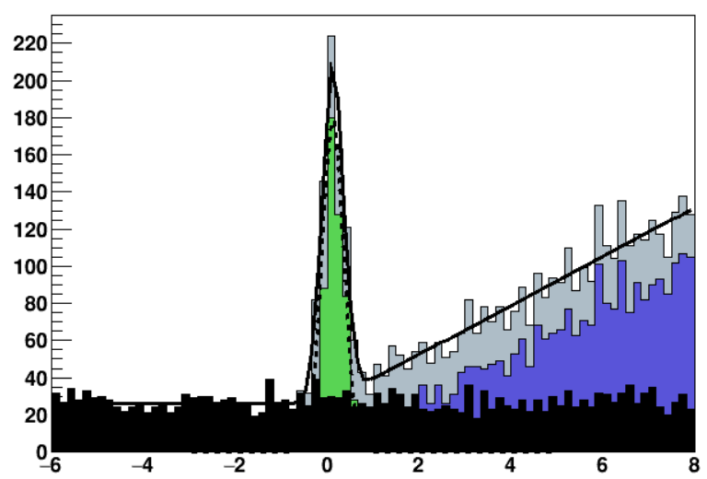
S/N について
HES-HKS で行って、HKSに e+e- がないとしHall A と同等のハドロンレート。
HES 計数率 = 2.5 MHz @8uA, 52Cr からスケールして (HES-HKS@20uA) →
2.2 (³He) MHz
3.6 (⁴⁰Ca) MHz
55.7 (²⁰⁸Pb) MHz
50 uA
S/N: HES-HKS @Hall C, 20 uA
HRS-HKS @Hall A
1.1 MeV FWHM
0.5 MeV FWHM
1.1 MeV FWHM
Stat. err. = 20 keV
Stat. err. < 30 keV
Stat. err. < 20 keV

Slide 9
Hall C possibility
Feasibility (崩れないか、置けるか)
Data quality (分解能、収量、S/N → 誤差 vs. 物理)
Cost (リーズナブルか。誰が払うか)

Slide 10
Target cells (tuna can)
e
K⁺
Gas targets (φ200 mm, height = 50 mm)
e’
Multi carbon targets
Solid targets (E12-15-008, E12-20-013)

Slide 11
Target cells (tuna can)
e
K⁺
Al cell (0.3 mm thick)
Gas (not to be used)
K⁺
Gas (to be used)
e
e’
e’
Available densities calculated by the JLab Target Group
maintaining a compatibility with our experimental setup:
Target | Density [/(g/cm³)] | Temperature [/K] | Pressure [/atm]
$${}_{}^{3}{He}$$ | 9.5 | 12 | 3
$${}_{}^{4}{He}$$ | 13.1
$${{}_{}^{1}H}_{2}$$ | 2.8 | 30

Slide 12
Target
TAC COMMENT 1:
The authors indicate that a new target system design was developed i n collaboration with the JLab
Target Group to accommodate the restricted space at the target pivot and for compatibility with the
E12-15-008 experiment. Some existing cryogenic gas handling systems can be utilized with
modified operating parameters specifi c to this application. It is noted a new ladder and motion
system (which can be similar to that used for PREX) will need to be built. It was not clear the cost
or how much time is needed for these developments. While the authors note a similar effort to that
of PREX/CREX is likely, it would be useful to illustrate further details of the setup (e. anticipated
power load, conceptual drawings, etc.) and required labor.
We gave up the high density targets (roughly 10 times larger density than that proposed this year was assumed last year) because of the space limitation.
To compensate the density reduction, a larger cell is assumed in this proposal;
50 mm → 200 mm for He gas targets (4 times thicker target).
In addition, 2 times longer beamtime is requested for ⁴He.
Manpower and cost
Designer and scientist 6 months working at about 60% to complete the design of the target.
Fabrication of the target will take about 6 months and about $500K in material and fabrication labor.
The installation will be about 6 weeks and require 80% of the target group technical staff, 1 engineer and 2 scientists.
Heat load $≤25$ W (gas + cell)

Slide 13
9/8—11 WEPH、可能でしたら是非ご参加お願いします
(前回： http://physics.daliborskoupil.cz/onlineWS2020/ )
PANIC とかぶっている…

Slide 14
Backup

Slide 15
散乱電子側の計数率の見積もり 制動放射のみ クロムを使った過去のデータより
He: (190/134. * 0.01 + 162/134*0.304) * 2.5 * 20./7.3 = 2.2 MHz
Ca: (100/134. * 0.7) * 2.5 * 20./7.3 = 3.6 MHz
Pb: (100/134. * 10.9) * 2.5 * 20./7.3 = 55.7 MHz

