Slide 1

Hypernuclear Experiment at Hall C
Kyoto University
Toshiyuki Gogami
July 1, 2021

Slide 2
Possibility of hypernuclear experiments at Hall C
SPL + HES + HKS
PCS + HES + HKS
PCS + SHMS + HKS

Slide 3
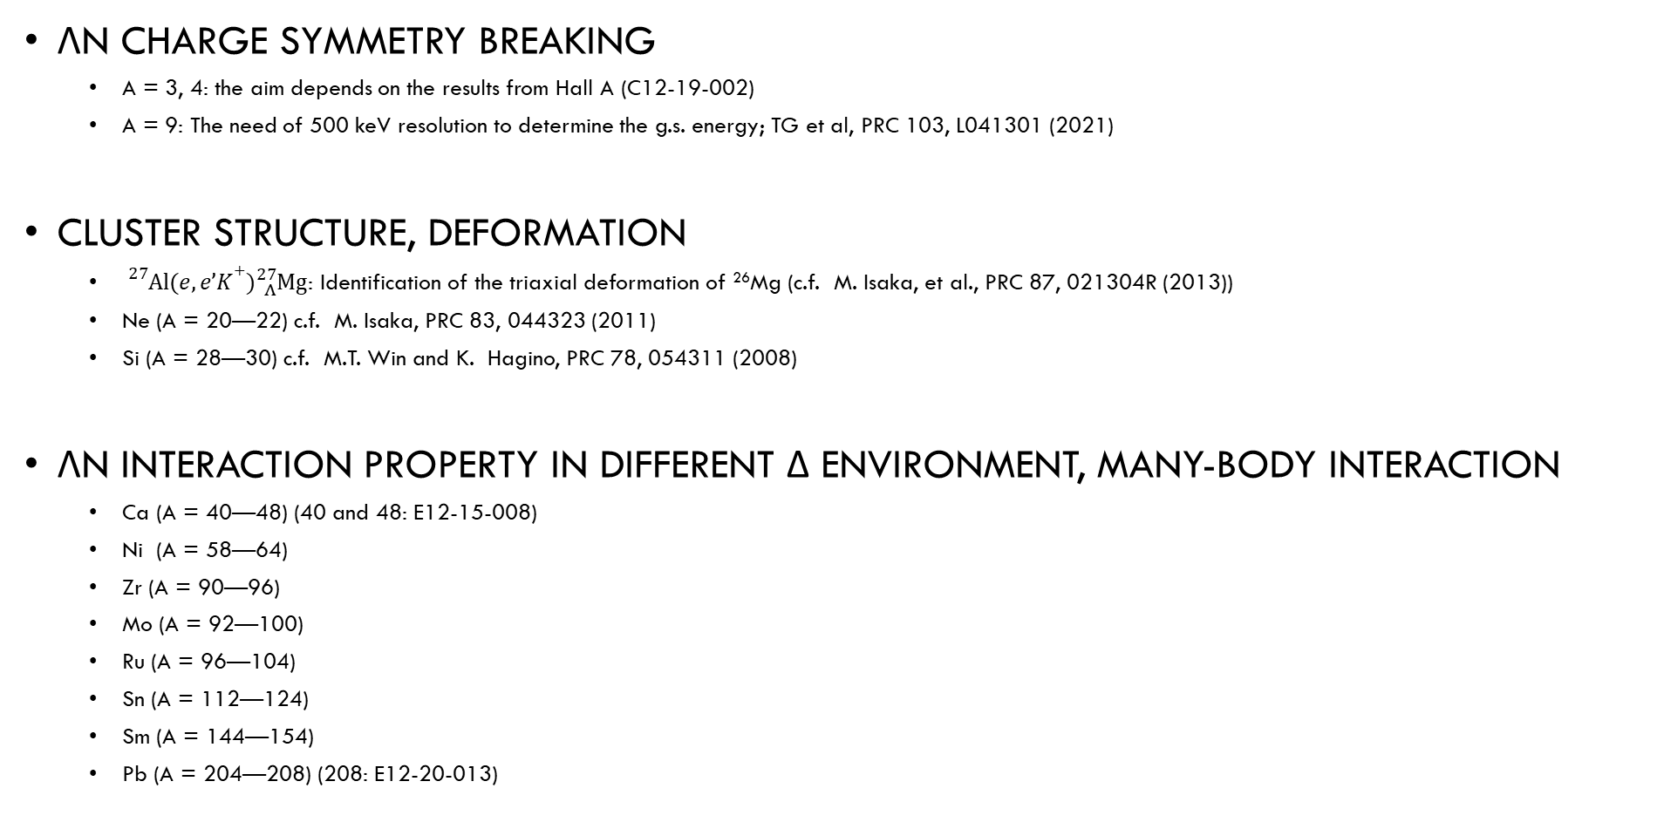
Some of physics motivation
ΛN Charge Symmetry Breaking
  A = 3, 4: the aim depends on the results from Hall A (C12-19-002)
  A = 9: The need of 500 keV resolution to determine the g.s. energy; TG et al, PRC 103, L041301 (2021)
Cluster structure, deformation
  ${}_{}^{27}{Al}(e,e’K+){}_{Λ}^{27}{Mg}$: Identification of the triaxial deformation of ²⁶Mg (c.f. M. Isaka, et al., PRC 87, 021304R (2013))
  Ne (A = 20—22) c.f. M. Isaka, PRC 83, 044323 (2011)
  Si (A = 28—30) c.f. M.T. Win and K. Hagino, PRC 78, 054311 (2008)
ΛN interaction property in different δ environment, many-body interaction
  Ca (A = 40—48) (40 and 48: E12-15-008)
  Ni (A = 58—64)
  Zr (A = 90—96)
  Mo (A = 92—100)
  Ru (A = 96—104)
  Sn (A = 112—124)
  Sm (A = 144—154)
  Pb (A = 204—208) (208: E12-20-013)
No data with sub-MeV resolution
CERN, BNL, KEK, J-PARC: > a few MeV (FWHM)
Future plan at HIHR in J-PARC: sub-MeV
  In a stage of funding proposal submission
  (No beam line / apparatus exist yet)
➔ JLab is a unique facility to realize it

Slide 4

ハイパー核研究 (s クォークを含む原子核)
散乱電子
K⁺
π⁻
γ*
p
強
n
Target
Λ
p
Λ
n
弱
n
電子
ハイパー核
ガンマ線
陽子: uud
中性子: ddu
ラムダ(Λ): uds
電磁
p
n

Slide 5

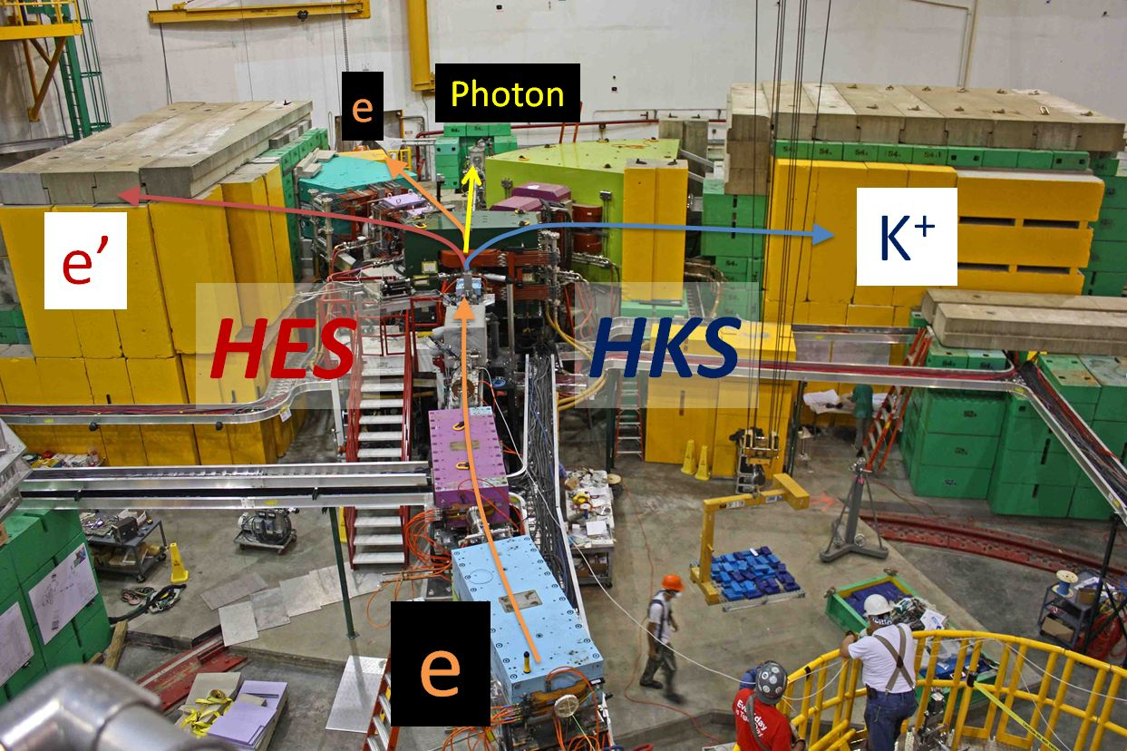
Experimental setup for E05-115 (2009) at JLab Hall C
0.8 GeV/c
1.2 GeV/c
2.3 GeV

Slide 6
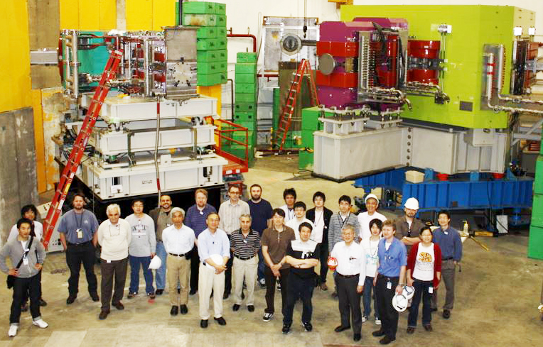
SPL+HES+HKS (E05-115) at Hall C
TG et al., PRC 103, L041301 (2021).
TG et al., NIMA 900, 69—83 (2016)
TG et al., PRC 94, 021302(R) (2016).
TG et al., PRC 93, 034314 (2016).
Y. Fujii et al., NIMA 795, 351—363 (2015).
L. Tang et al., PRC 90, 034320 (2014).
TG et al., NIMA 729, 816—824 (2013).

Slide 7
Issue to solve in HKS
Ref.) TG et al., NIMA 900, 69—83 (2018)
e⁺/e⁻ backgrounds generated at HKS-D exit
  High accidental coincidence rate
    Beam intensity was limited particularly for a large Z target
    S/N was bad in resulting spectra
Possible solutions:
Introduction of septum magnet
Changing to a lighter material for the lower momentum side of the HKS-D vacuum extension (or VE → He bag)
Changing to the vertical bending
  ← The need of massive modification (Base for HKS magnets, frames for detectors etc.)

Slide 8
To use gas targets
Reaction-position information would need to be measured by a vertical bending magnet at least because a point production cannot be assumed for a long z target.
  Previous configuration of HES-HKS is not suitable
  SHMS for e’ ?

Slide 9
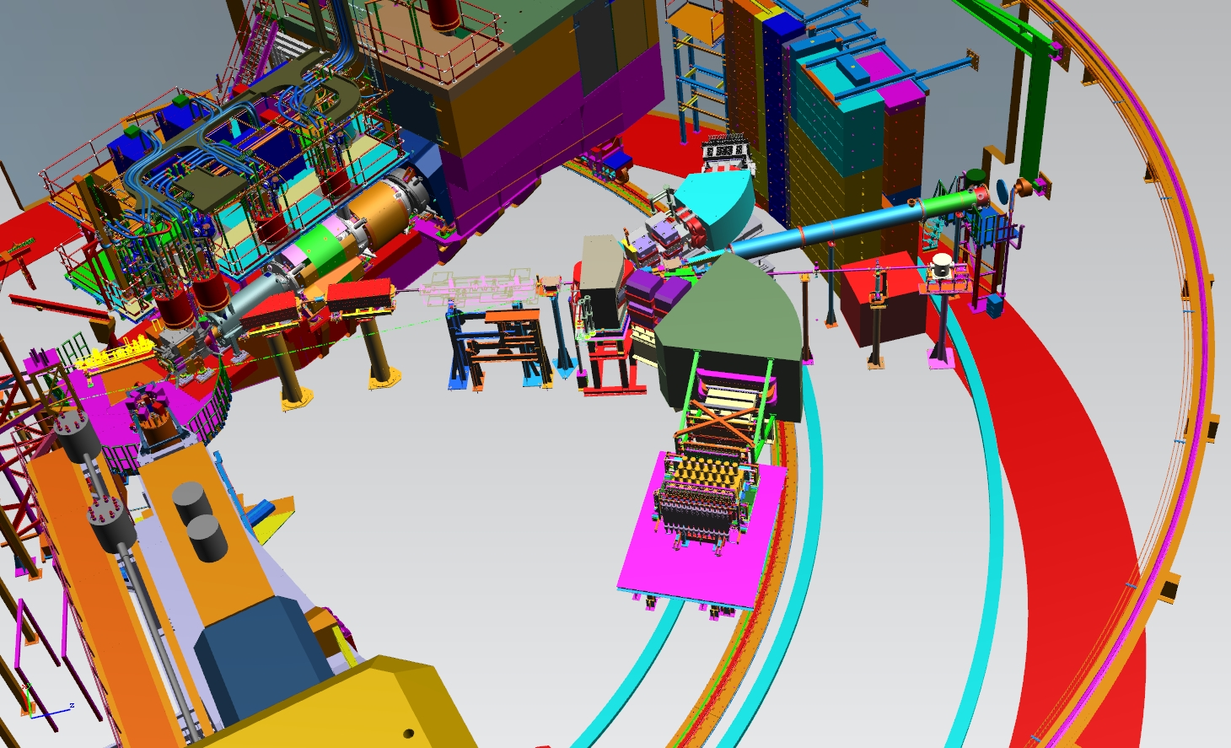

Slide 10
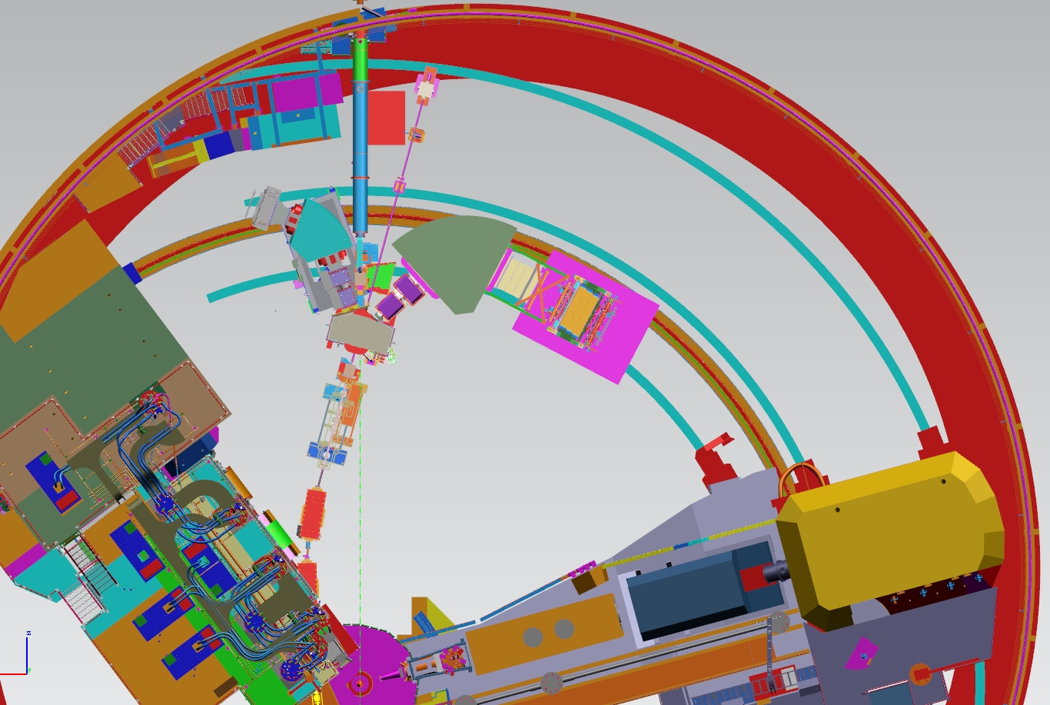

Slide 11
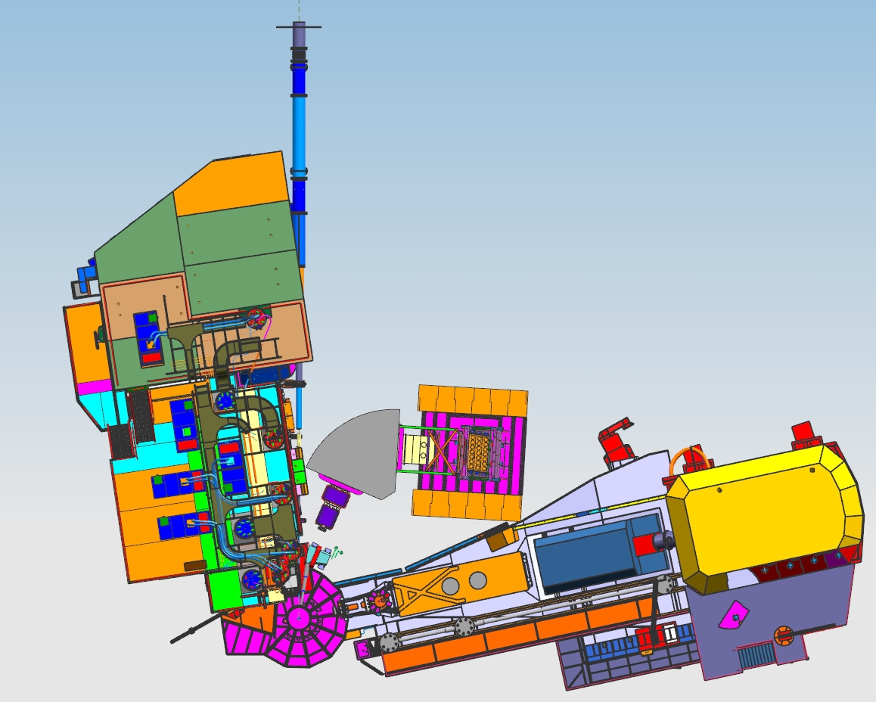

Slide 12


SHMS
5.5 deg
$$e’$$
Pre-chicane
e
HKS
$$K^{+}$$
HMS

Slide 13
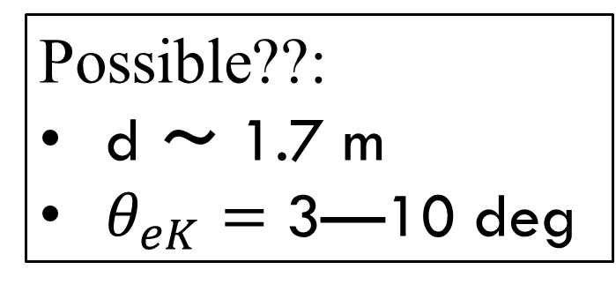
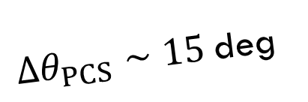

Possible??:
d ～ 1.7 m
$θ_{eK}=$ 3—10 deg
0.844 GeV/c
SHMS
5.5 deg
$$e’$$
d
$θ_{eK}>3$deg
Pre-chicane
${Δθ}_{PCS}∼15$deg
e
Q1
Q2
HKS
$$K^{+}$$
2.344 GeV
1.2 GeV/c
HMS

Slide 14
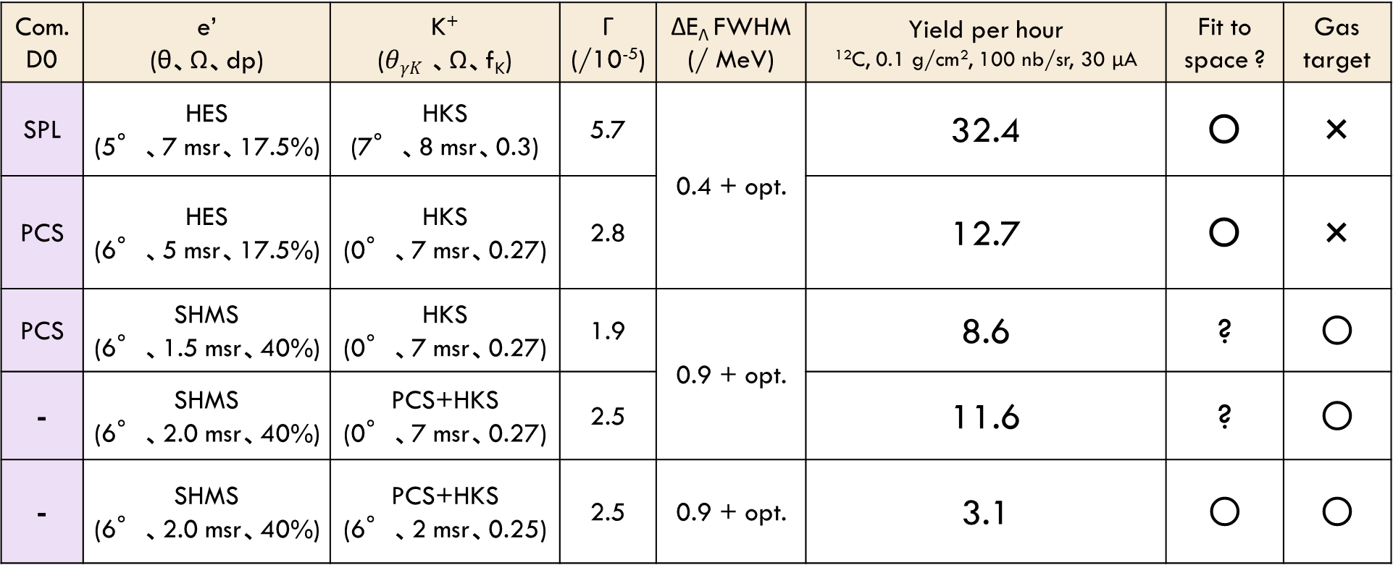
Rough estimations
Com. D0 | e’ (θ、Ω、dp) | K⁺ ($θγK$ 、Ω、f_{K}) | Γ (/10⁻⁵) | ΔE_{Λ} FWHM (/ MeV) | Yield per hour ¹²C, 0.1 g/cm², 100 nb/sr, 30 μA | Fit to space ? | Gas target
SPL | HES (5°、7 msr、17.5%) | HKS (7°、8 msr、0.3) | 5.7 | 0.4 + opt. | 32.4 | 〇 | ×
PCS | HES (6°、5 msr、17.5%) | HKS (0°、7 msr、0.27) | 2.8 |  | 12.7 | 〇 | ×
PCS | SHMS (6°、1.5 msr、40%) | HKS (0°、7 msr、0.27) | 1.9 | 0.9 + opt. | 8.6 | ? | 〇
- | SHMS (6°、2.0 msr、40%) | PCS+HKS (0°、7 msr、0.27) | 2.5 |  | 11.6 | ? | 〇
- | SHMS (6°、2.0 msr、40%) | PCS+HKS (6°、2 msr、0.25) | 2.5 | 0.9 + opt. | 3.1 | 〇 | 〇
e: 2.344 GeV, e’: 0.844 GeV/c, K+: 1.2 GeV/c
Efficiency = 0.7
Scale for e’ solid angle = 0.75428571

Slide 15
Yield per day @ 20μA
 | ³He 5 nb/sr | ¹²C 100 nb/sr | ⁴⁰Ca 10 nb/sr | ²⁰⁸Pb 10 nb/sr
SPL+HES+HKS | 102 | 512 | 153 | 3
PCS+HES+HKS | 38 | 192 | 57 | 1.1
PCS+HRS+HKS | 25 | 128 | 38 | 0.8

Slide 16
Summary
HES+HKS
  The best option
  HKS needs to be modified (VE modification / VE → He bag)
  w/ PCS → S/N (could be)↑、yield ↓
  The need of massive modification to the vertical bending for long z target
PCS+SHMS+HKS
  Might be similar quality of data to that of the Hall A experiment

