Slide 1
Questions
Toshiyuki Gogami
June 30, 2021

Slide 2
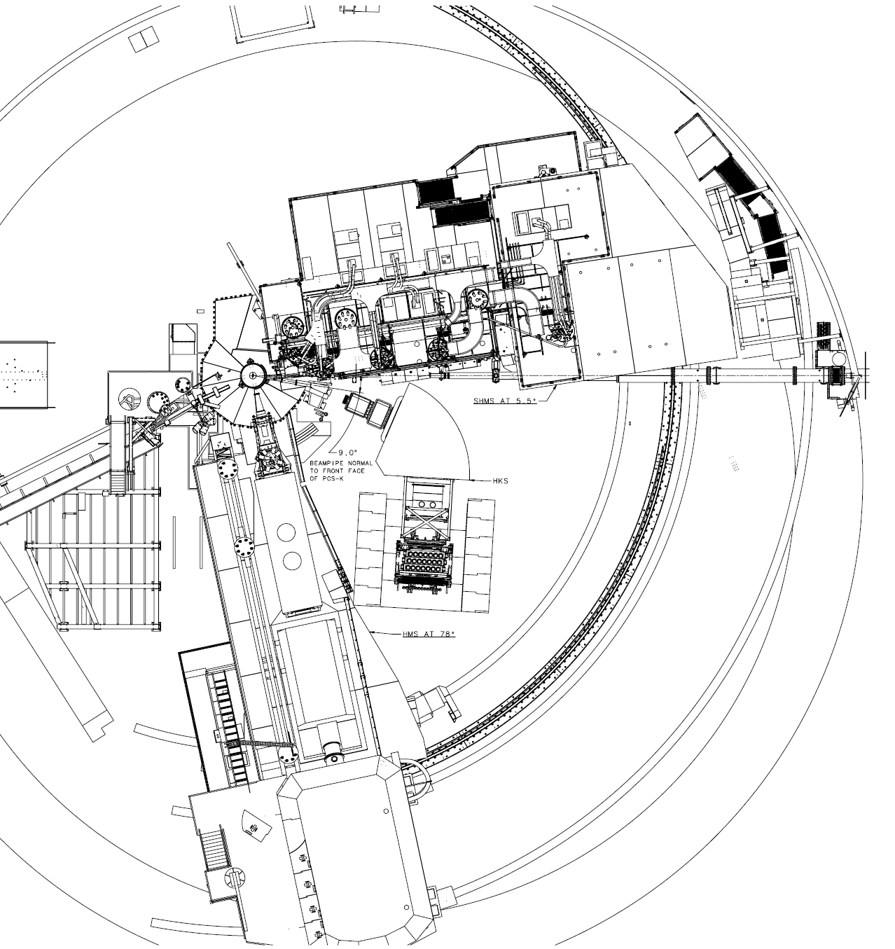
HKS is far from the target…
Yield drastically decreases
(roughly 1/5;
solid angle ¼ , K survival ratio 0.8)
Comparing to the previous HKS experiment

Slide 3

Q1
Pre- and post-chicanes for the beam are feasible?
If yes → Q2 (next page)
SHMS
5.5 deg
$$e’$$
SHMS moves back to make space for HKS
Pre-chicane
e
HKS
$$K^{+}$$
HMS

Slide 4
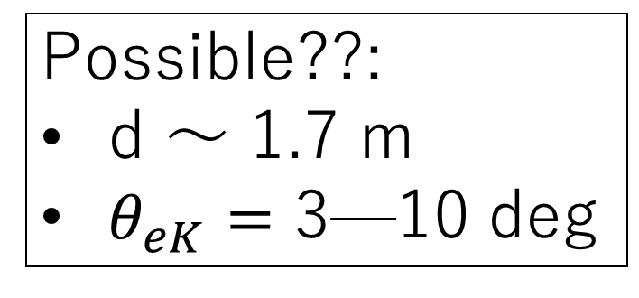
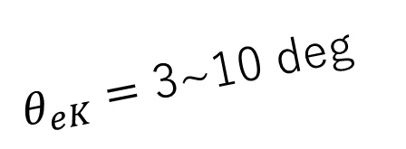
Q2
Possible??:
d ～ 1.7 m
$θ_{eK}=$ 3—10 deg
0.844 GeV/c
SHMS
5.5 deg
$$e’$$
d
$θ_{eK}=$ 3~10 deg
Pre-chicane
${Δθ}_{PCS}∼15$deg
e
Q1
Q2
HKS
$$K^{+}$$
2.344 GeV
1.2 GeV/c
HMS

