Slide 1
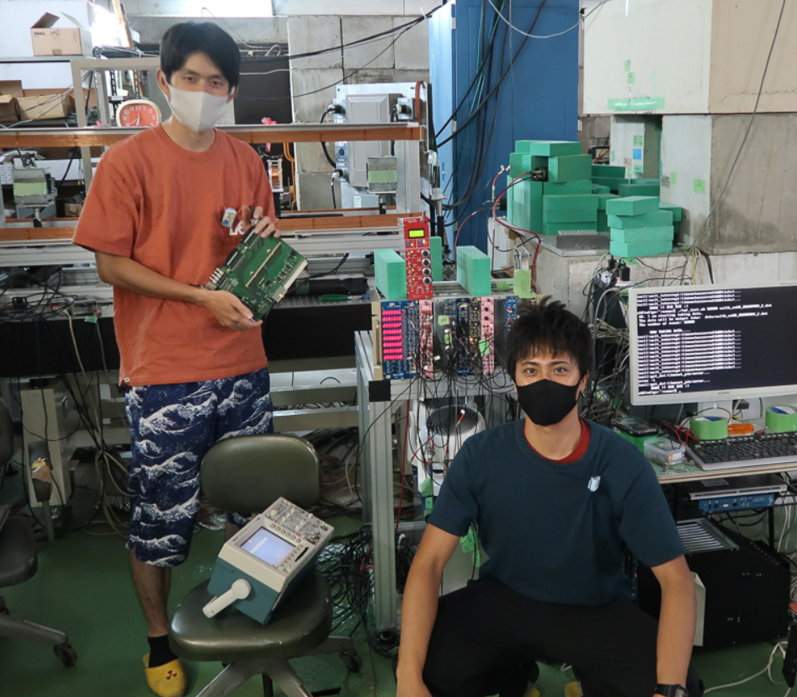
JLab Hall A meeting (Jan 21—22, 2021)
Future hypernuclear experiments with HKS
Graduate School of Science, Kyoto University, Japan
Toshiyuki Gogami
for the JLab Hypernuclear Collaboration
Jan 22, 2021
@KUANS, Kyoto Univ. (2020)

Slide 2
Contents
Introduction
Experiments
C12-19-002 (${}_{Λ}^{3,4}H$): future
E12-17-003 (Λnn)
E12-15-008 (${}_{Λ}^{40,48}K$): future
E12-20-013 (${}_{Λ}^{208}{Tl}$): future
Summary

Slide 3
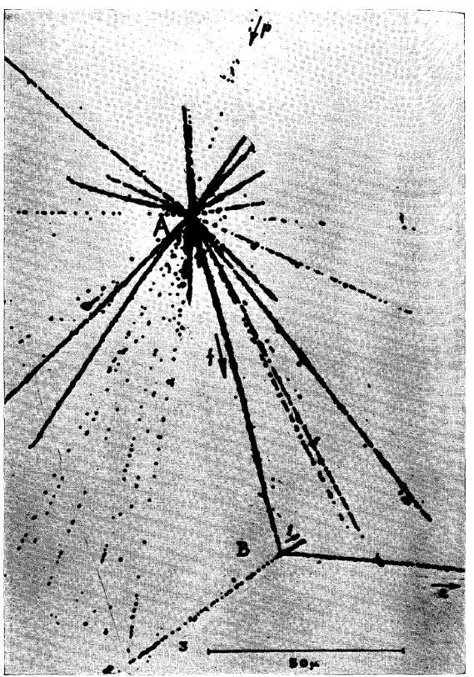
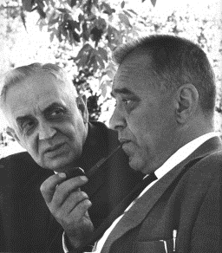
The first hypernuclus
The fist Λ hypernucleus in history
A.K. Wroblewski,
Acta Physica Polonica B 35, 3 (2004).
M. Danysz & J. Pniewski, Phil. Mag. Ser. 7, 44, 14 (1953).

Slide 4
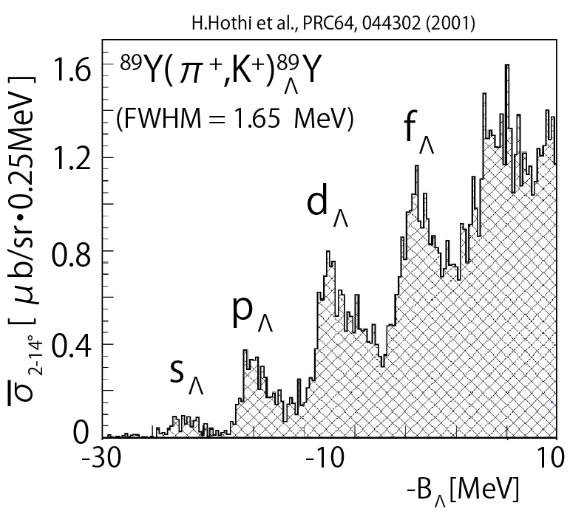
What we can study?
YN / YY Interaction：Strong forces with different flavor from u and d
Prove to investigate deep in nucleus：No Pauli Blocking from N
Impurity effect：Deformation, Shrinkage

Slide 5
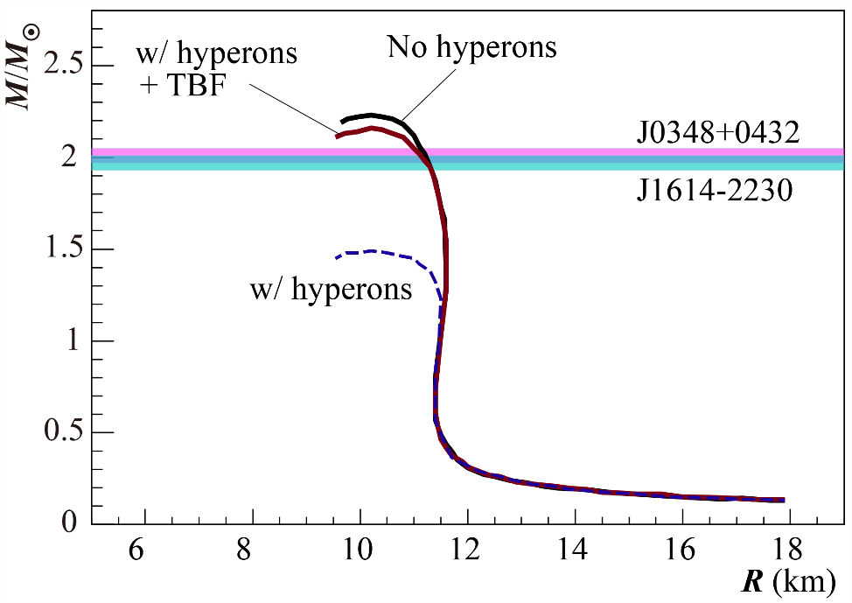
Role of strangeness in high-density hadronic matters
Hyperon appearance → Softening of EOS
The EOS cannot hold 2M⦿ (Hyperon puzzle)
YNN three-body force would be a key
H. Togashi et al., Phys. Rev. C 93, 035808 (2016)
Terrestrial experiments
BB interaction with strangeness degree of freedom
Astronomical observation
Binary NS Mergers observed
B. P. Abbott et al., Phys. Rev. Lett. 119, 161101 (2017).

Slide 6
MAMI
CERN
GSI
FAIR
BNL
JLab
KEK
J-PARC

Slide 7
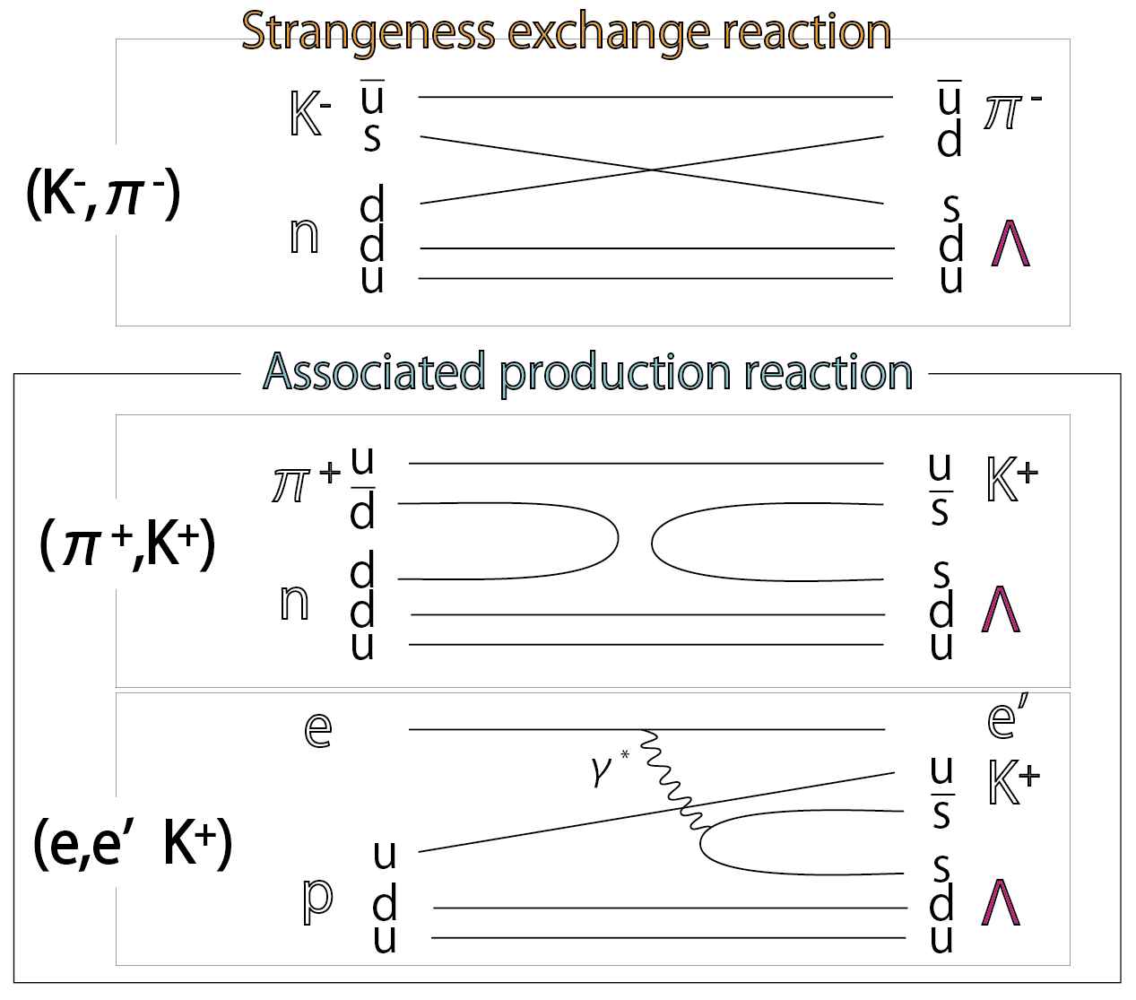
reactions
electron vs. hadron beams

Slide 8
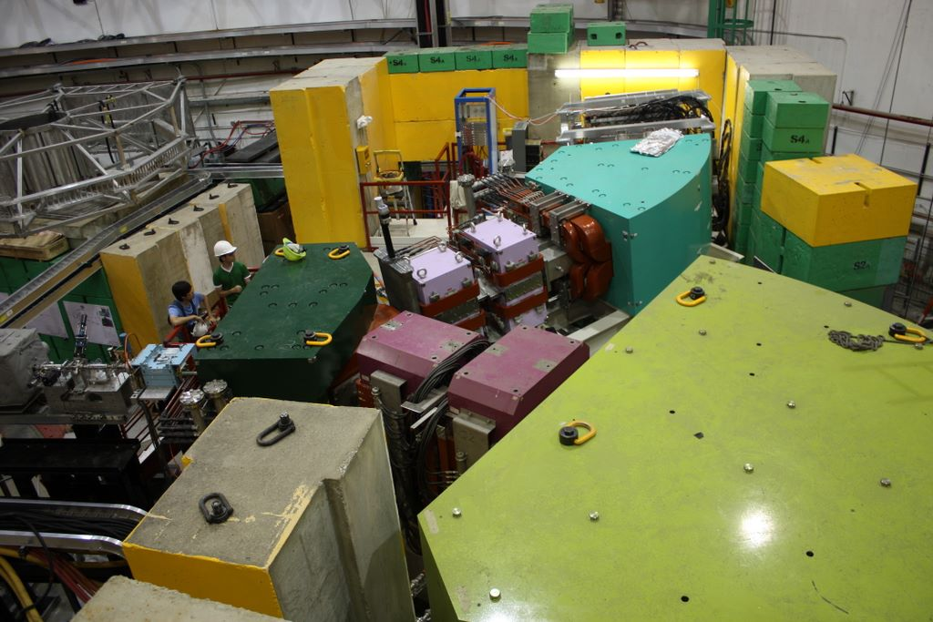
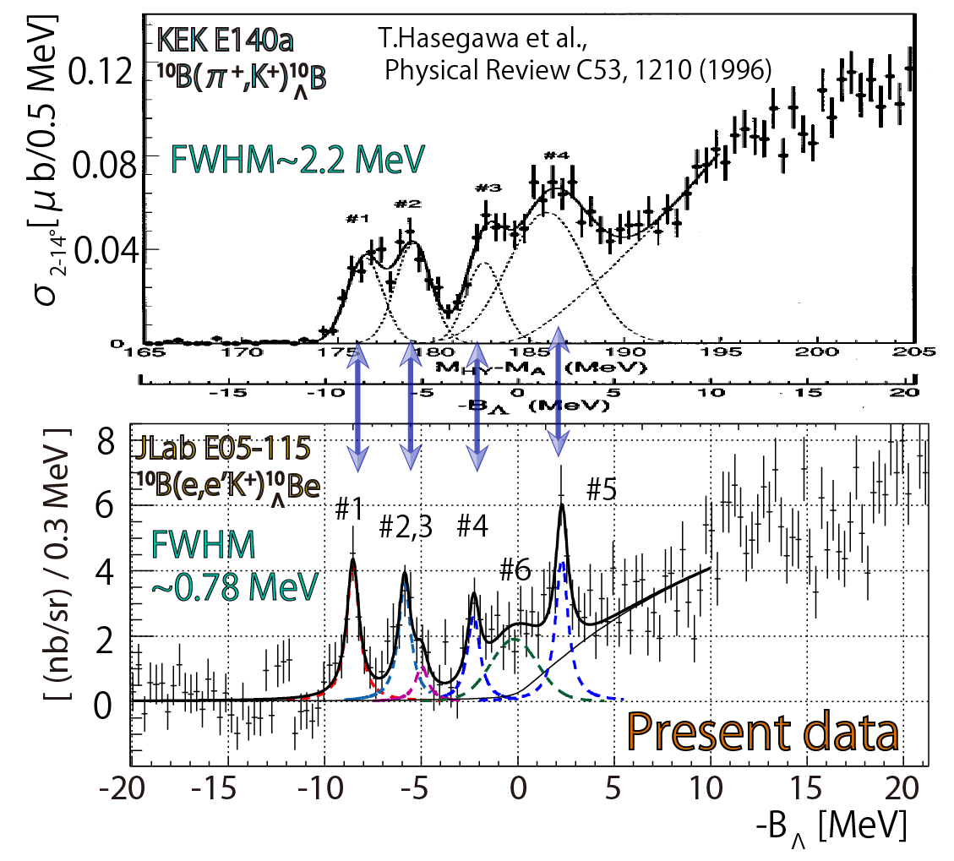
High precision measurement ${}_{Λ}^{10}B$ and ${}_{Λ}^{10}{Be}$
$$e^{′}$$
¹⁰B
_{Λ}
Electron
$$K^{+}$$
$${dσ}/{dΩ}$$
¹⁰Be
_{Λ}
High resolution
High accuracy
RPC 93 (2016) 034314.

Slide 9
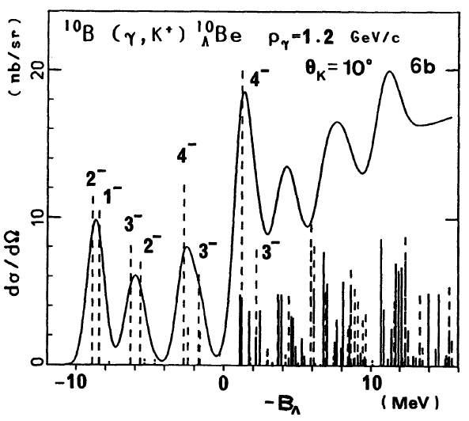
T. Motoba et al.,
PTP 117 (1994)
What’s surplus, a ？
Conventional shell model did not predict the state
It was found that model space needs to be extended (A. Umeya et al., JPS Conf. Proc. 26, 023016 (2019)).
TG et al., PRC 93 (2016) 034314.

Slide 10
Future hypernuclear measurements that I am going to talk
C12-19-002 (${}_{Λ}^{3,4}H$): hypertriton puzzle, CSB issue
E12-15-008 (${}_{Λ}^{40,48}K$): ΛNN isospin interaction
E12-20-013 (${}_{Λ}^{208}{Tl}$): ΛNN 3BF in uniform nuclear medium

Slide 11
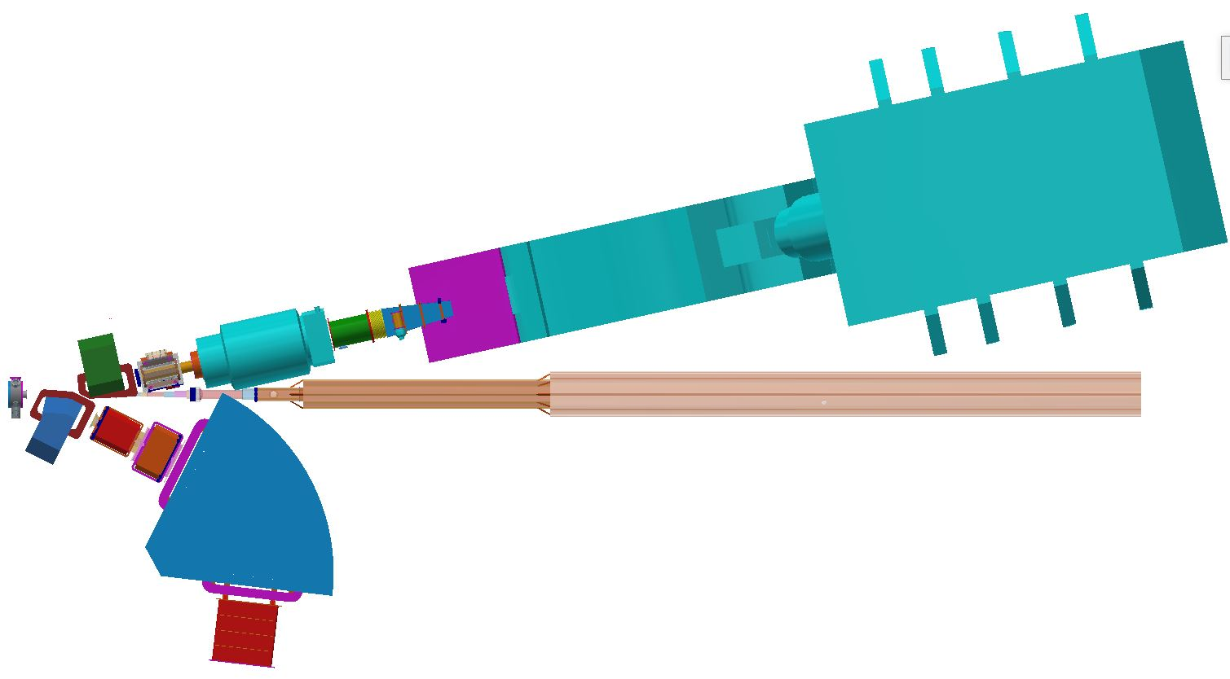
Experimental Setup
Experimental Setup
Particle
Charge
Separator
(PCS)
Q
Detector
Plane
High Resolution Spectrometer (HRS)
D
3.0 GeV/c
e'
D
Q
Q
e⁻ beam
(4.5 GeV, 100 μA)
K⁺
D
Q
3 m
Q
1.2 GeV/c
D
High resolution
Kaon Spectrometer (HKS)
Detector
Plane
Taken from Sho’s slides (Tohoku Univ.)

Slide 12
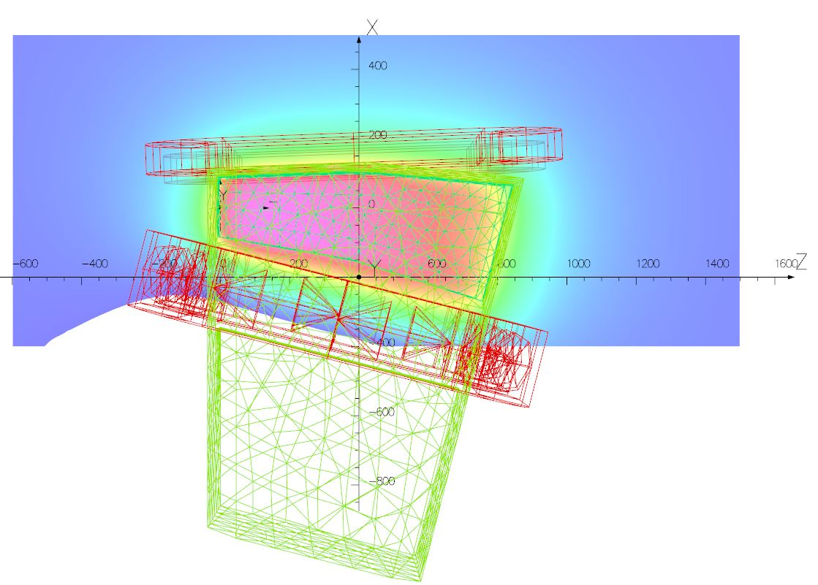
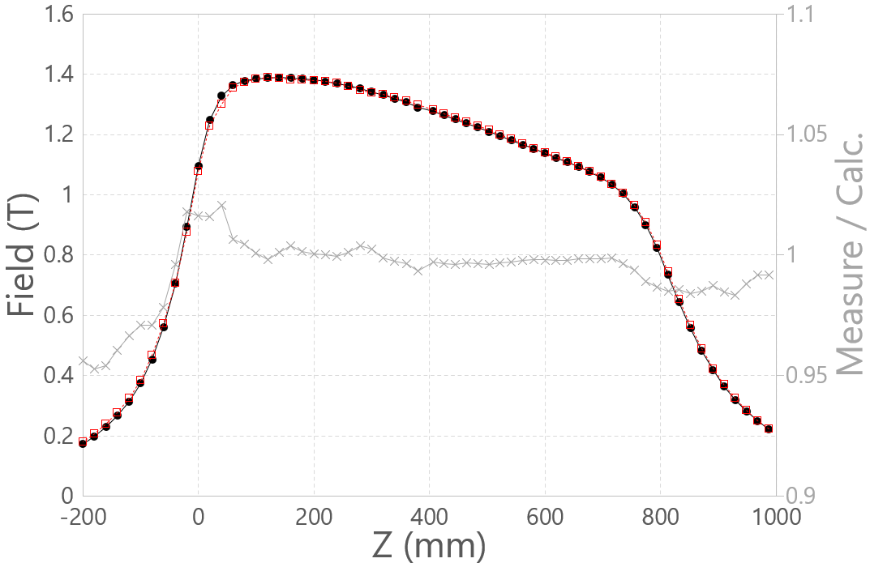
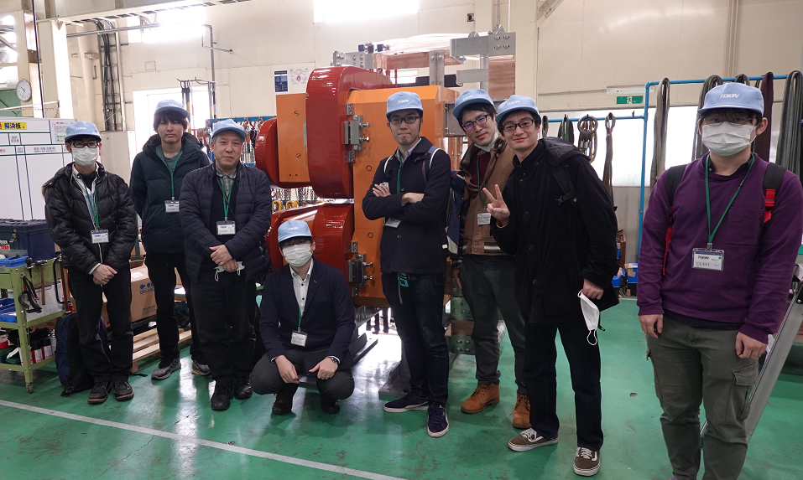
Magnetic field measurement
K⁺
Good agreement (<1%)
Calc.
Measure
Measure / Calc. (right axis)
Entrance Edge
Exit Edge
K⁺
Taken from Sho’s slides (Tohoku Univ.)

Slide 13
C12-19-002 (${}_{Λ}^{3,4}H$)

Slide 14
Hypertriton (${}_{Λ}^{3}H$) puzzle
Small $B_{Λ}$
Short Lifetime
VS.
$$π^{−}$$
Weak Decay
p
10 fm
Λ
n
n
$${}_{}^{3}{He}$$
p
p
$B_{Λ}=0.13±0.05$ MeV (emulsion¹)
$B_{Λ}=0.41±0.12±0.11$ MeV (STAR²)
$$τ=(0.5～0.92) τ_{Λ}$$
(HypHI, STAR, ALICE)
RMS radius, $\sqrt{<r^{2}>} ≅\frac{ℏ}{\sqrt{4μB_{Λ}}}$
Fadeev calcuation with realistic NN/YN interactions
→$τ=0.97 τ_{Λ}$
(H. Kamada et al., Phys. Rev. C 57, 4 (1998))
¹ M. Juric et al., Nucl. Phys. B 52, 1-30 (1973).
² The STAR Collaboration, Nature Physics (2020);
https://doi.org/10.1038/s41567-020-0799-7

Slide 15
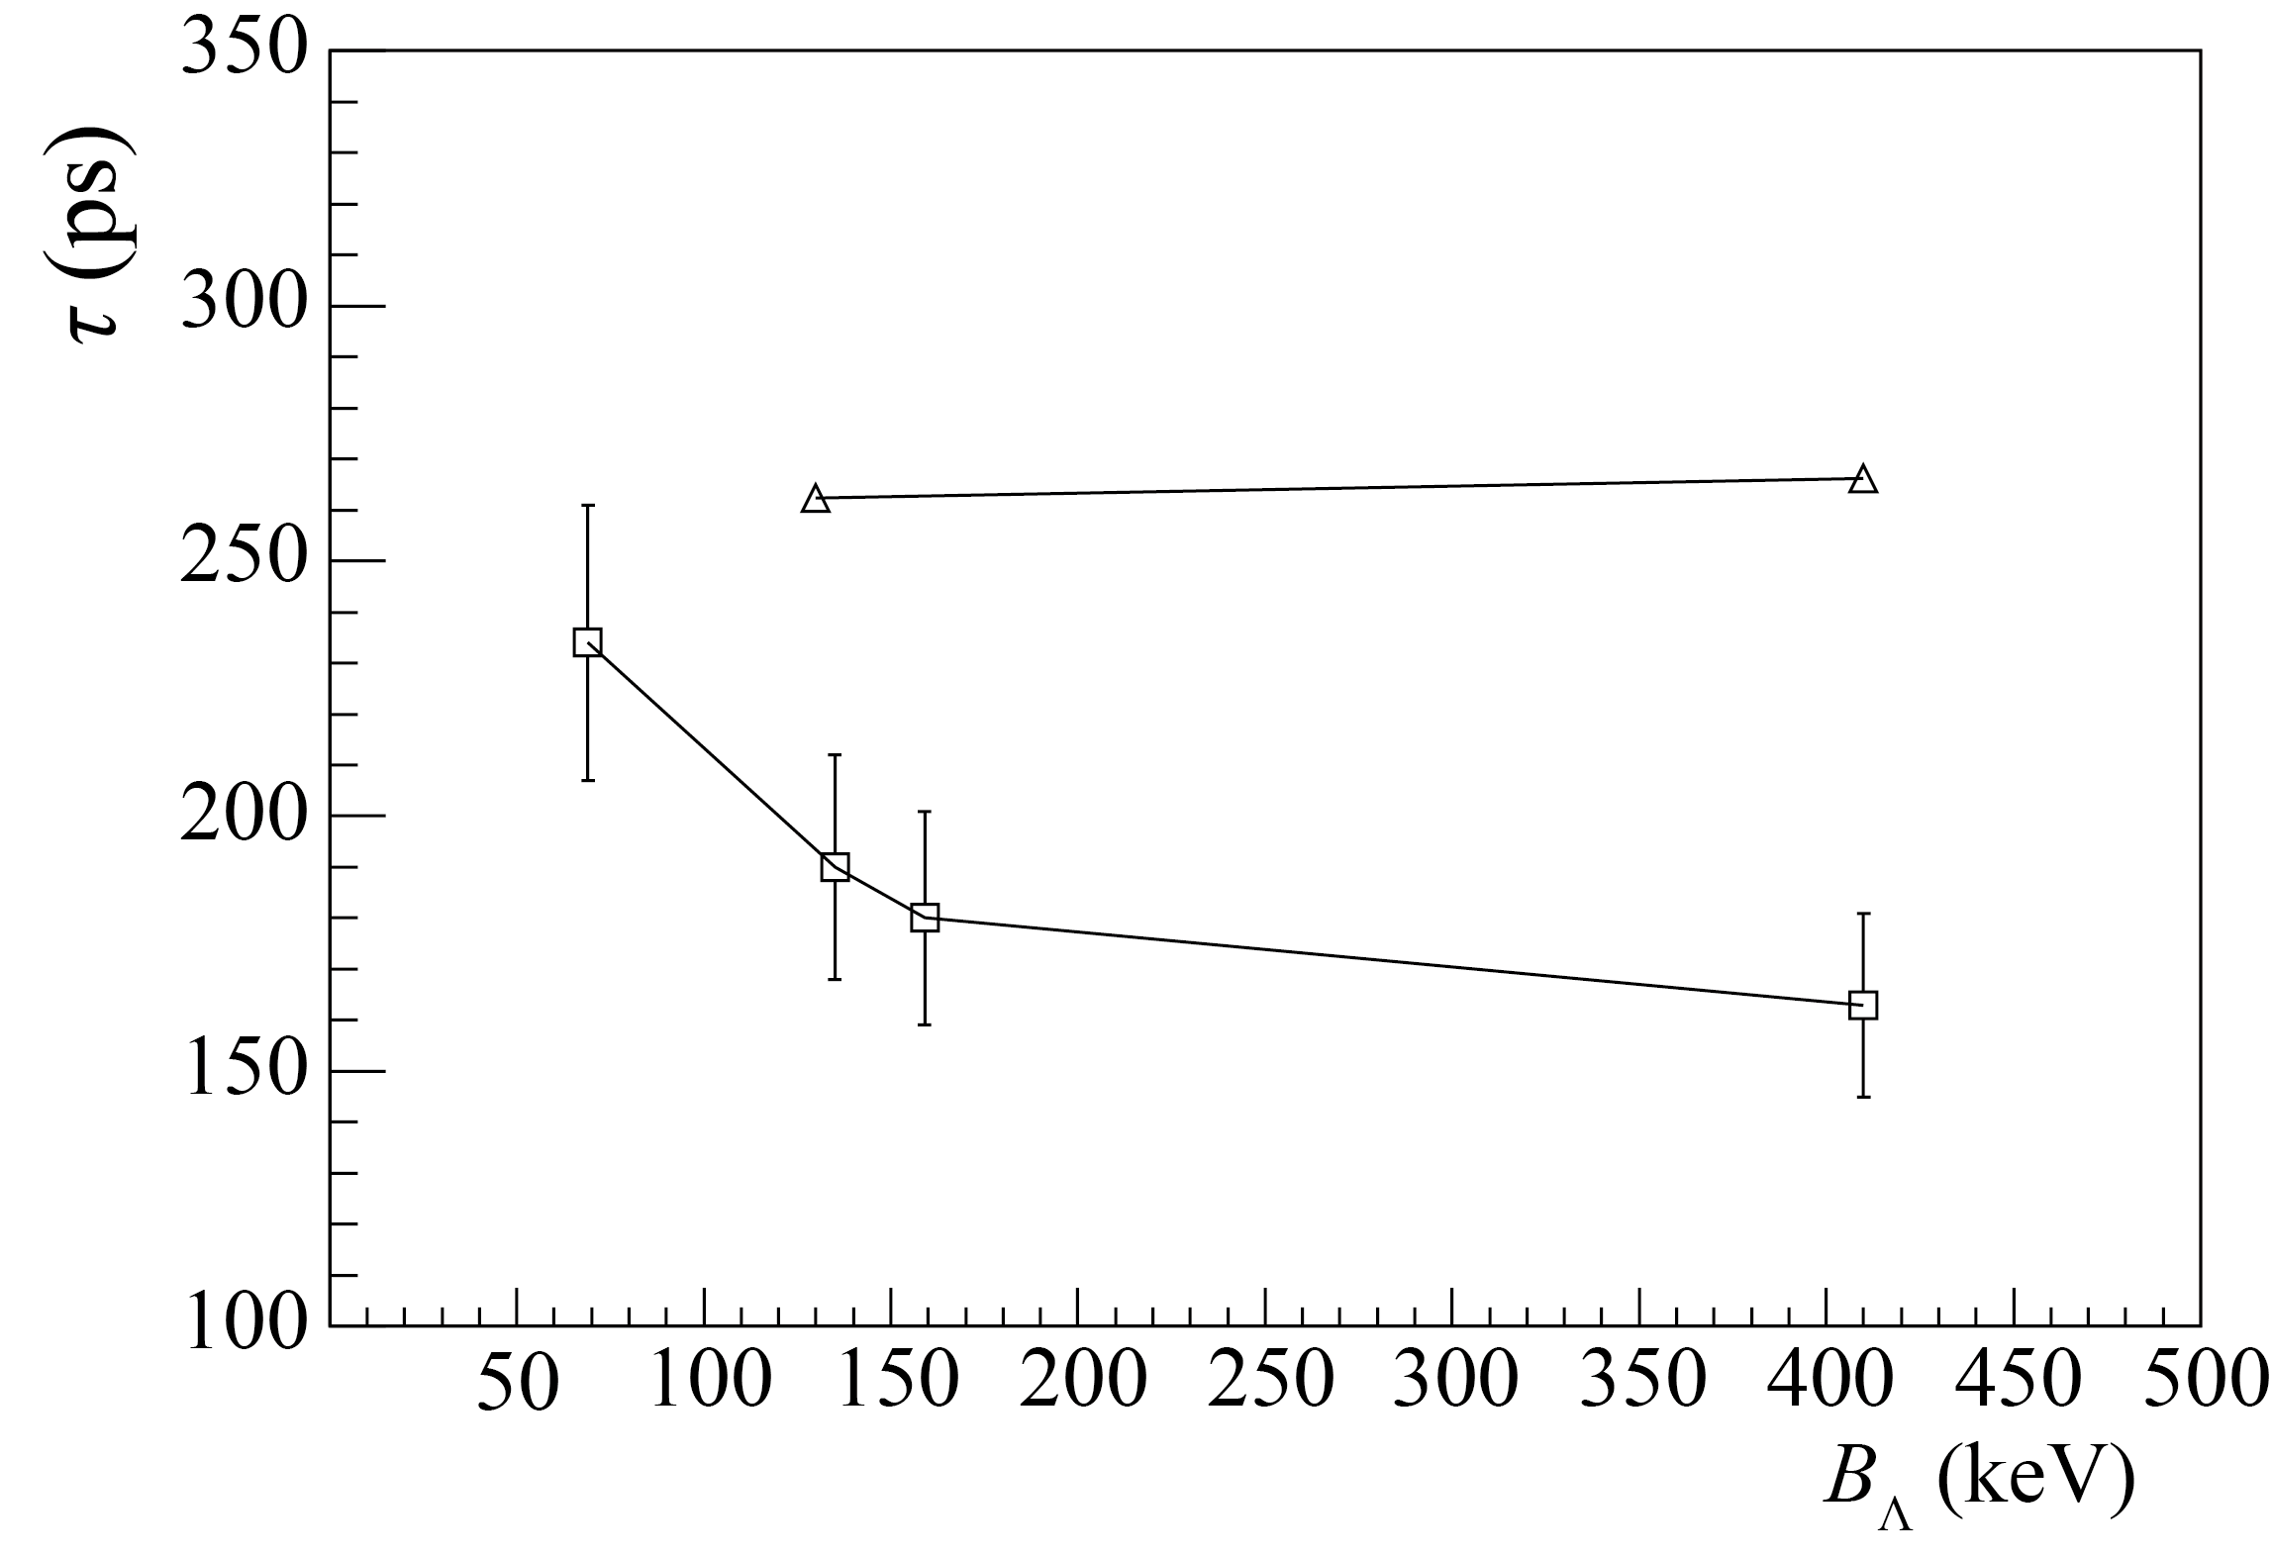
Lifetime vs. Binding energy of ${}_{Λ}^{3}H$
arXiv:2006.16718v2 [nucl-th] 8 Jul 2020
This exp.
Free Λ
ex.) Decay width of 2BD channel:
ALICE 2
Lifetime (ps)
π FIS
HypHI
ALICE 1
STAR
Form factor
(π FSI is included)
Spin indep. amp.
Binding energy (keV)
Emulsion
STAR
Spin dep. amp.
$$∝\sqrt{B_{Λ}}$$
NPB52 (1973)1—30
PRA982 (2019)811—814
2BD: 60±110 keV
3BD: 230±110 keV
2BD: 176±150 keV
3BD: 586±160 keV
Proposed experiment (C12-19-002)
$\left|ΔB^{stat.}\right|=30$ keV, $\left|ΔB^{sys.}\right|=70$ keV
Best Accuracy on $B_{Λ}$(${}_{Λ}^{3}H$)
➔ Pin down the hyperon puzzle

Slide 16
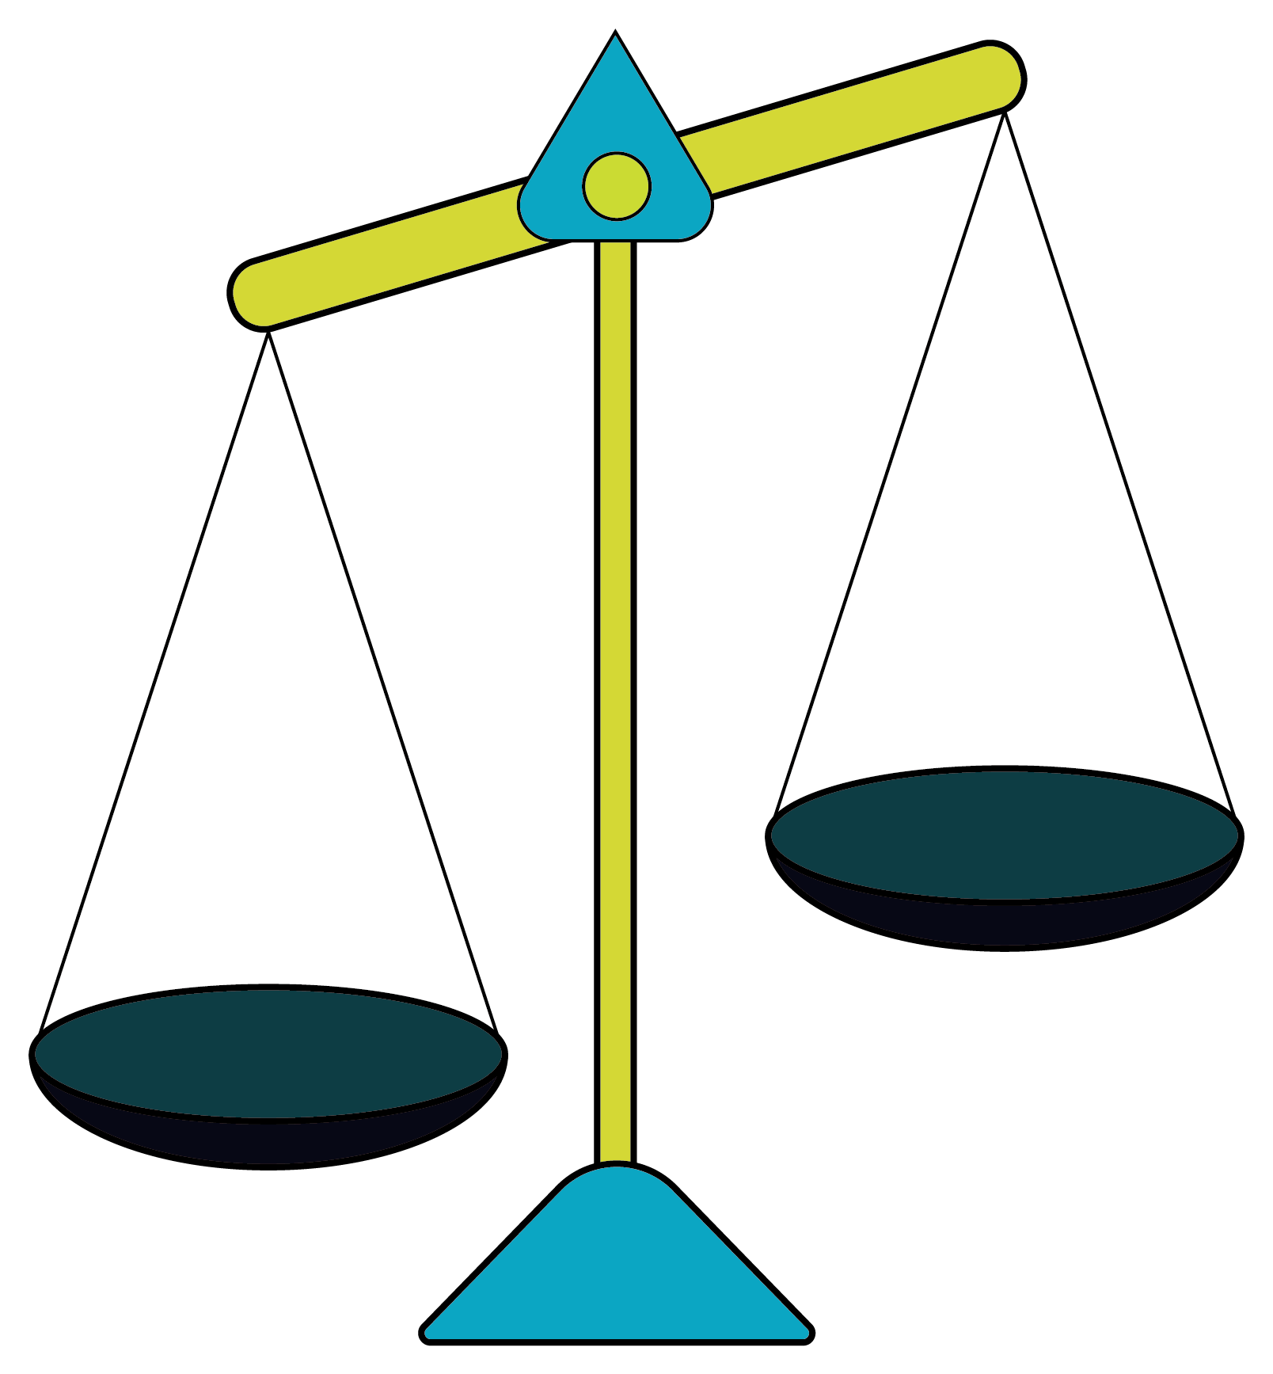
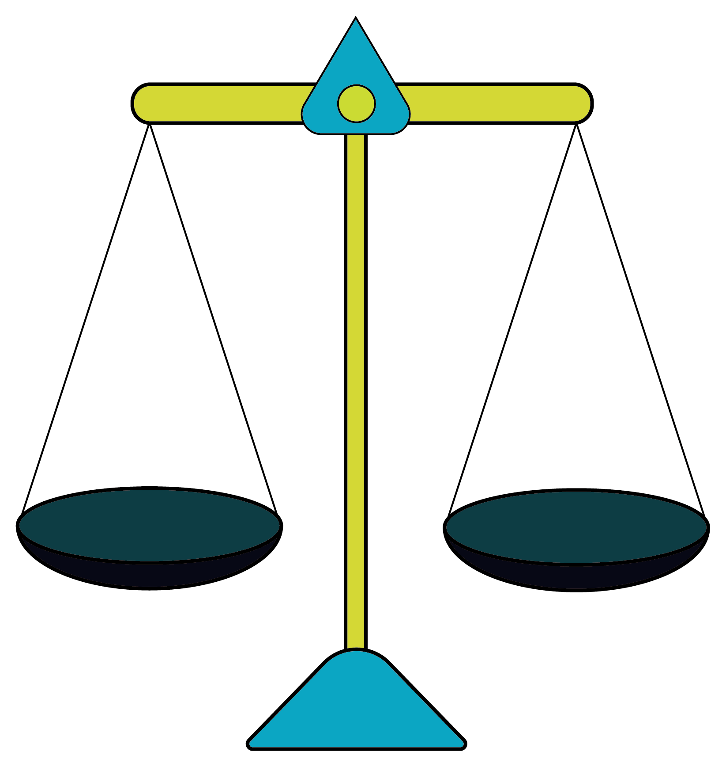
Charge Symmetry Breaking in the ΛN interaction
$${}_{Λ}^{4}H$$
Mirror
$${}_{Λ}^{4}{He}$$
Unbalanced
Balanced
0⁺
ΛN-ΣN 3BF⁽¹⁾
Fujita-Miyazawa 3BF⁽²⁾
1⁺
1⁺
N
$$Λ$$
N
N
N
N
0⁺
$$Σ$$
$$Δ$$
Emulsion
(reliable)
MAMI2015
Old γ ray
J-PARC2015
PRL 114, 232501 (2015)
PRL 115, 222501 (2015)
N
$$Λ$$
N
N
N
N
p
p
Σ may admix in the ΛN/ΛNN interaction
Λ
Λ
n
n
(1) Y. Akaishi et al., PRL 84, 3539 (2000)
(2) J. Fujita and H. Miyazawa,
Prog. Theor. Phys.,17, 3, 360–365 (1957)

Slide 17
Charge Symmetry Breaking in the ΛN interaction
$${}_{Λ}^{4}H$$
Mirror
$${}_{Λ}^{4}{He}$$
Unbalanced
Balanced
New exps.
@ J-PARC
@ JLab
0⁺
ΛN-ΣN 3BF⁽¹⁾
Fujita-Miyazawa 3BF⁽²⁾
1⁺
1⁺
N
$$Λ$$
N
N
N
N
0⁺
$$Σ$$
$$Δ$$
Emulsion
(reliable)
MAMI2015
Old γ ray
J-PARC2015
PRL 114, 232501 (2015)
PRL 115, 222501 (2015)
N
$$Λ$$
N
N
N
N
p
p
Σ may admix in the ΛN/ΛNN interaction
Λ
Λ
n
n
(1) Y. Akaishi et al., PRL 84, 3539 (2000)
(2) J. Fujita and H. Miyazawa,
Prog. Theor. Phys.,17, 3, 360–365 (1957)

Slide 18
Basic Information for the Λn CSB study:
$${}_{Λ}^{4}{He}−{}_{Λ}^{4}H$$
Explicit inclusion of Σ
Phenomenological potential
A. Gal, Phys. Lett. B 744, 352 (2015)
D. Gazda and A. Gal, Phys. Rev. Lett. 116, 122501 (2016)
E. Hiyama et al., Phys. Rev. C 80, 054321 (2009).
A. Gal et al., IOP Conf. Series: Jour. Phys.: Conf. Ser. 966 (2018) 012006
M. Isaka et al., Phys. Rev. C 101, 024301 (2020).
Λ
Σ⁰
Λ
$$V_{ΛN−ΣN}$$
δM
N
N
$\left\langle NΛ | V_{CSB} | NΛ\right\rangle$ $=−0.0297τ_{Nz}\frac{1}{\sqrt{3}}\left\langle NΣ | V_{CS} | NΛ\right\rangle$
A=5
CSB interaction
A=7
HKS, PRL 110, 012502 (2013)
Fundamental benchmark
A=4
HKS, PRC 94, 021302(R) (2016)
A=9
Hall A, PRC 91,034308 (2015)
A=10
HKS, PRC 93, 034314 (2016)
…
HKS, PRC 90, 034320 (2014) …

Slide 19
How we confirm the $B_{Λ}({}_{Λ}^{4}H; 1+)$
n
p
p
n
p
n
Λ
Λ
Conventional way
Proposed exp.
$ΔB_{Λ}≤$ 100 keV
$ΔB_{Λ}≤$ 100 keV
$$B_{Λ}(1+)$$
C12-19-002
(2 days)
J-PARC
E63
Absolute Energy Measurement:
Very unique (direct meas.)
Complementary with other data
$$B_{Λ}(0+)$$
Emulsion: $2.08±0.06± 0.04$MeV ⁽¹⁾
MAMI: $2.12±0.01± 0.09$MeV ⁽²⁾
(1) NPB 52, 1-30 (1973)
(2) PRL 114, 232501 (2015)

Slide 20
E12-17-003 (nnΛ)

Slide 21
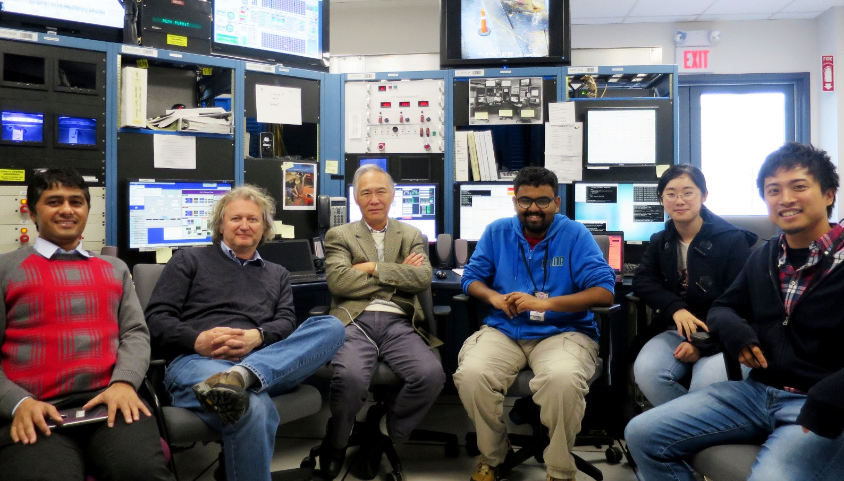
nnΛ search experiment at JLab
${}_{}^{3}{H\left(e,e^{′}K^{+}\right)nnΛ}$ with HRSs
Counting room at JLab Hall A (2018)
E12-17-003 (Oct 30—Nov 25, 2018 )
e’
$${}_{}^{3}H$$
$$K^{+}$$
n
p
n
Electron beam
$$γ^{∗}$$
n
Λ
n
We have sensitivity to both bound and resonant states

Slide 22
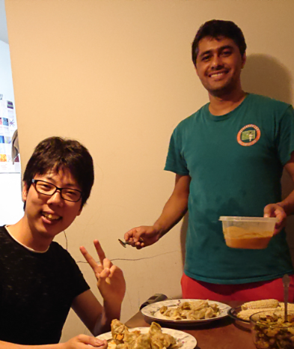
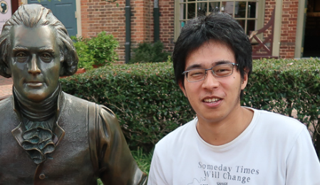
Students who Analyze data
Independent analyses are in progress by students
to doublecheck (triplecheck) results
Talked Yesterday
K. Itabashi
K. Okuyama
E. Umezaki
K.N. Suzuki
B. Pandey
Tohoku Univ., Japan
Kyoto Univ., Japan
Hampton Univ., US
Λn FSI, elementary production, nnΛ search/CS, etc.

Slide 23
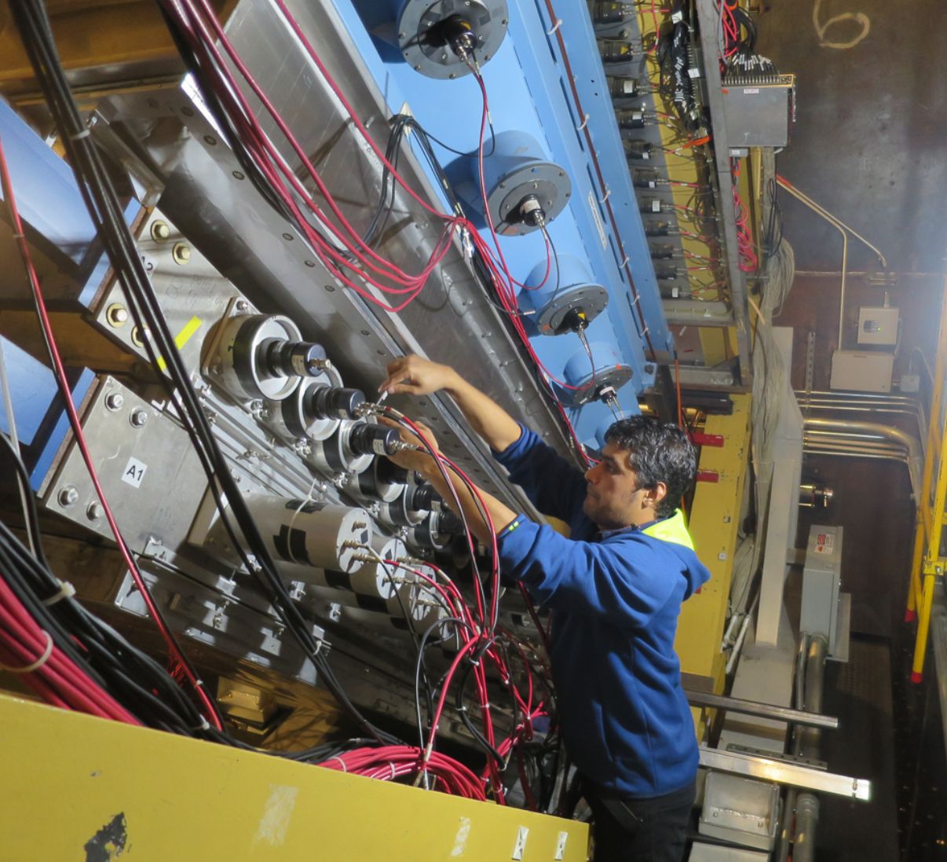
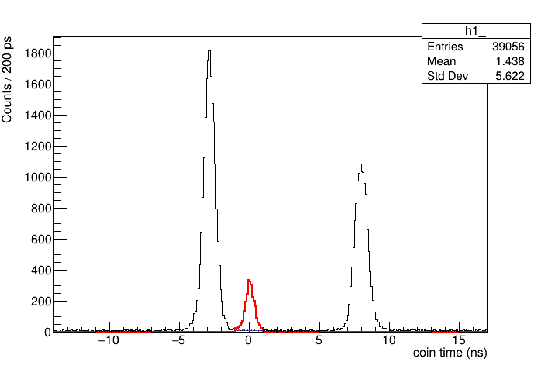
Kaon identification
Cut
A1 NPE
K⁺, π⁺, p
Cut
2nd TOF
A2 NPE
Aerogel Cherenkov 2 (A2)
Cut
Aerogel Cherenkov 1 (A1)
$σ_{K}≈300$ ps
π⁺
K⁺
p
Coin time (ns)
Timing consistency between L and R assuming m_{K}

Slide 24
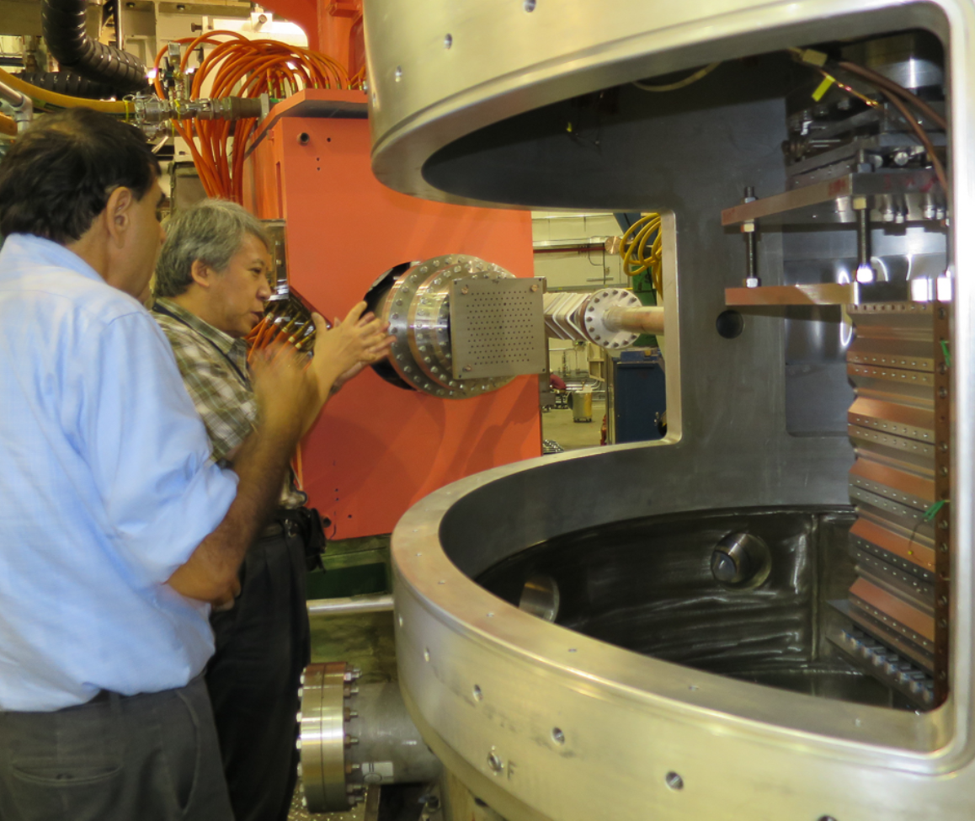
Calibration
5th order matrix (z_{t}<2)
5th order matrix (z_{t}<2)
Sieve Slit
Angle calibration
Momentum calibration
e’
Target
TG et al., APPC14, Proceedings (in Press)

Slide 25
Data vs. Geant4 (sim) for T₂ target
Momentum
$x_{FP}$ (cm)
$y_{FP}$ (cm)
$${x′}_{FP}$$
$${y′}_{FP}$$
DATA (Λ, Σ)
L-HRS
(e’)
G4 SIM. (T2)
G4 SIM. (H)
H contamination
Preliminary
R-HRS
(K⁺)
Acceptance evaluation
Cross section
Simulation by K.N. Suzuki (Kyoto Univ., 2020)

Slide 26
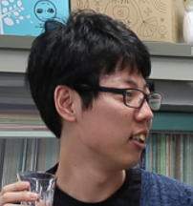
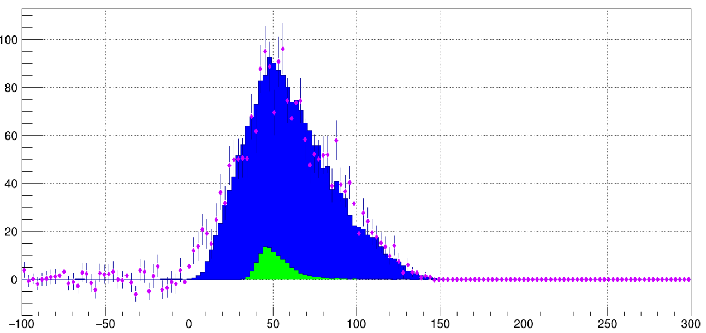
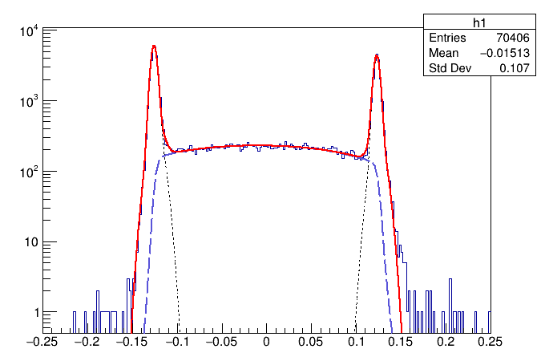
Preliminary ${}_{}^{3}H\left(e,e^{′}K^{+}\right)nnΛ$
T₂ gas
$$−0.125$$
$$+0.125$$
Figure made by K.N. Suzuki 2021 (Kyoto)
(m)
T2 gas selection
(m)
Counts
Preliminary
DATA (Λ, Σ)
Al
Al
Region of Interest
G4 SIM. (QF-Λ)
T₂ gas
G4 SIM. (Λ)
H contamination (~3%)
$z_{t}$ (m)
$−B_{Λ} [=M_{x}−\left(M_{Λ}+2M_{n}\right)]$ (MeV)
FWHM = 8.5 mm
(by two arms)

Slide 27
E12-15-008 (${}_{Λ}^{40,48}K$)

Slide 28
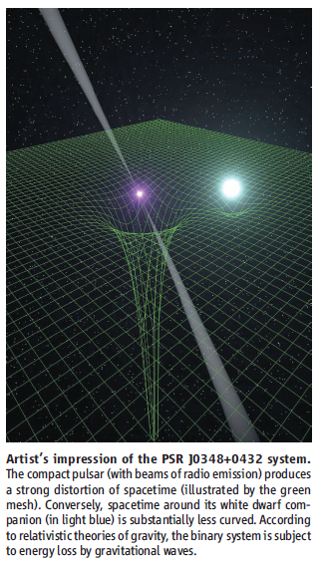
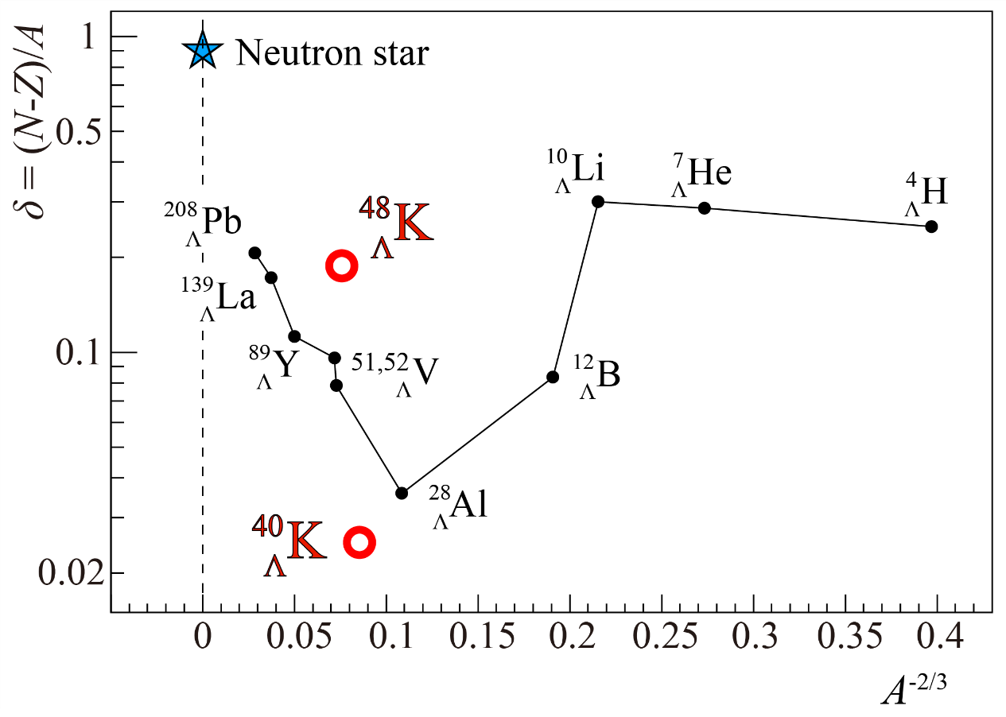
Study of isospin dependence through precise measurement of ${}_{}^{40,48}{Ca}(e,e^{′}K^{+}){}_{Λ}^{40,48}K$
J. Antoniadis et al., Science 340,
1233232 (2013).
Neutron star:
Very dense nuclear matter ($δ=\frac{N−Z}{Α}\sim 0.9$)
$≤2M_{⨀}⇎$ Λ inclusion (hyperon puzzle)
$B_{Λ}({}_{Λ}^{40,48}K)$ with high precision
Isospin dependence
of the $NNΛ$ interaction

Slide 29
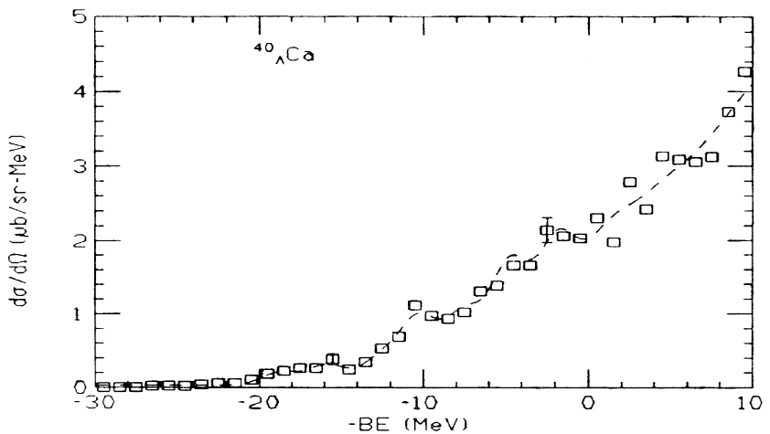
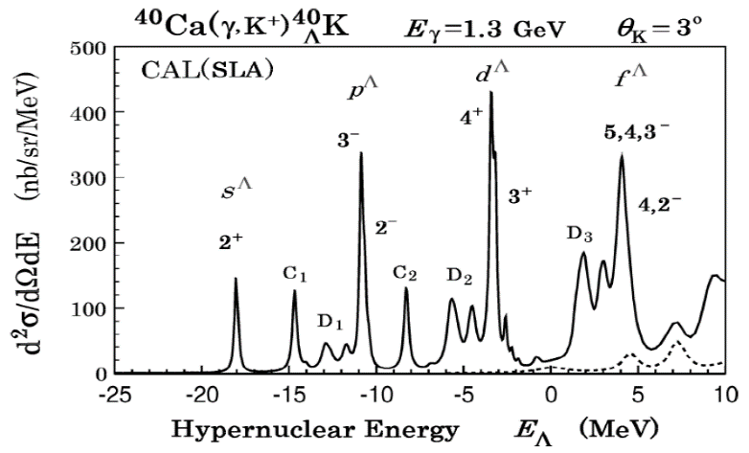
$ΛNN$ isospin dependence
P. H. Pile et al., Phys. Rev. Lett. 66, 20 (1991).
$(π^{+},K^{+})$ experiment at BNL
$${}_{Λ}^{40}{Ca}$$
$18.70±1.1$ MeV
AFDMC calculation
T. Motoba et al., Prog. Theor. Phys. Suppl., 185, 224 (2010).
(F. Paderiva et al., arXiv:1506.04042v1 (2015))
$${}_{Λ}^{40}K$$
$B_{Λ}\left({}_{Λ}^{40}K\right)−B_{Λ}\left({}_{Λ}^{48}K\right)$
with $<100$ keV accuracy
→ Insights for the isospin dependence of ΛNN force
C_{t}: Strength factor for the isospin triplet term

Slide 30
E12-20-013 (${}_{Λ}^{208}{Tl}$)

Slide 31
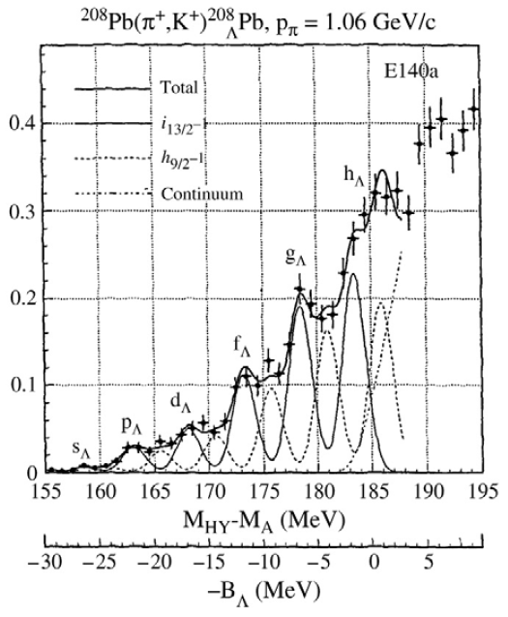
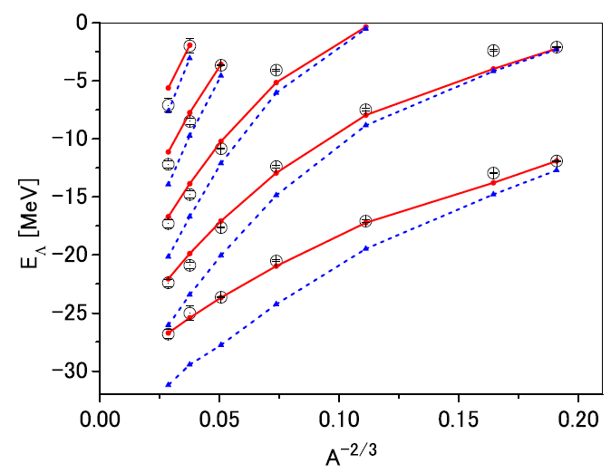
three body force
ESC16+ / ESC16
W/ 3BF
W/o 3BF
M. M. Nagels et al., Phys. Rev. C 99, 044003 (2019)
T. Hasegawa et al., Phys. Rev. C 53 (1996) 1210.

Slide 32
Λ in (almost) nuclear matter
B. Frois and C.N. Papanicolas, Ann. Rev. Nucl. Part. Sci. 37, 133 (1987)
Deeply bound protons in the ²⁰⁸Pb ground state largely unaffected by finite size and shell effect
It behave as if they were in nuclear matter
→The use of a ²⁰⁸Pb target appears to be uniquely suited to study Λ interactions in a uniform nuclear medium with large neutron excess

Slide 33
Toward precise spectroscopy
S/N = 21
T. Hasegawa et al., Phys. Rev. C 53 (1996) 1210.
T. Motoba, JPS Conf. Proc. 17, 011003 (2017)

Slide 34
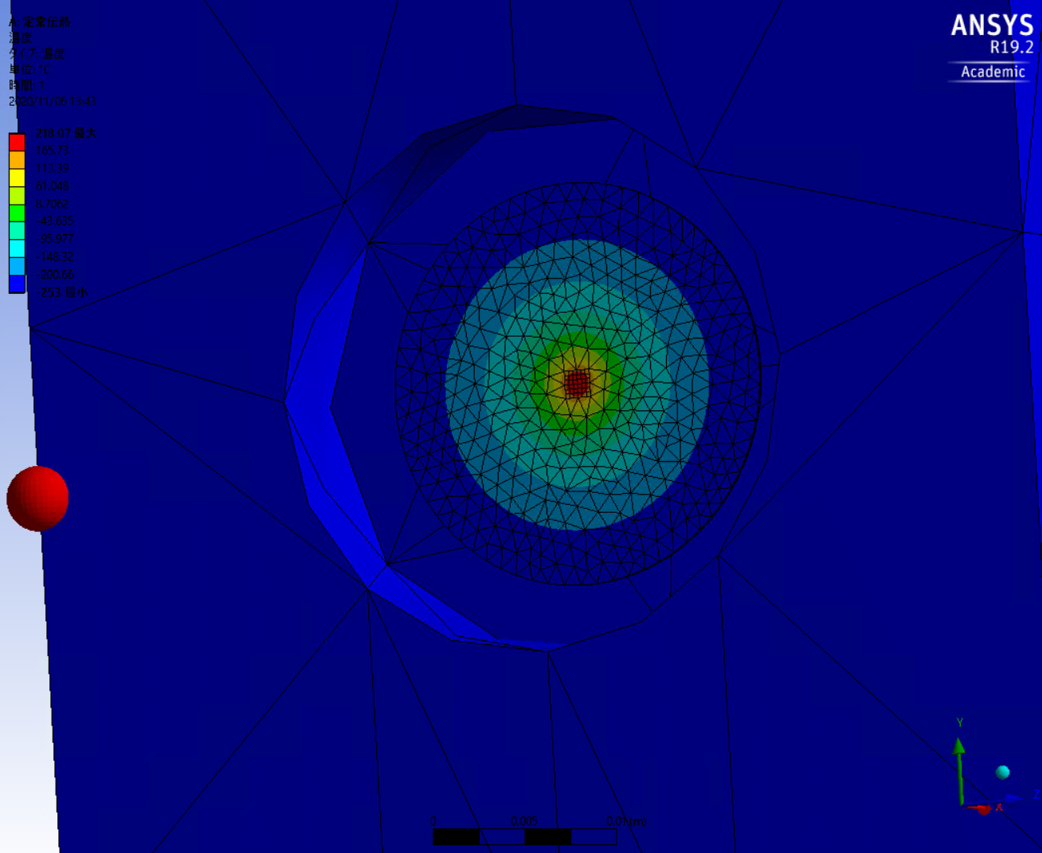
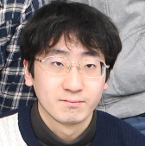
ANSYS calc. w/ simple model (Pb target)
Pb (200 mg/cm²)
Raster: 1.5 x 1.5 mm²
I = 25 μA
T. Toyoda, Master’s thesis, Kyoto Univ. JFY2020

Slide 35
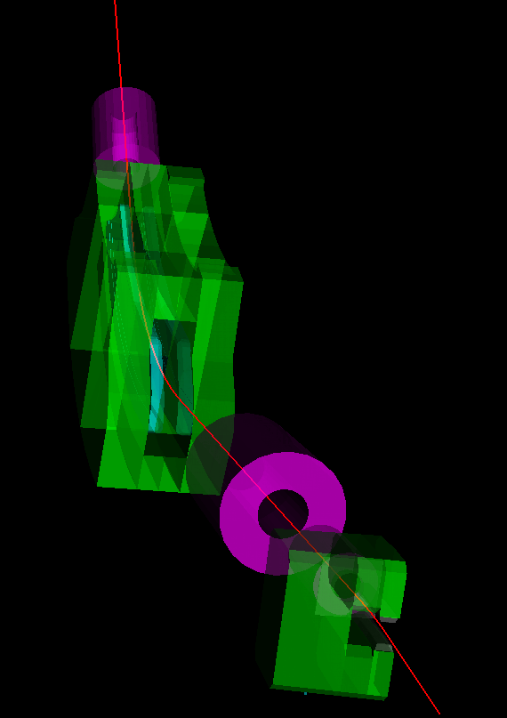
Accidental Rate estimations
Geant4 (PCS+HRS+HKS) + Physics Event Generators
(K. Katayama, Master’s Thesis, Kyoto Univ. 2020)
Target | Thickness (mg/cm²) | Beam Current (μA) | e’ (kHz) | p (kHz) | π (kHz) | Acc. rate (kHz) | Acc. rate w/ Chernkovs (kHz)
$${}_{}^{12}C$$ | 100 | 100 | 21.5 | 56 | 71 | 0.4 | 0.023
$${}_{}^{40}{Ca}$$ | 100 | 50 | 64.5 | 48 | 71 | 1.2 | 0.060
$${}_{}^{208}{Pb}$$ | 100 | 25 | 97.0 | 22 | 33 | 0.8 | 0.041
${}_{}^{3}{He}$+${}_{}^{27}{Al}$ | 37+160 | 50 | 71.8 | 95 | 170 | 2.8 | 0.13
${}_{}^{4}{He}$+${}_{}^{27}{Al}$ | 74+160 | 50 | 74.0 | 112 | 197 | 3.4 | 0.16

Slide 36
Summary
E12-17-003 (${}_{Λ}^{3}n$): nnΛ puzzle, ΛN interaction
C12-19-002 (${}_{Λ}^{3,4}H$): hypertriton puzzle, CSB issue = 25 days (requesting)
E12-15-008 (${}_{Λ}^{40,48}K$): ΛNN isospin interaction = 28 days (approved)
E12-20-013 (${}_{Λ}^{208}{Tl}$): ΛNN 3BF in uniform nuclear medium = 20 days (approved)
Spectrometer system
PCS was constructed → needs to be transported to JLab
HKS base design/construction
Detectors
New WC → Design was done (Master’s thesis, Tohoku Univ. JFY2020)
Need detectors’ commissioning
Target
Basic concept to integrate solids and He targets was agreed
→ Detailed design with JLab target group will be done
Software
Geant4 → Trigger rate / yield / resolutions were estimated
FPGA → Being developed (Master’s thesis, Kyoto Univ. JFY2020)
Analyzer needs to be developed
Ready by 2022

Slide 37
Backup

Slide 38
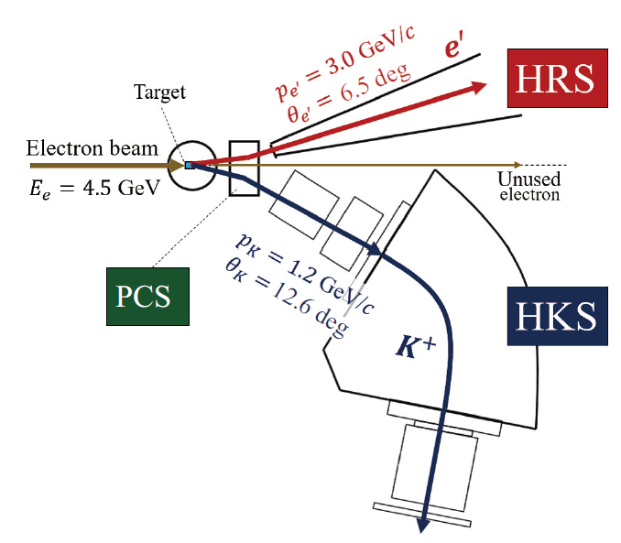
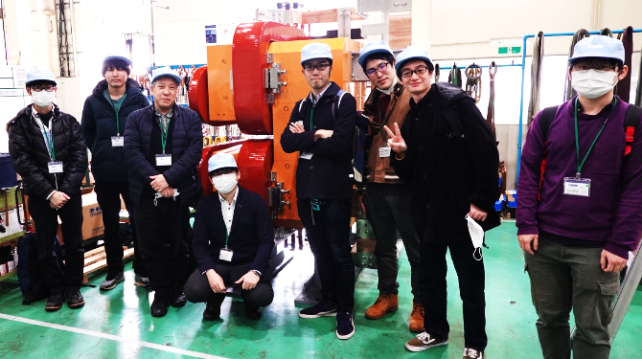
Experimental Setup
$$e$$
$$e^{′}$$
$$K^{+}$$
$$γ$$
$${}_{}^{3}{He}$$
$${}_{Λ}^{3}H$$
Same as E12-15-008 (${}_{Λ}^{40,48}K$)
PCS → constructed in Japan
Proposed targets
Physics: ³He, ⁴He gases
Calibration: ¹H gas, Multi-C, Empty
Target ladder may be separated from others
New magnet
HKS magnet: Y. Fujii et al., NIMA 795 (2015) 351—363
Kaon ID: TG et al., NIMA 729 (2013) 816—824
PCS @ TOKIN, Sendai, Japan (March 2020)

Slide 39
Expected missing mass resolution
Analysis by K.N. Suzuki (Kyoto)
$$z_{T,HRS}^{}=\sum_{i+j+k+l=0}^{n_{1}}{a_{ijklm}x_{FP}^{i}{x′}_{FP}^{j}y_{FP}^{k}{y′}_{FP}^{l}}$$
$$\overset{⃑}{p^{HRS,HKS}}=\sum_{i+j+k+l+m=0}^{n_{2}}{a_{ijklm}x_{FP}^{i}{x′}_{FP}^{j}y_{FP}^{k}{y′}_{FP}^{l}z_{T,HRS}^{m}}$$
 | $$Δp/p$$ | $Δθ$ (mrad)
HRS | $$2.6×{10}^{−4}$$ | 0.6
HKS | $$4.2×{10}^{−4}$$ | 1.5
E12-17-003 could be reproduced
Same framework
w/ materials (e.g. target):
$\frac{Δp}{p} ⇒ \frac{Δp}{p}×1.1$, $Δθ ⇒ Δθ×1.4$
HRS
Geant4 simulation
for C12-19-002
PCS(e’)
$ΔM_{HYP}=1$ MeV (FWHM)

Slide 40
Yield estimation
F. Dohrmann et al., Phys. Rev. Lett. 93, 242501 (2004).
p
n
n
p
n
Λ
5 nb/sr
Λ
20 nb/sr
Product | Target (mg/cm²) | $I_{beam}$ ($μA$) | CS (nb/sr) | Yield / day | Beamtime (day) | Total yield
$${}_{Λ}^{3}H$$ | ${}_{}^{3}{He}$ (37) | 50 | 5 | 23 | 20 | 464
$${}_{Λ}^{4}H$$ | ${}_{}^{4}{He}$ (74) |  | 20 | 139 | 2 | 278
VP flux = 2×10⁻⁵ (/e), $ε_{det}=0.75, f_{density}=0.85, f_{Kdecay}=0.26, Ω_{K}=7 msr$

Slide 41
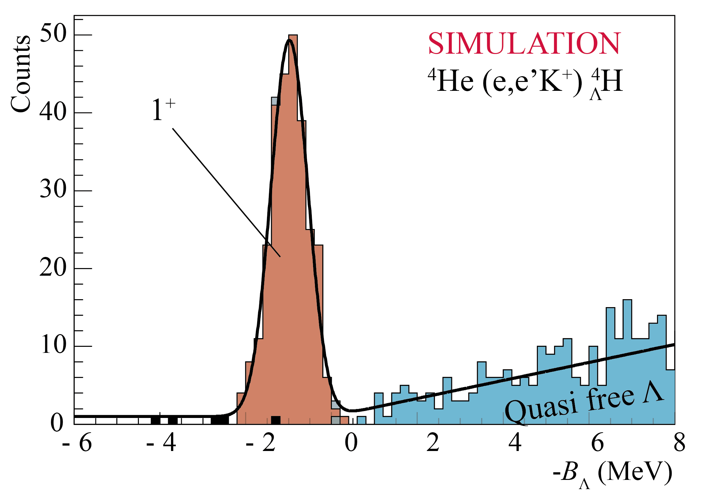
Expected Spectra and statistical errors
p
n
Λ
n
p
n
Λ
$\left|ΔB_{Λ}^{stat.}\right|=20$ keV
$\left|ΔB_{Λ}^{stat.}\right|=30$ keV
Hypertriton Puzzle + ΛN int.
(g.s. or excited states)
ΛN CSB in A = 4

Slide 42
Calibrations and a systematic error on $B_{Λ}$
Calibration | Target + Sieve Slit | Reaction | $z_{t}$ range (mm) | Beamtime (day) | Remarks
Mom. +${ z}_{t}$ | H | $$p\left(e,e^{′}K^{+}\right)Λ,Σ^{0}$$ | $$−115<z_{t}<115$$ | 1 | $Λ:\text{61}\text{00}$, $Σ^{0}:2030$
Mom. +${ z}_{t}$ | ${}_{}^{12}C$ (multi foils) | $${}_{}^{12}C\left(e,e^{′}K^{+}\right){}_{Λ}^{12}B$$ |  | 1 | ${{}_{Λ}^{12}B}^{g.s.}$: $300×5$
Angle + $z_{t}$ | ${}_{}^{12}C$ (multi foils) + SS | - |  | 0.2
$$z_{t}$$ | Empty | - | $$−100<z_{t}<100$$ | 0.1 | + Background study
 | Empty (or gas) + SS | - |  | 0.2 | + Angle resolution check
Physics | ${}_{}^{3,4}{He}$ | $${}_{Λ}^{3,4}H$$ | $$−100<z_{t}<100$$ | 22
Major contributions to a systematic error on $B_{Λ}$
Energy scale calibration^{(*)} : $±50$ keV
Energy loss correction: $±40$ keV
target density $\left|Δd\right|=3\%$
cell thickness uniformity $\left|Δt\right|=10\%$
$|ΔB_{Λ}^{sys.}|=70$ keV
^{(*)} TG et al., NIMA 900 (2018) 69—83

Slide 43
Ground state of ${}_{Λ}^{3}{H }\left(T=0, J^{π}={1/2}^{+}\right)$
p
n
Λ
Hypertriton Puzzle
Λd rm radius ($|Δr|≤1$ fm)
➔ Better estimation for the lifetime
ΛN interaction
Constraint for
Interaction models
The ΛN spin singlet scattering length ($\left|Δa_{s}\right|∼1 fm$; cf. $a_{s}={1.8}_{−4.2}^{+2.3} fm$)

Slide 44
Excited states of ${}_{Λ}^{3}{H }$
$$T=0$$
${}_{Λ}^{3}{H }\left(T=0, J^{π}={3/2}^{+}\right)$
Has NOT been measured
Hard to measure by emulsion / HI experiments
Does it exist?
If yes, the CS is larger than ½ by a factor of 8 ⁽¹⁾
If no, only the 1/2⁺ state will be observed
⬅ $π$EFT predicts 3/2⁺ as a virtual state ⁽²⁾
Strong constraint for the ΛN spin triplet interaction
${}_{Λ}^{3}{H }\left(T=1, J^{π}={1/2}^{+}\right)$
Isospin partner of $nnΛ$ (and $ppΛ$)
➔ significant information on the existence of $nnΛ$
CSB study in the A = 3 hypernuclear system
If the CS is 0.5 nb/sr → $\left|ΔB_{Λ}^{stat.}\right|∼70$ keV
p
n
Λ
$$T=1?$$
n
n
p
n
p
p
Λ
Λ
Λ
T. Mart et al, Nucl. Phys. A 640, 235-258 (1998)
M. Schäfer et al., Phys. Lett. B 808, 135614 (2020)

Slide 45
Summary
HRS-HRS @ Hall A (JLab E12-17-003, 2018)
${}_{}^{3}H\left(e,e^{′}K^{+}\right)nnΛ$
Analysis in progress (by 3 independent teams)
➔ Peak search, n(n)-Λ FSI, reaction cross section
n
n
Λ
HRS-HKS @ Hall A (JLab C12-19-002, 2022/2023)
$B_{Λ}({}_{Λ}^{3,4}H)$ with an accuracy of
$ΔB_{Λ}^{tot.}= \sqrt{{\left|ΔB_{Λ}^{sys.}\right|}^{2}+{\left|ΔB_{Λ}^{stat.}\right|}^{2}}<80 \text{k}\text{eV}$
➔ Hypertriton Puzzle / Charge Symmetry Breaking
p
n
n
p
n
Λ
Λ

Slide 46
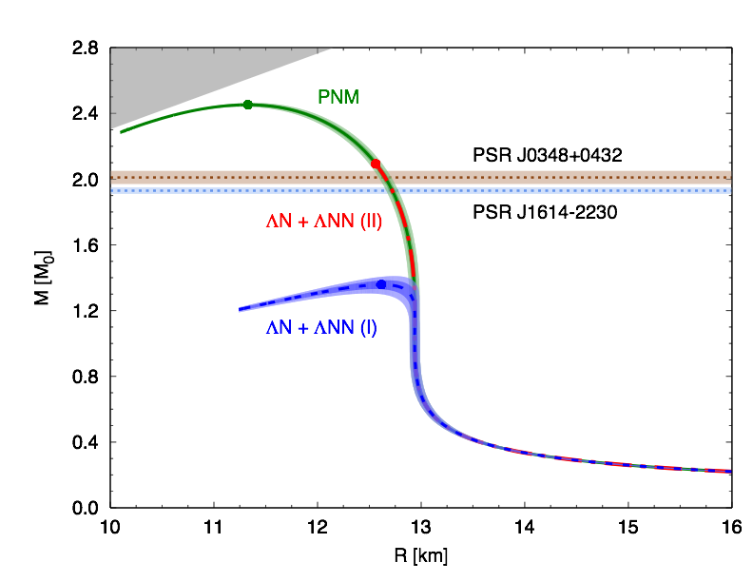
Studying Λ interactions in nuclear matter with the ${}_{}^{208}{Pb}(e,e^{′}K^{+}){}_{Λ}^{208}{Tl}$
Hyperon Puzzle
Strong softening of the EoS of dense matter due to the appearance of hyperons which leads to maximum masses of compact stars that are not compatible with the observations.
D.Lonardoni et al., Phys. Rev. Lett. 114, 092301 (2015)
It clearly appears that the inclusion of
YNN forces (PNM) leads to the right mass (~2 solar masses
Three-body ΛNN forces are known to be strongly A-dependent, making the ²⁰⁸Pb target uniquely suited to study Λ interaction in a uniform nuclear medium with large neutron excess
From Franco

Slide 47
B. Frois and C.N. Papanicolas, Ann. Rev. Nucl. Part. Sci. 37, 133 (1987)
The measured charge density distribution of ²⁰⁸Pb clearly shows that the region of nearly constant density accounts for a very large fraction (~70 %) of the nuclear volume, thus suggesting that its properties largely reflect those of uniform nuclear matter in the neutron star
The validity of this conjecture has been long established by a comparison between the results of theoretical calculations and the data extracted from the ²⁰⁸Pb(e,e´p)²⁰⁷Tl cross sections measured at NIKHEF in the 1990s
Deeply bound protons in the ²⁰⁸Pb ground state largely unaffected by finize size and shell effect
→ behave as if they were in nuclear matter
→ The use of a ²⁰⁸Pb target appears to be uniquely suited to study Λ interactions in a uniform nuclear medium with large neutron excess
From Franco

