Slide 1
Fiber target simulation for S-2S experiment
Toshiyuki Gogami
2015/10/15

Slide 2
Setup in the simulation
SIDE view
FRONT view
TOP view
Beam direction

Slide 3
Geant4 Monte Carlo Simulation
Ξ⁻ hypernucleus
→ Decay
②
K⁺
③
y
z
x
K⁻
①

Slide 4
Simulation Flow
Sim.1
K⁻ energy loss
Energy loss in fibers
¹²C(K⁻,K⁺)¹²_{Ξ}Be kinematics
K⁺ energy loss
Energy loss in fibers
Sim.2
Ξ⁻ + ¹¹B
→ ¹⁰Be + Λ + Λ
→ …
Sim.3
Analysis

Slide 5
Assumptions in the simulation
Assumption
p_{K⁻}: 1.8 GeV/c
Incident K⁻ angle: 0 deg
Ξ production point: Random in z-axis, but zero for x and y
Δp/p for K⁻: 10.0E⁻⁴
Δp/p for K⁺: 5.0E⁻⁴

Slide 6
Event display (1)
Blue: K⁻ related
Red: K⁺ related
Black + Green: Xi hyp. related.
Z [cm]
Z [cm]
X [cm]
Y [cm]

Slide 7
Event display (2)
Blue: K⁻ related
Red: K⁺ related
Black + Green: Xi hyp. related.
Z [cm]
Z [cm]
X [cm]
Y [cm]

Slide 8
Event display (3)
Blue: K⁻ related
Red: K⁺ related
Black + Green: Xi hyp. related.
Z [cm]
Z [cm]
X [cm]
Y [cm]

Slide 9
Event display (4)
Blue: K⁻ related
Red: K⁺ related
Black + Green: Xi hyp. related.
Z [cm]
Z [cm]
X [cm]
Y [cm]

Slide 10
Event display (5)
Blue: K⁻ related
Red: K⁺ related
Black + Green: Xi hyp. related.
Z [cm]
Z [cm]
X [cm]
Y [cm]

Slide 11
Missing mass distribution
FWHM = 11.2 MeV by a Gaus fit

Slide 12
Energy loss of K⁻ and K⁺ in fibers
Energy loss in fibers
(Only related to K⁻ and K⁺)
Strong correlation
the Missing mass can be corrected
(See also: this)

Slide 13
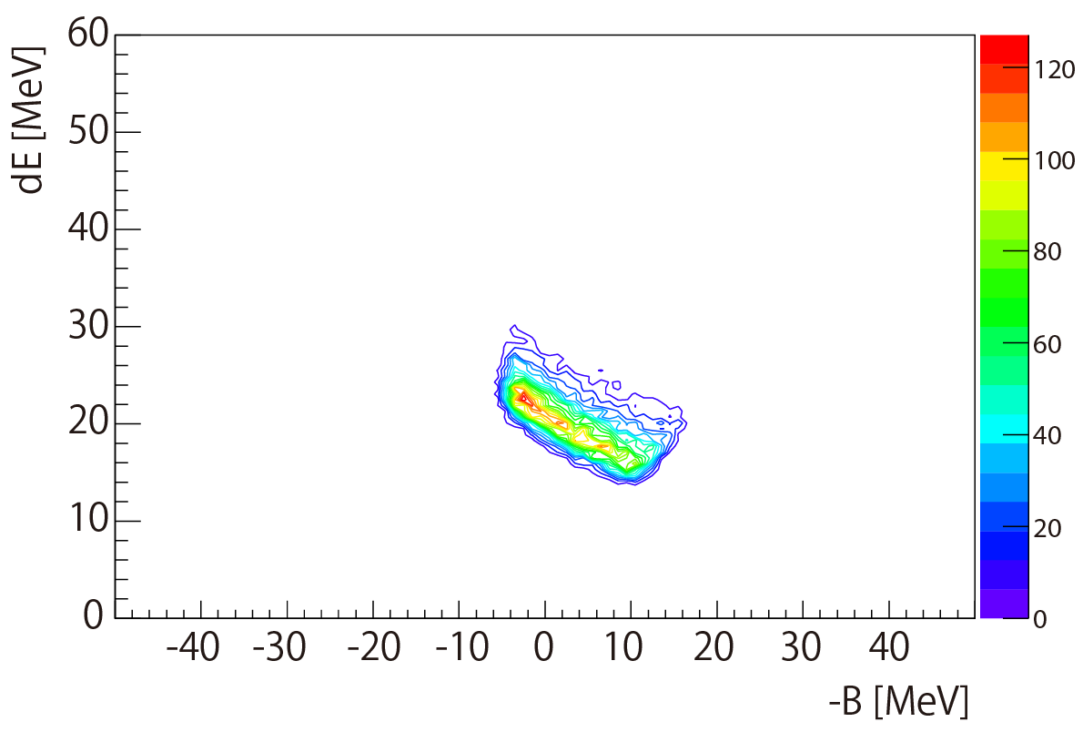
Energy loss in fibers
dE of K⁻ ,K⁺
and decayed particle from Xi-hyp.
Only dE of K⁻ and K⁺
Selected hit fibers related to K⁻ and K⁺ events
for this dE calculation.

Slide 14
Simple missing mass correction
Fit by linear function to
the distribution profile
(Red line).
2. Shift was applied to the line
because the red line is taken
up by the large dE tail.
(Black line)
3. The missing mass is
corrected by the Black line.
But the correction was
applied only to dE<26 MeV.

Slide 15
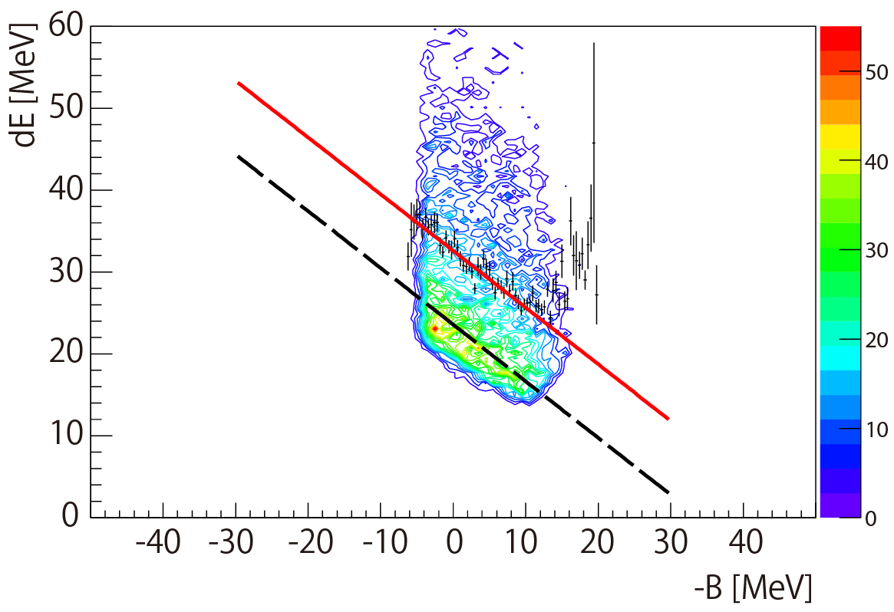
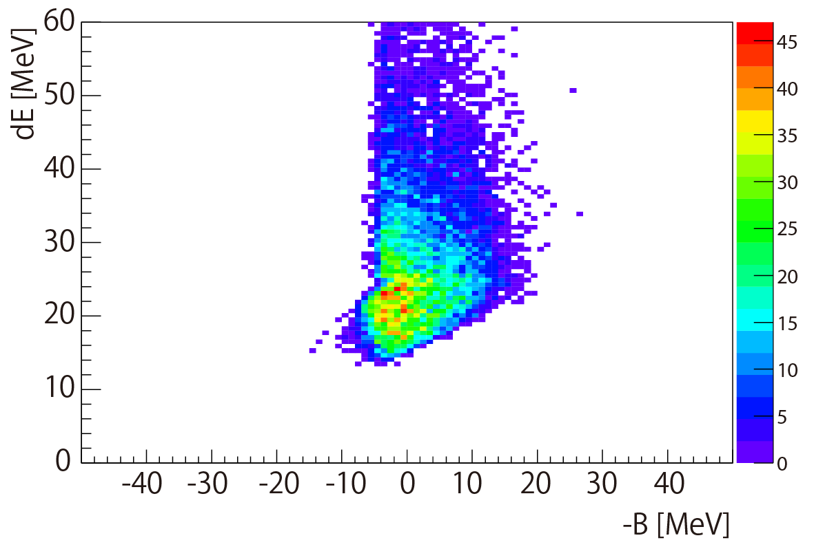
Missing mass resolution with the simple correction.
(w/o correction: >11 MeV →)
w/o correction
FWHM = 6.4 MeV
w/ correction
w/ correction
Notes:
R STEP FIRST
NO. NAME VALUE ERROR SIZE DERIVATIVE
1 Constant 1.26993e+03 1.69325e+01 1.07427e-01 -2.22335e-05
2 Mean -1.01454e+00 4.69865e-02 2.61088e-04 3.89096e-04
3 Sigma 2.72580e+00 3.06166e-02 1.95225e-05 -1.75259e-01
FWHM = 6.41876 0.0720965 MeV

Slide 16
Expected spectra between fiber target and normal target
Used Motoba-san’s calculation for this figure.
Notes:
Fiber target: 6.4 MeV FWHM
Normal target: 2.2 MeV FWHM (3 g/cm2)
Statistic: 1 moth

