Slide 1
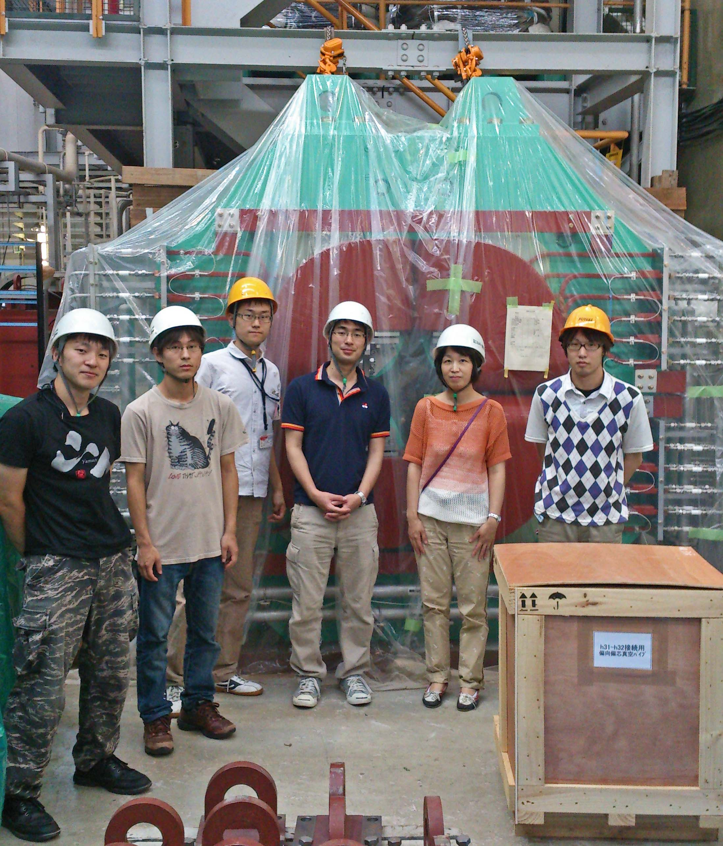
S-2S meeting
2015/4/14
Toshiyuki Gogami

Slide 2
Contents
Assembly of new water Cherenkov detector

Slide 3
WC was delivered on 26Mar2015

Slide 4
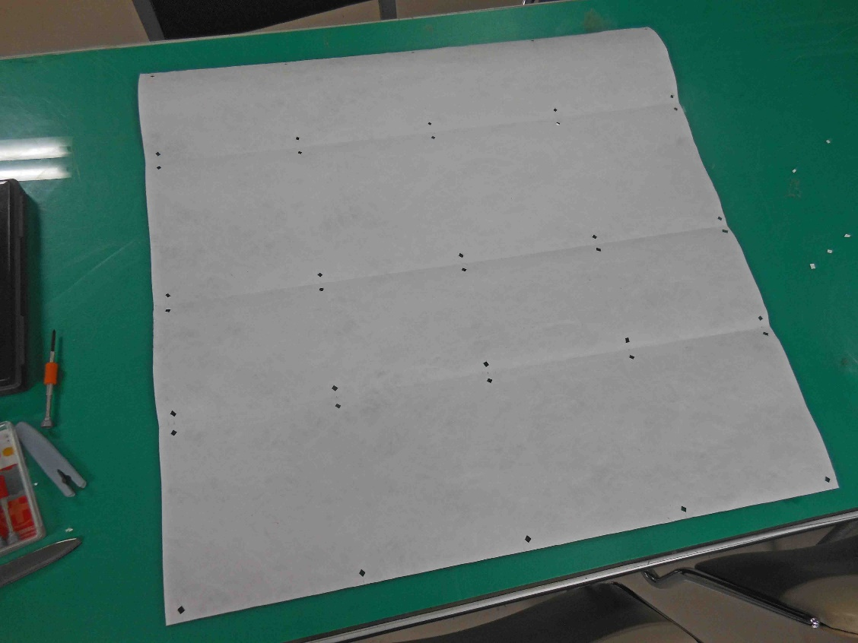
Cut Tyvek sheets
For side
For bottom
For top cap

Slide 5
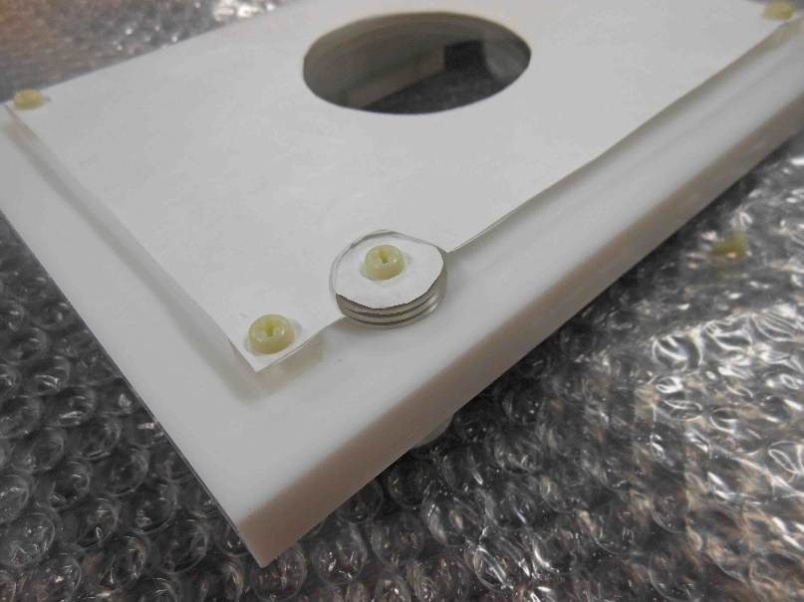
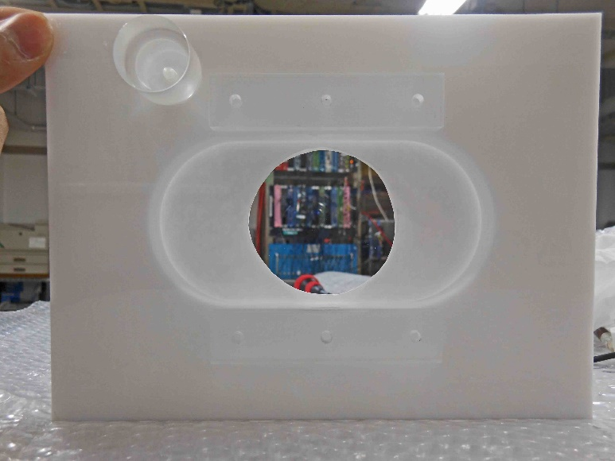
Attach the sheets (top cap)
2-layer sheets were
attached inside container.

Slide 6
Attach the sheets (bottom)
2-layer sheets were
attached inside container.

Slide 7
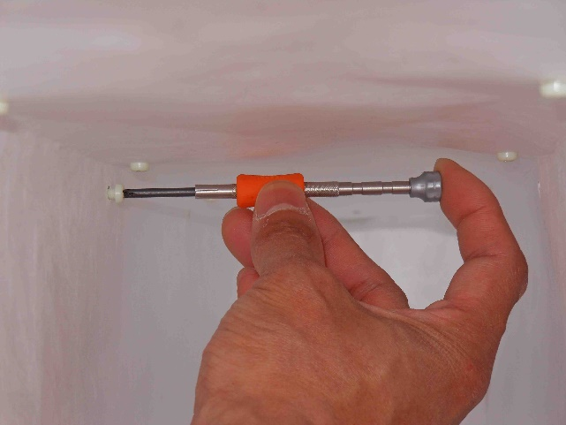
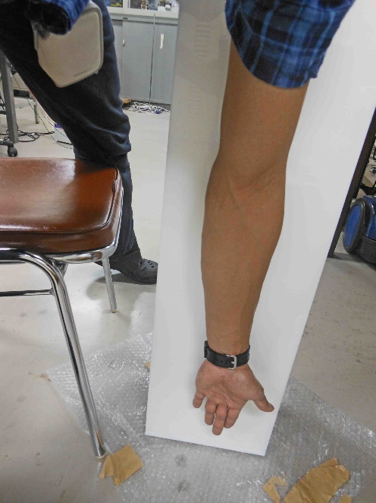
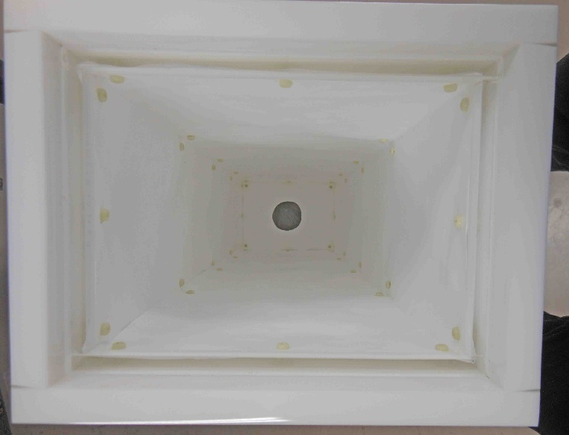
Attach the sheets (side)
2-layer sheets were
Attached inside container.

Slide 8
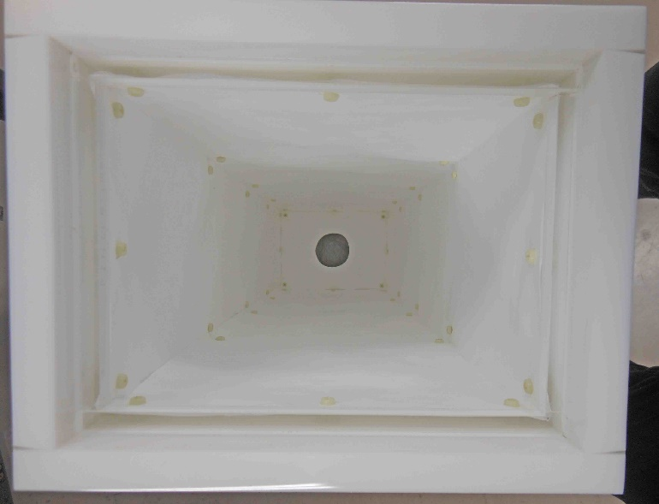
Attach the cap with glue

Slide 9
Attach the cap with glue

Slide 10
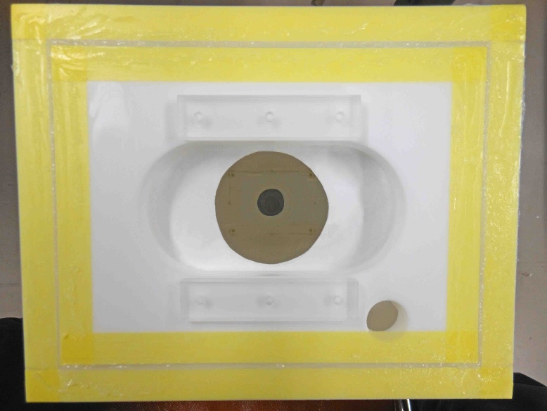
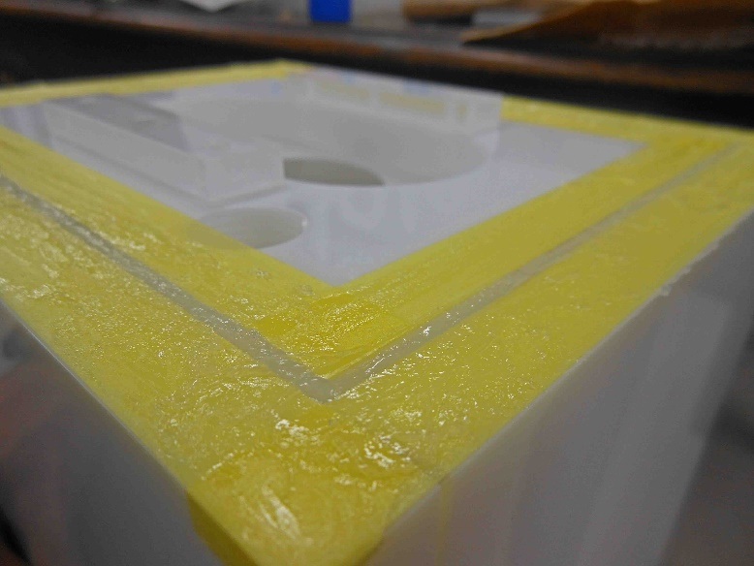
Attach the cap with glue
Fill gaps with bath-caulk N
Put masking tapes

Slide 11
Attach the cap with glue
After 3 days, removed the masking tapes.
→ Looks OK.

Slide 12
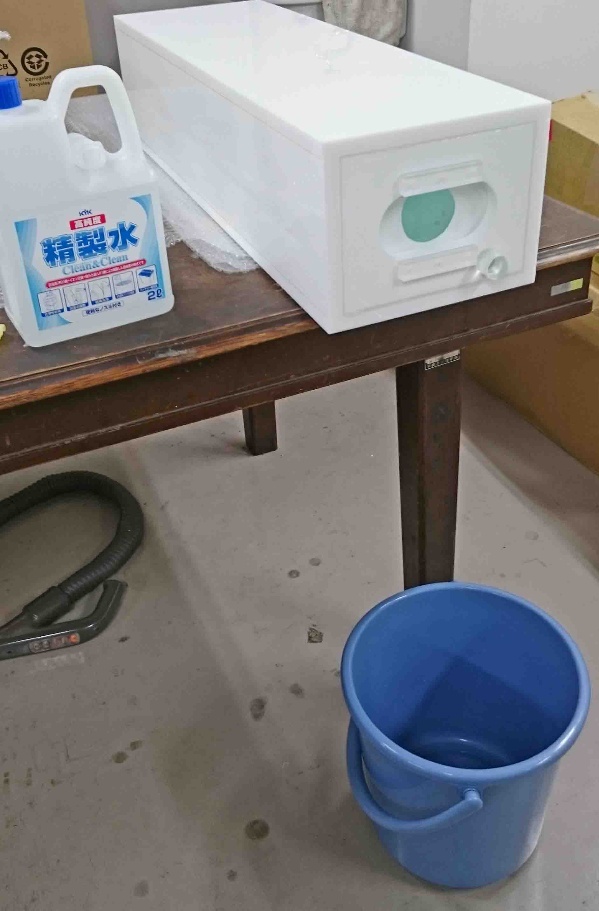
Water leakage check

Slide 13
No leakage !!!

Slide 14
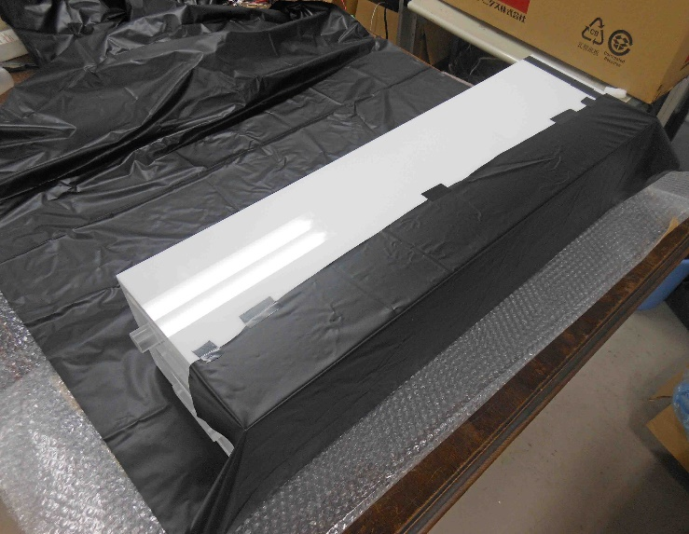
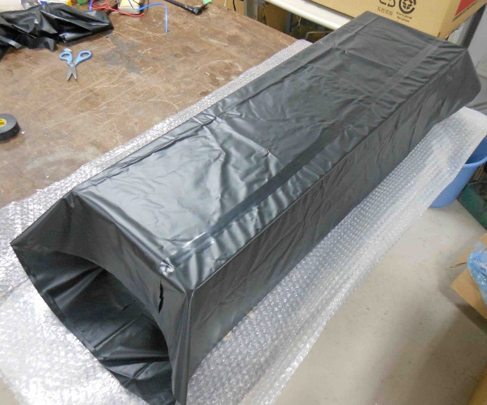
Light shielding
I’m on this stage now.
Want to start taking data with cosmic-ray this week.

Slide 15
Pictures
http://www-nh.scphys.kyoto-u.ac.jp/~gogami/pictH/pict_e05.html

