Slide 1
S-2S MEMO New WC test
13 May 2015
Toshiyuki Gogami

Slide 2
Contents
組立の様子(4/14の資料の続き)
Phase1(4/21-4/25)の解析結果の一部紹介

Slide 3
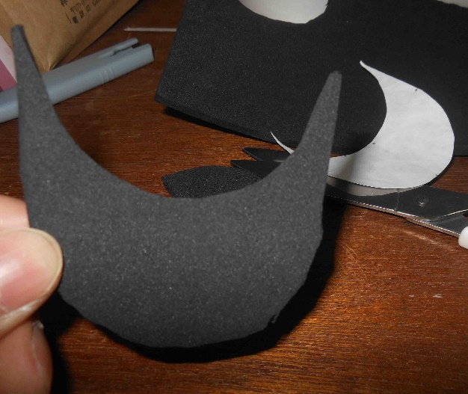
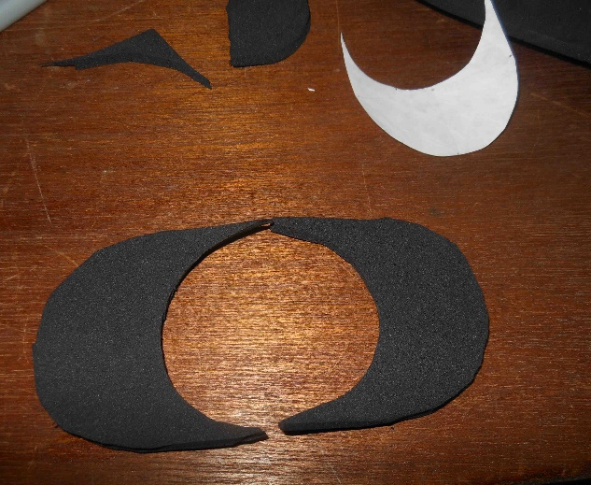
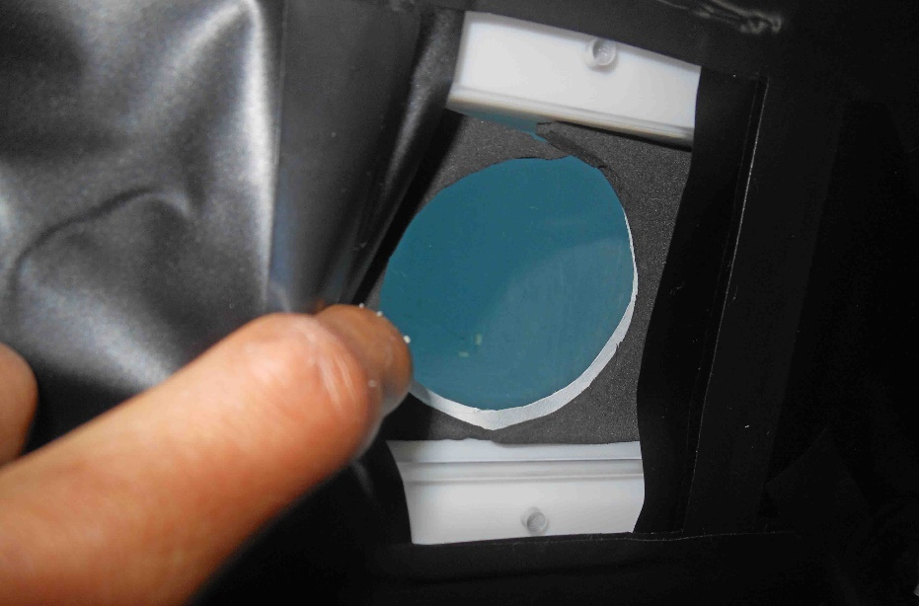
Window cover

Slide 4
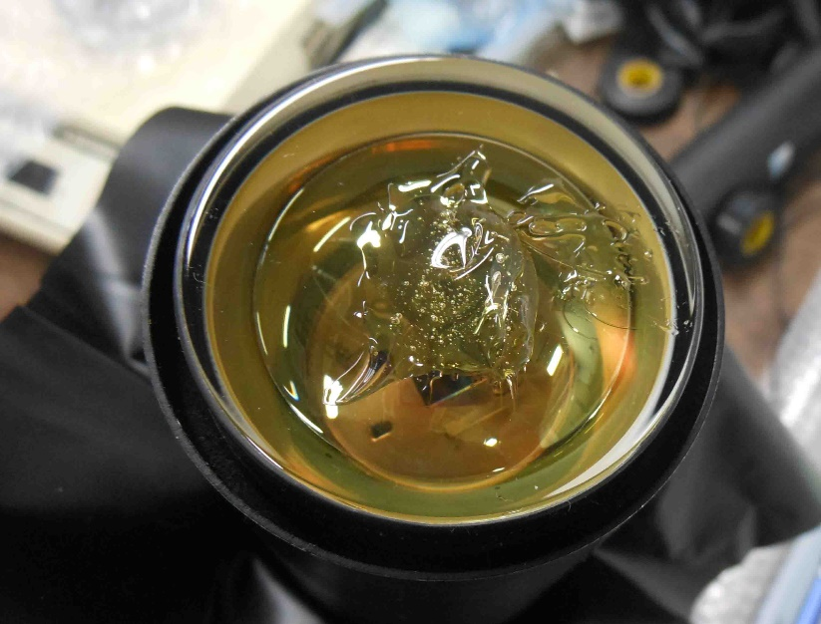
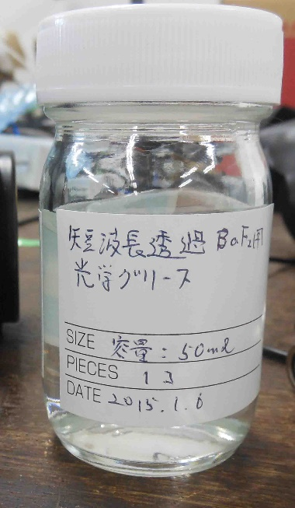
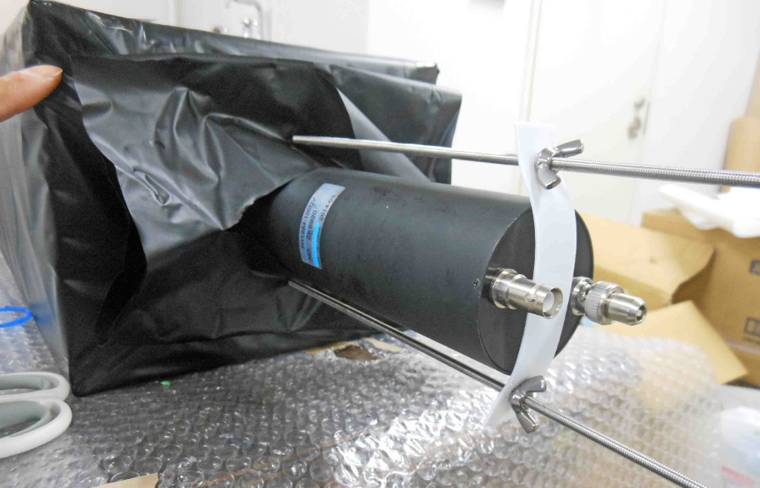
PTM attachment with optical grease

Slide 5
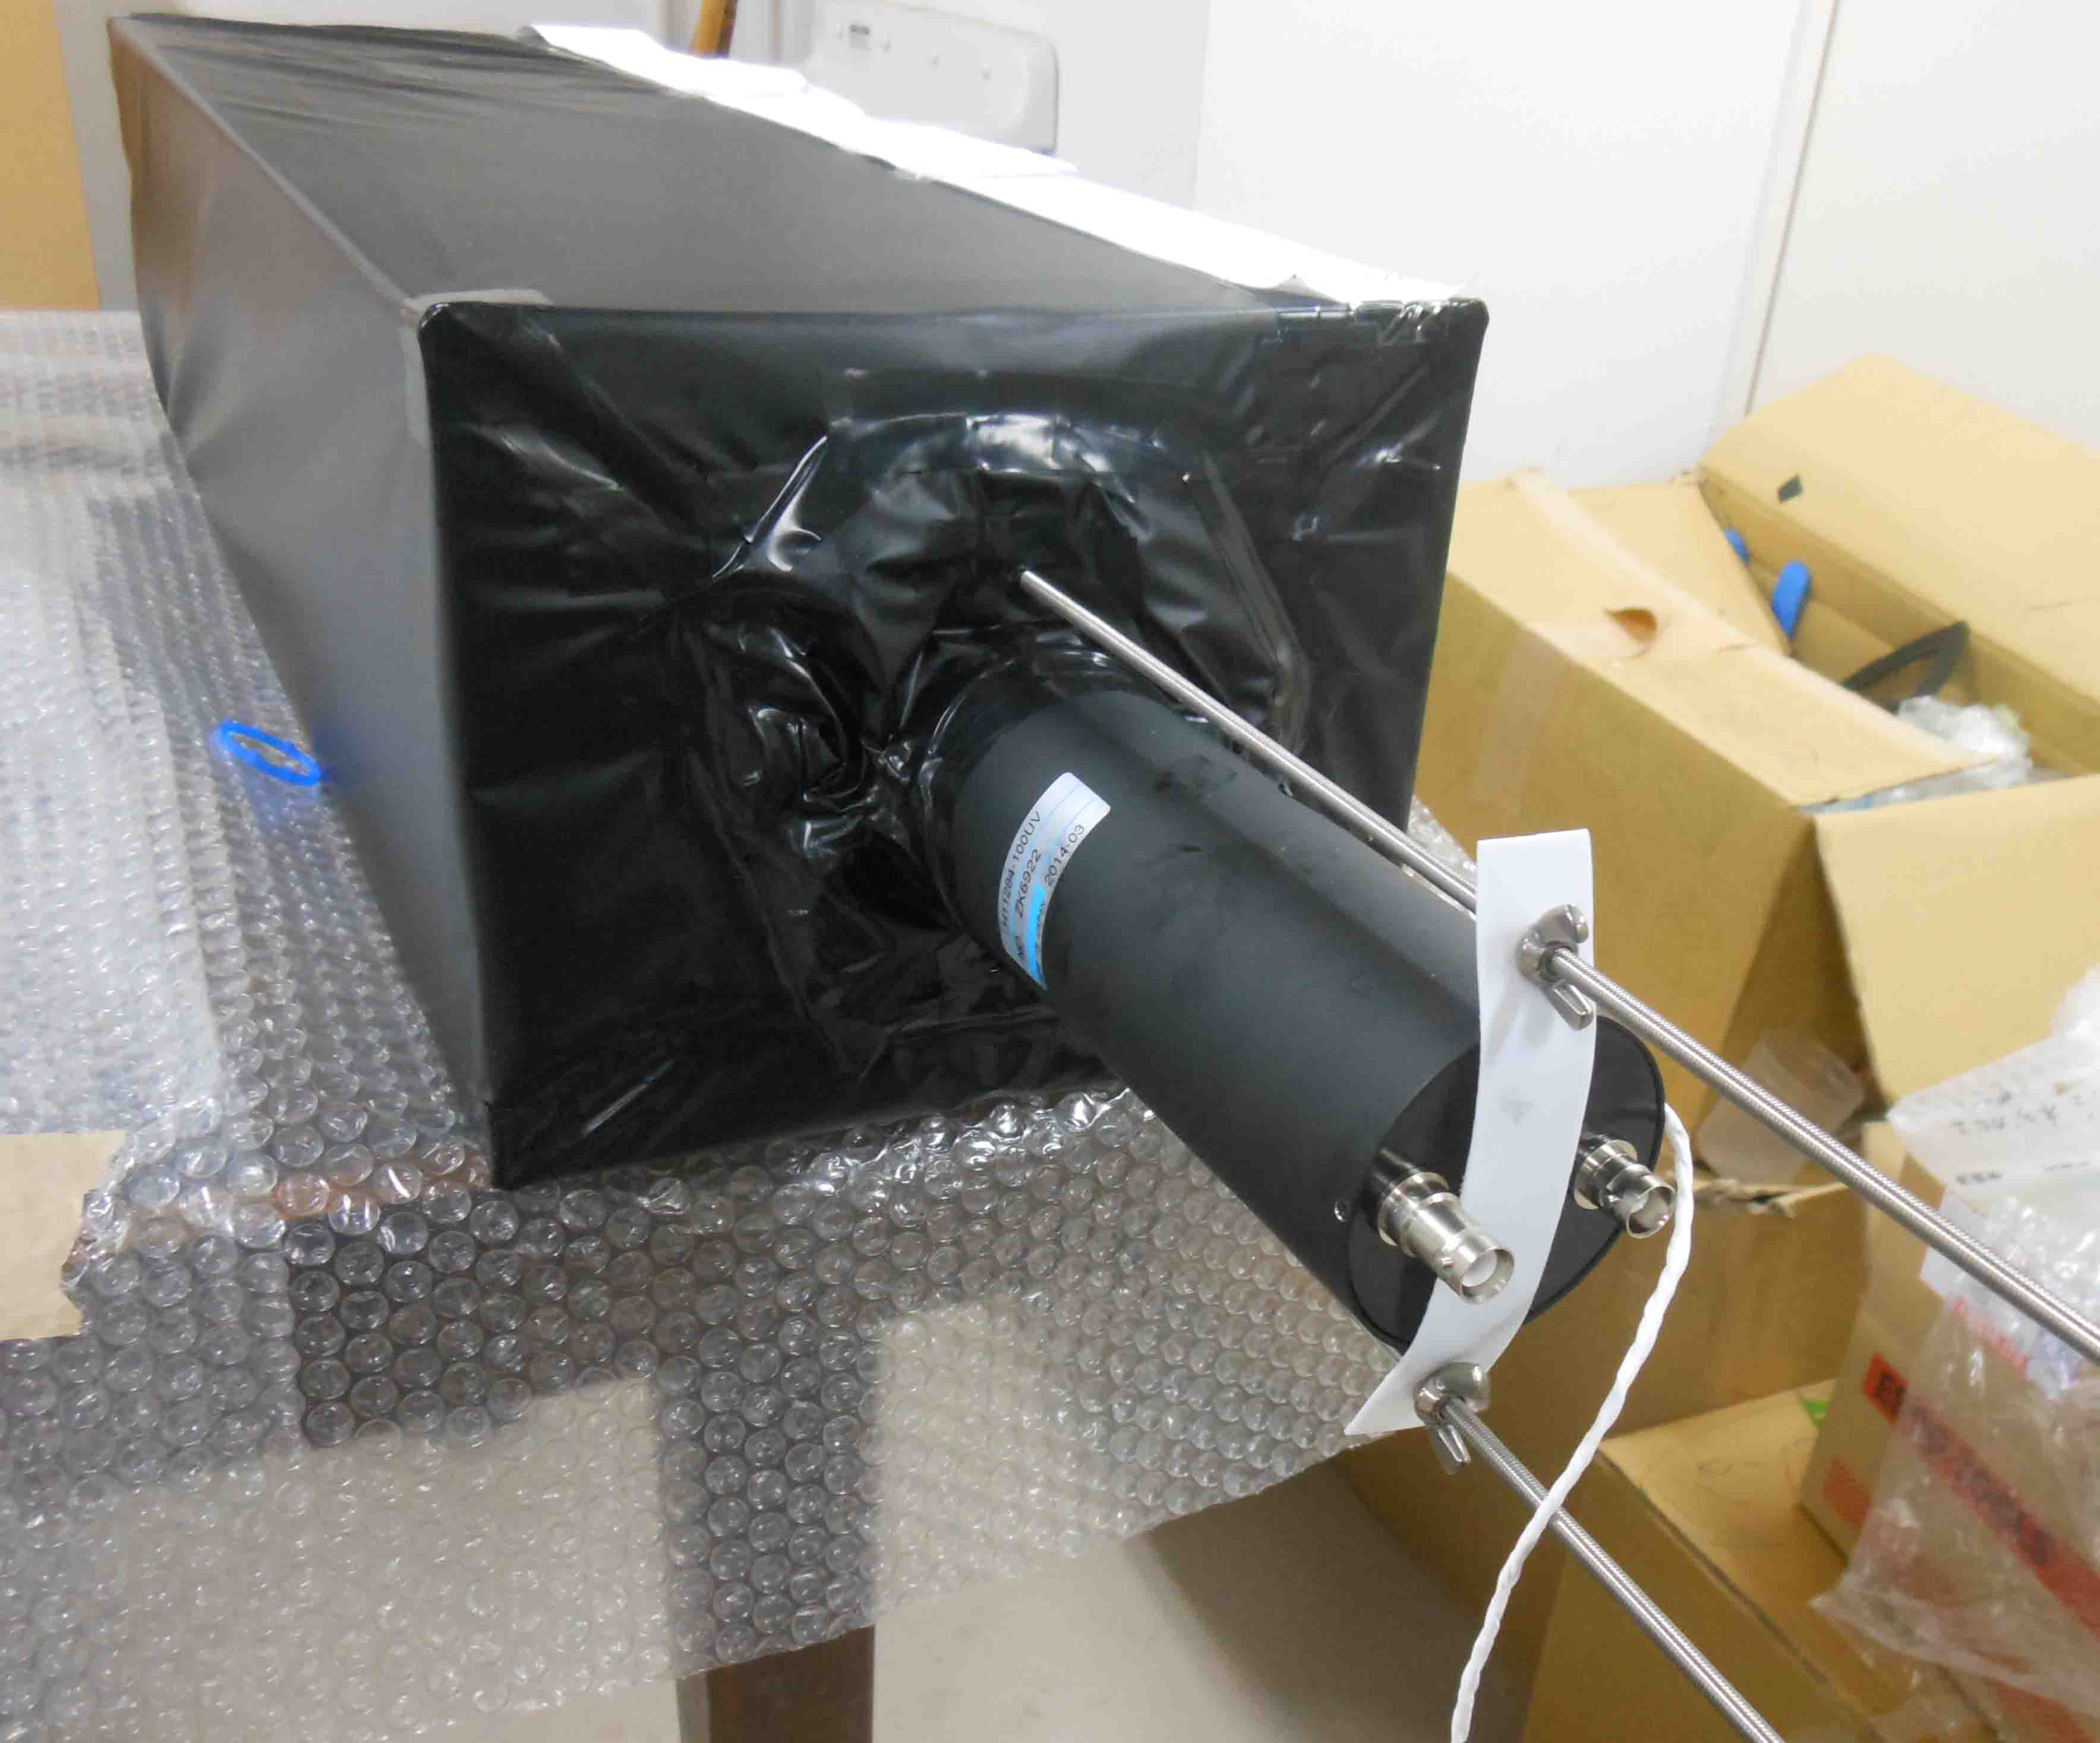
LED attachment on PMT

Slide 6
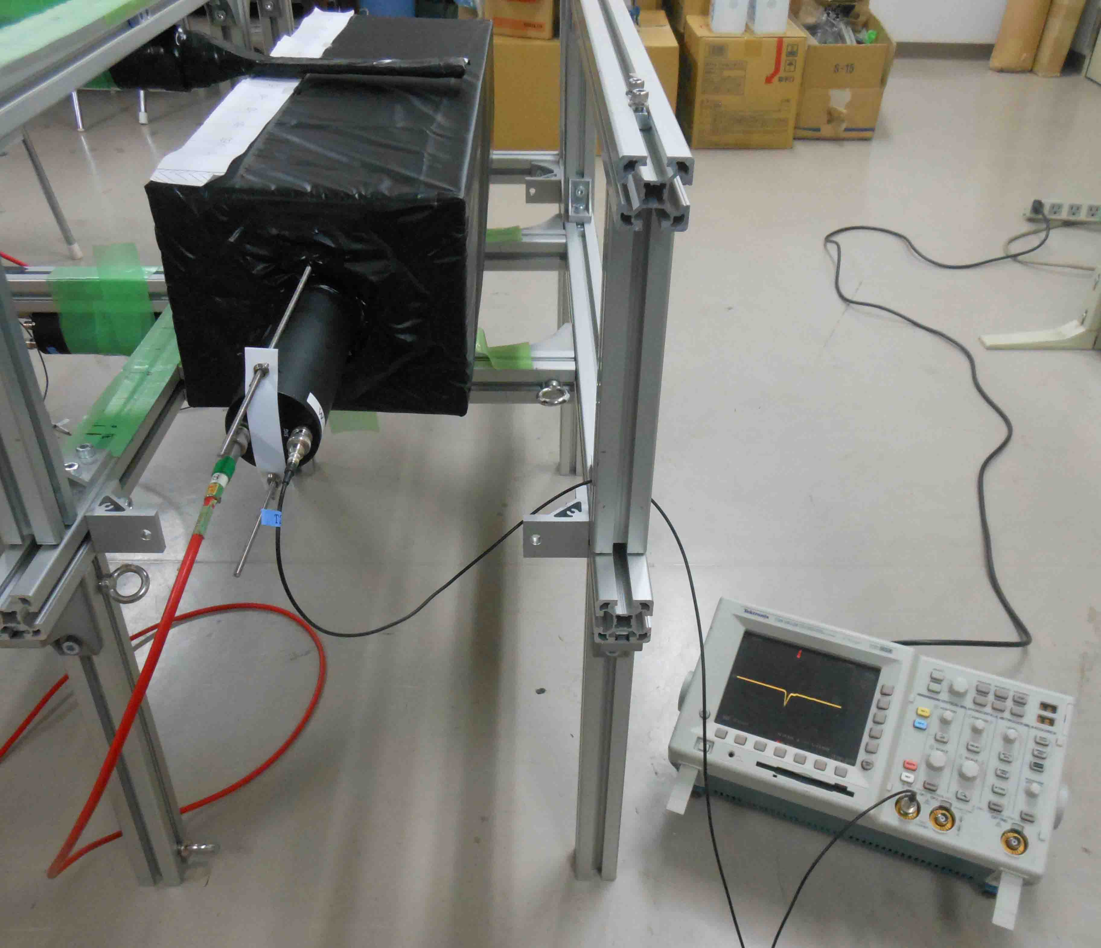
Light shield check

Slide 7
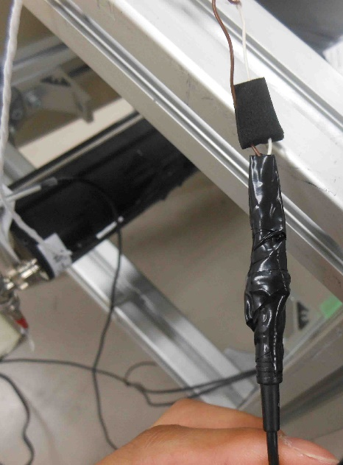
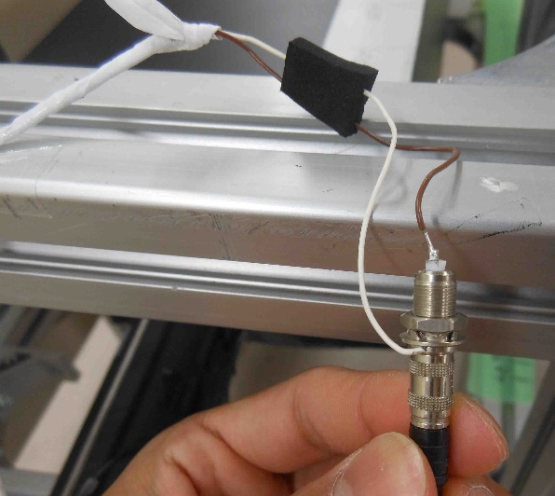
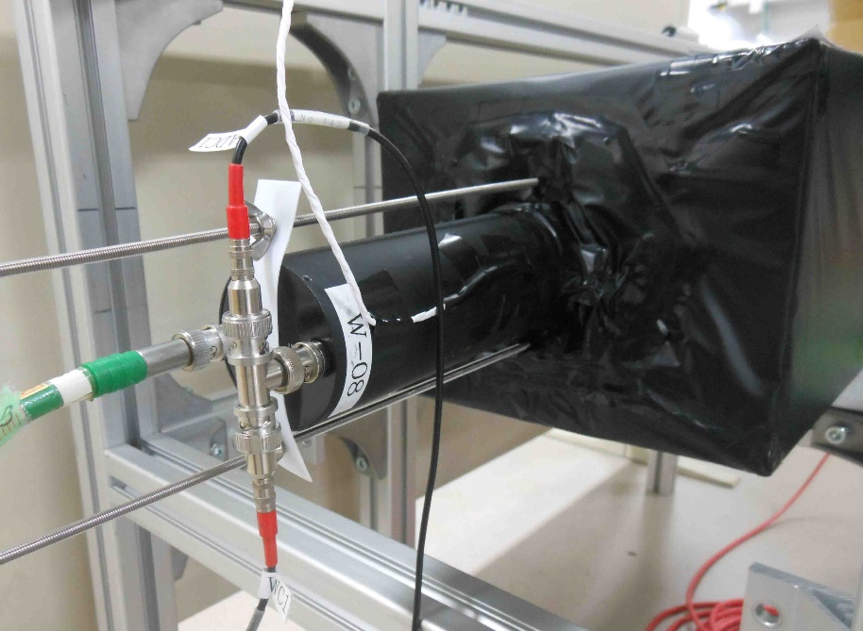
LED wiring
LED
Signal
HV

Slide 8
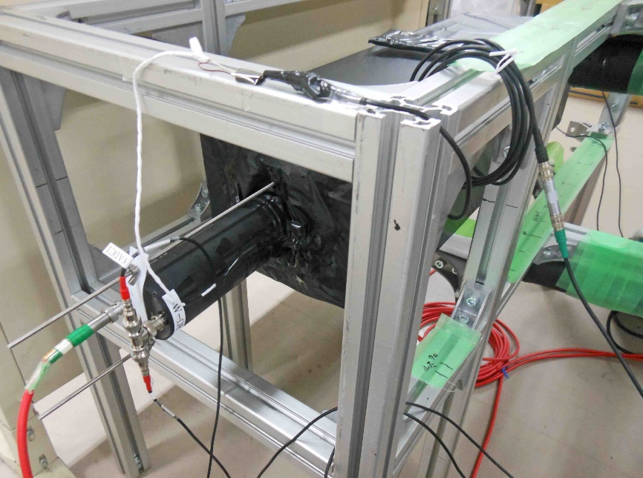
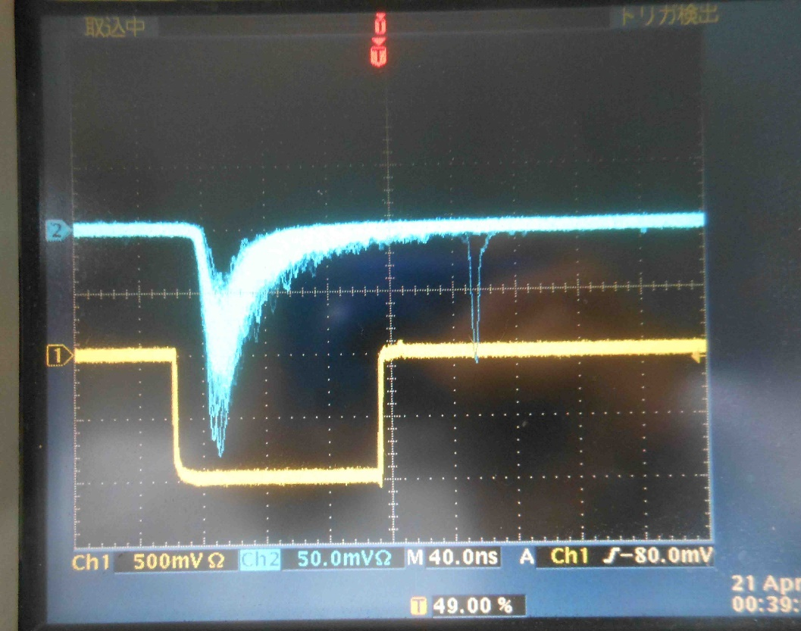
PMT signal check detecting LED light
LED OFF
LED ON

Slide 9
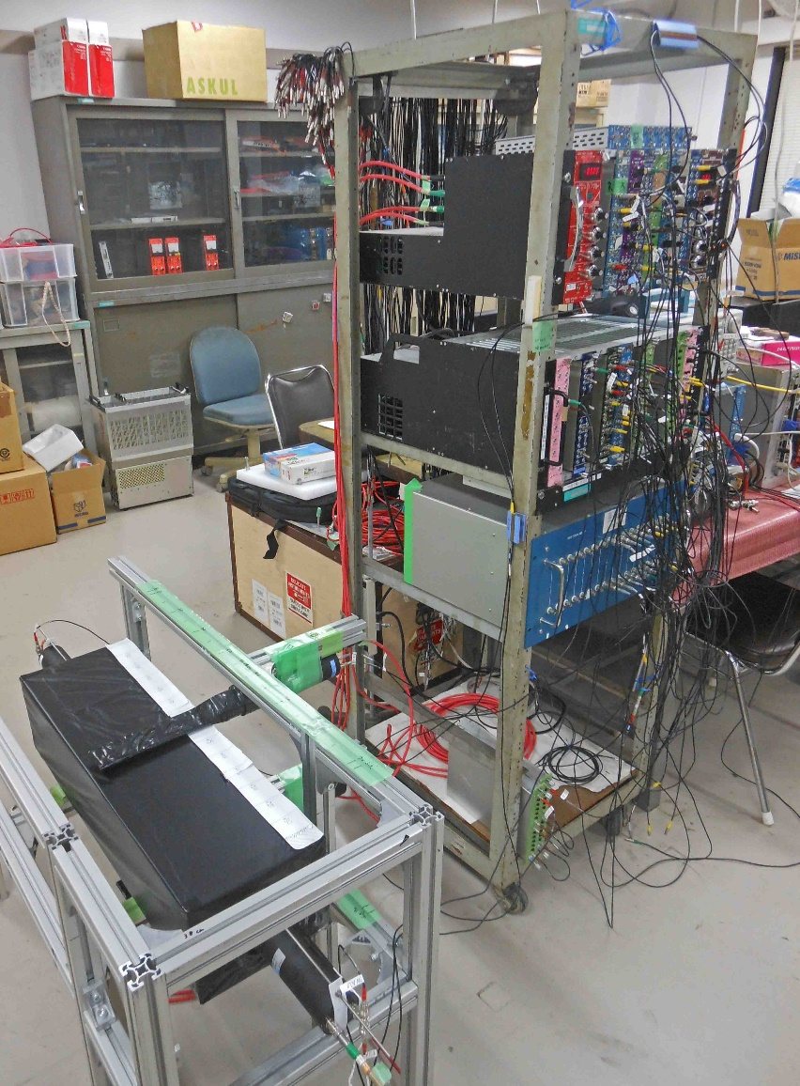
Prepare the circuit
→ http://www-nh.scphys.kyoto-u.ac.jp/~gogami/s-2s/meeting/2015/gogami_S-2Smeeting(2015_4_24).pdf

Slide 10
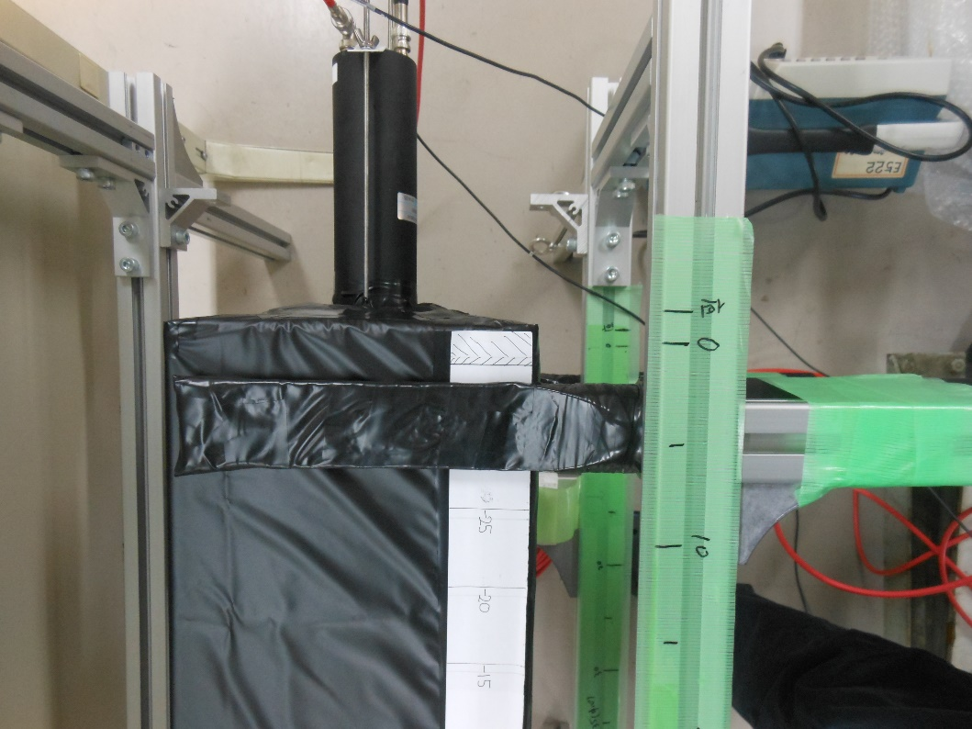
Started taking data on 2015/4/21

Slide 11
Data phase
Phase 1 (4/21 – 4/25); 作り立て
Phase 2 (5/11 – ); 作ってしばらく後

Slide 12
Run summary and ELOG
Run summary:
http://www-nh.scphys.kyoto-u.ac.jp/~gogami/s-2s/doc/wctest2015/RunSummary_wctest2015.pdf
ELOG:
http://172.16.1.169:8080/wc-test-2015/

Slide 13
One of the results for phase 1
蓋側
(前回のミテーィングで話した不感領域がある方)
At y = 0 cm,
(PMT1, PMT2, Sum ) = (77.8±0.3, 99.0±0.4, 176.5±0.7)
Notes:
Colored regions are the systematic errors which come from a LED calibration.

Slide 14
One of the results for phase 1
Analysis detail for phase 1
and results for phase 2 are coming soon !!!!!
At y = 0 cm,
(PMT1, PMT2, Sum ) = (77.8±0.3, 99.0±0.4, 176.5±0.7)

