Slide 1
S-2S MEMO
Toshiyuki Gogami
17 May 2015

Slide 2
Contents
Analysis results of WC test

Slide 3
Experimental setup
SIDE VIEW
Cosmic ray
Plastic scintillator (TOF1)
Gravity
z
PMT(H11284-100UV)
x
y
WC2
WC1
Plastic scintillator (TOF2)
Outer size: ${730}^{h}×{230}^{w}×{180}^{t}$

Slide 4
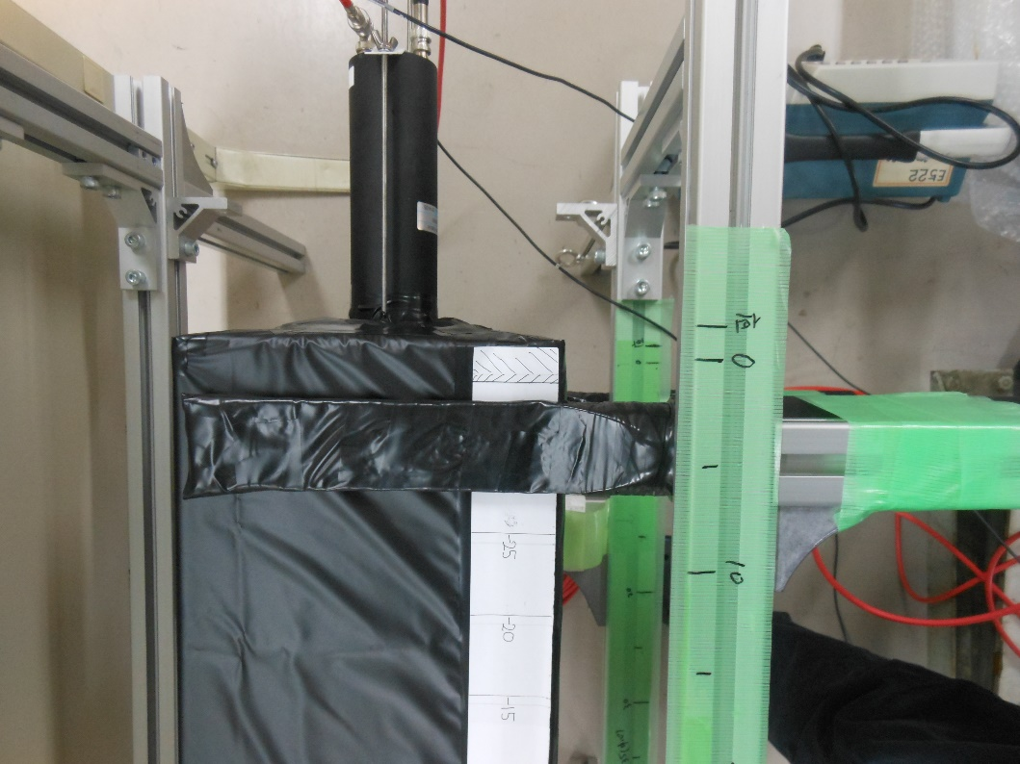
Pictures of WC at room.319 in Kyoto Univ.

Slide 5
Run summary
http://www-nh.scphys.kyoto-u.ac.jp/~gogami/s-2s/doc/wctest2015/RunSummary_wctest2015.pdf

Slide 6
Analysis

Slide 7
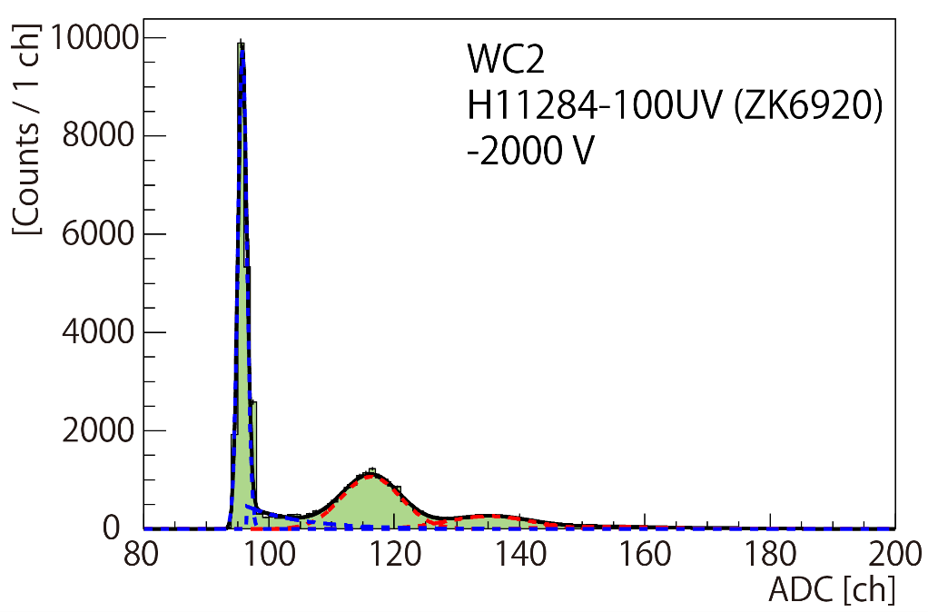
NPE calibration using LED
Obtain ADC channels per NPE
But !!!
Fluctuate from time to time due to:
Fitting results
Performance fluctuations of electric circuit and PMT etc.

Slide 8
Ensemble of calibration data
Filled fitting results of each calibration run.
Run ID:
3, 5, 7, 9, 11, 13, 15, 17, 18 , 20 and 21

Slide 9
Ensemble of calibration data
Used for a conversion
from ADC ch to NPE
Systematic error:
0.25 / 6.84 for WC1
0.22 / 18.95 for WC2
Run ID:
3, 5, 7, 9, 11, 13, 15, 17, 18 , 20 and 21

Slide 10
NPE derivation from NPE histograms
Used function: Single Gaussian function
Scan a fitting range to minimize the fitting chi-square
Obtain the mean value → Used as a result

Slide 11
A typical NPE histogram with a fitting result
Run37 for y=0 cm

Slide 12
Data phase
Phase 1 (4/21 – 4/25)
Phase 2 (5/11 – )

Slide 13
NPE comparison between Phase1 and Phase2 at y=0

Slide 14
NPE comparison between Phase1 and Phase2 at y=0
PHASE 1
PHASE 2
Reducing ? → will keep taking data more.

Slide 15
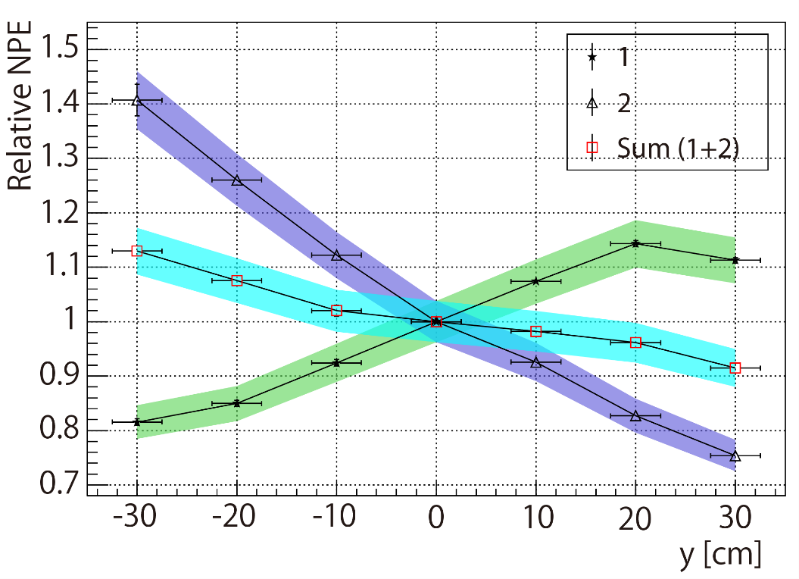
y-dependence for Phase 1 and 2
Phase 1
Tendency is
Phase 2
consistent with the errors.

Slide 16
y-dependence for Phase 1 and 2
Phase 1
Tendency is
Phase 2
consistent with the errors.
At y = 0 cm,
(PMT1, PMT2, Sum )
= (77.8±0.3, 99.0±0.4, 176.5±0.7)
At y = 0 cm,
(PMT1, PMT2, Sum )
= (68.0±0.5, 86.3±0.6, 154.0±0.7)
REDUCED !!

Slide 17
Summary
NPE is reducing…
The reduction may be caused by water deterioration due to caulking material (Bathcaulk-N).
Further studies will be done !!

